Slide 1
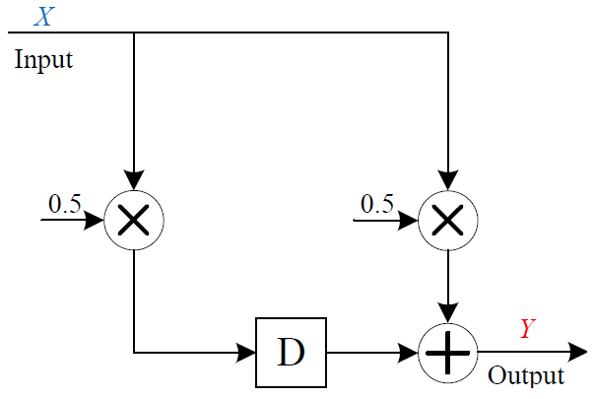
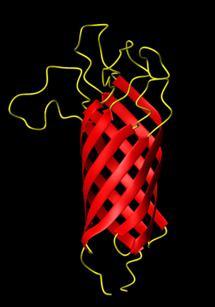
Synchronous Sequential Computation with Molecular Reactions
Hua Jiang, Marc Riedel, and Keshab Parhi
Electrical and Computer Engineering
University of Minnesota
Notes:
1

Slide 2
Overview
  Synchronous sequential computation with molecular reactions:
    Synchronous
    Exact and rate-independent designs
  Technology-independent design (abstract chemical reactions)
  Technology-mapping (DNA strand displacement)
  Examples: Counter and FFT
Notes:
Animate

Slide 3
Molecular Computation
Input
Output
10, 2, 12, 8, 4, 8, 10, 2, …
5, 6, 7, 10, 6, 6, 9, 6, …
Molecular
Reactions
…
…
Time-varying changes in concentrations of an input molecular type.
Time-varying changes in concentrations of output molecular type.

Slide 4
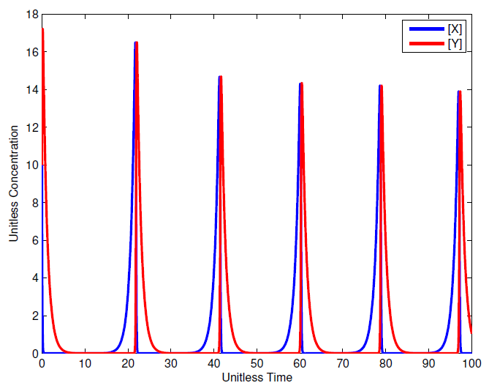
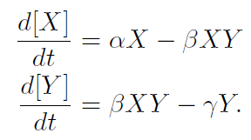
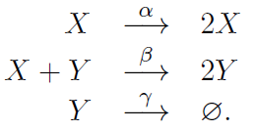
From Chemical Reactions to Differential Equations
Notes:
Spend less time; get the LF slide

Slide 5
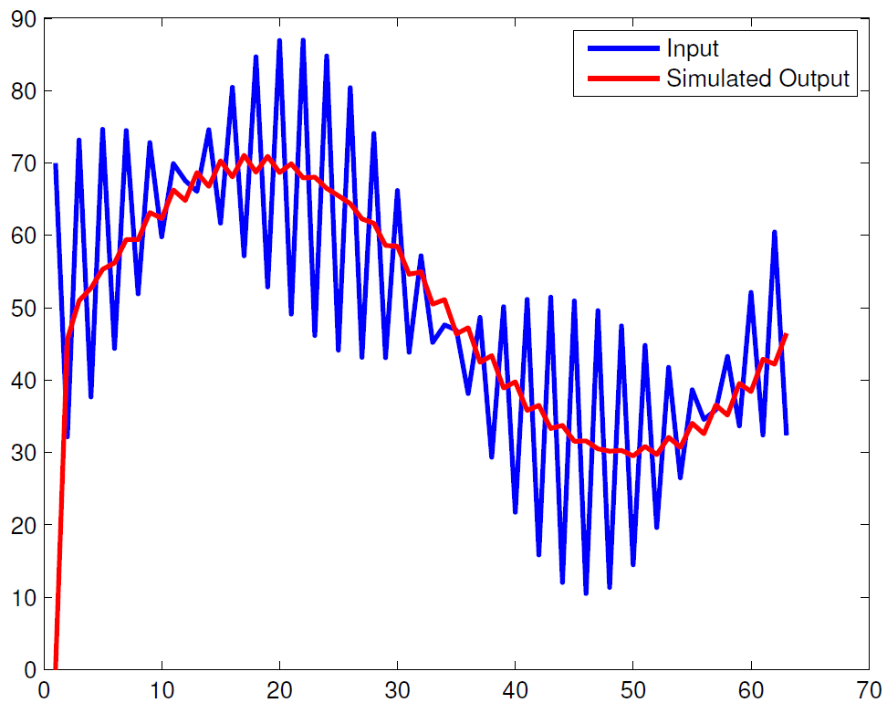
From Input/Output Specification to Chemical Reactions?
input
output
Chemical Reactions?
Rates?
Low Pass Filtering?
Notes:
Color-code this slide

Slide 6
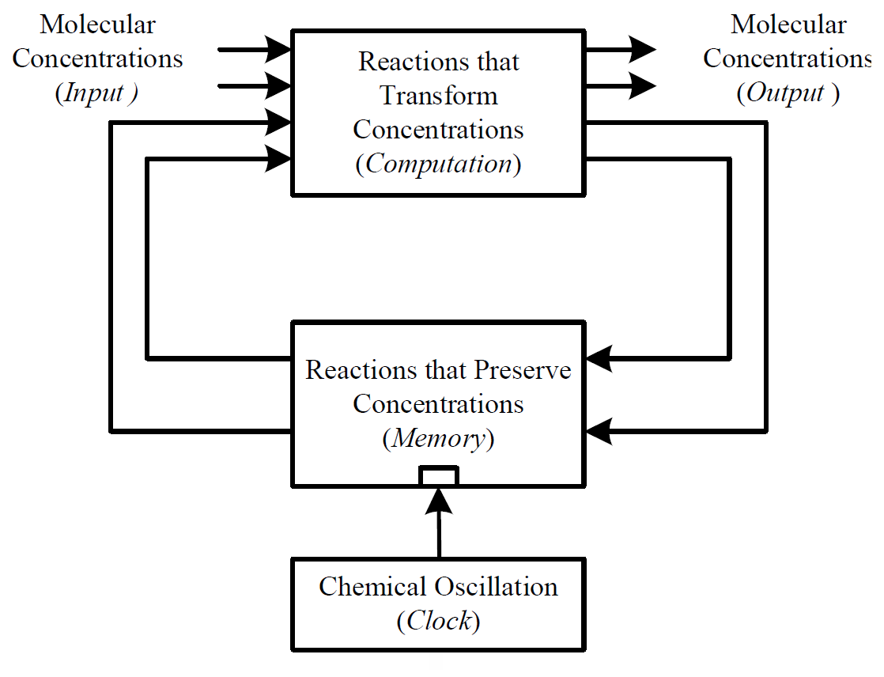
Synchronous Sequential Computation
Notes:
animation; references

Slide 7
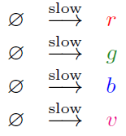
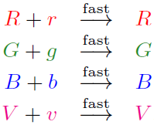
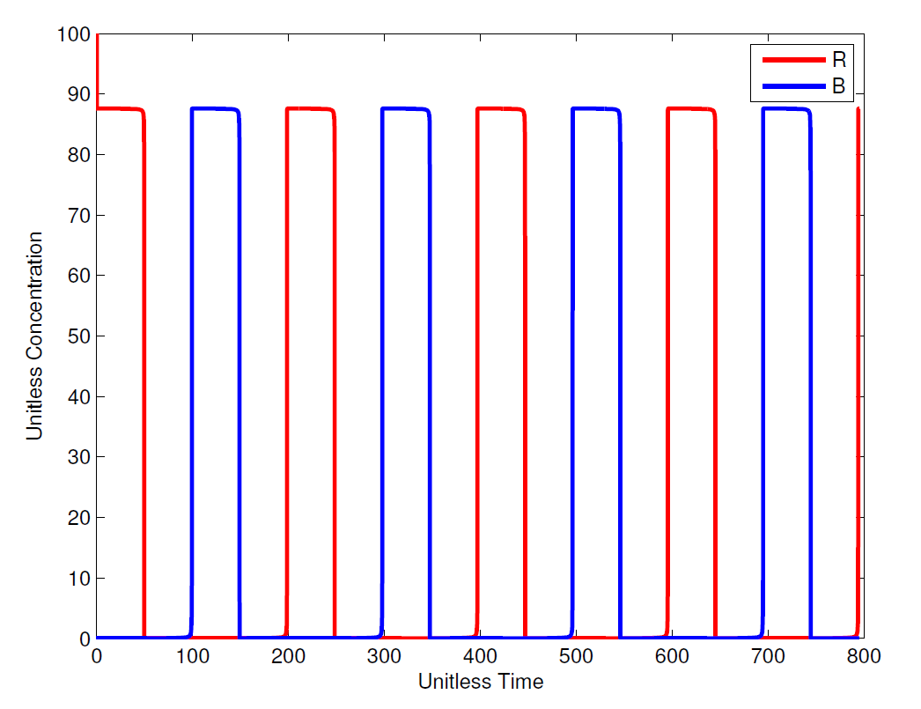
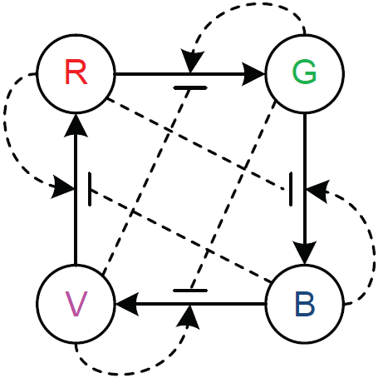
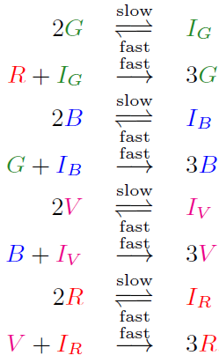
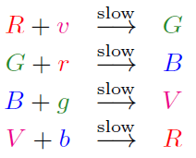
Implementing Clock

Slide 8

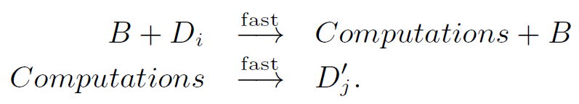

Implementing Memory
D₁’
D₁
D₂’
D₂
Blue phase:
Red phase:

Slide 9
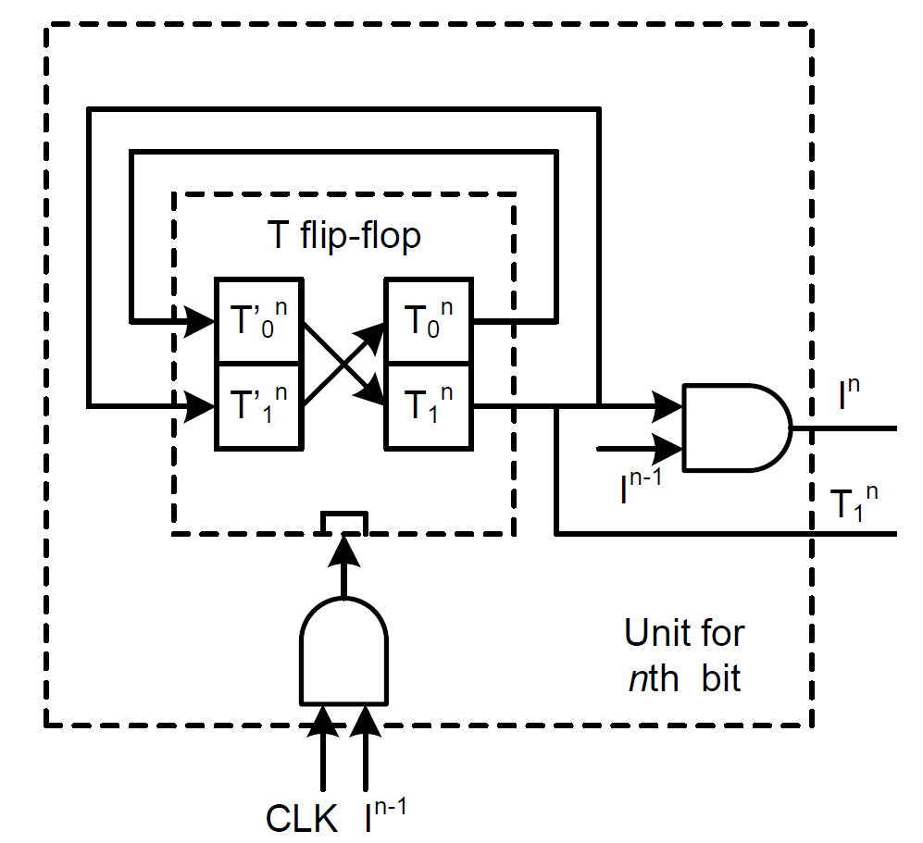
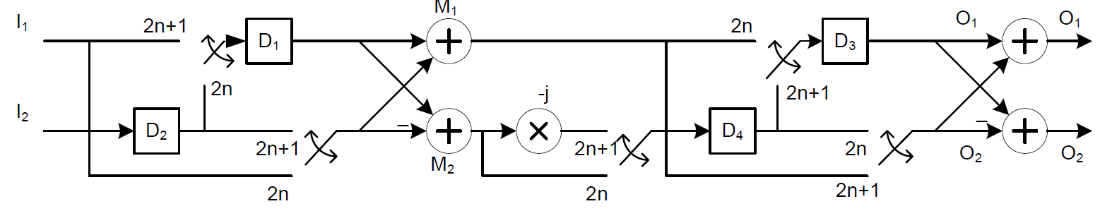
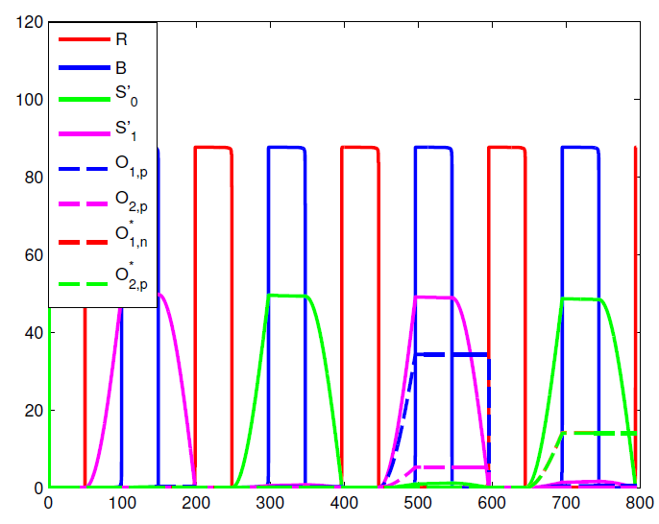
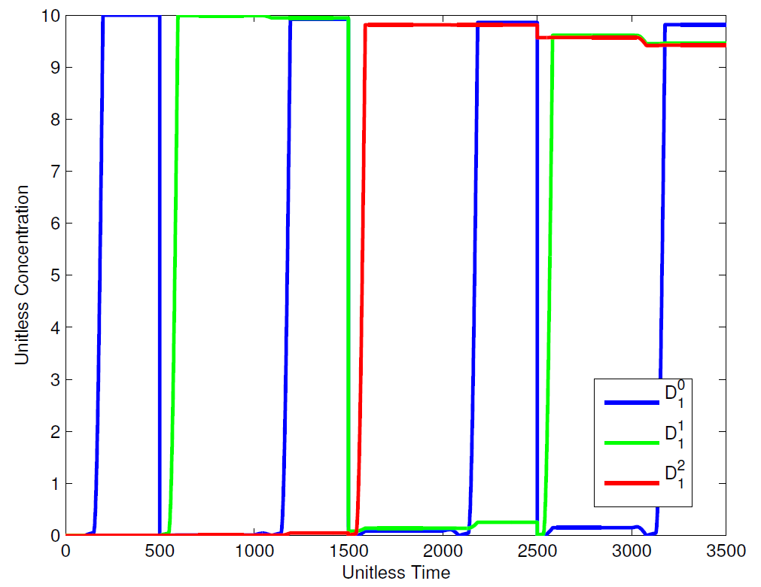
Examples
Counter
4-point FFT

Slide 10
Discussion
Computational Chemical Design
vis-a-vis
Technology-Independent Logic Synthesis
Synthesize a design for a precise, robust, programmable computation – with abstract types and reactions.
Experimental Design
vis-a-vis
Technology Mapping in Circuit Design
Implement design by selecting specific types and reactions – say from “toolkit”.

Slide 11


Thanks (Advisors, Fellow Students, Funders, Audience…)
Biomedical Informatics & Computational Biology
UMN / Mayo Clinic / IBM
NSF EAGER Grant #0946601

