Slide 1
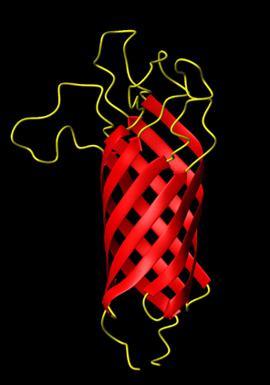
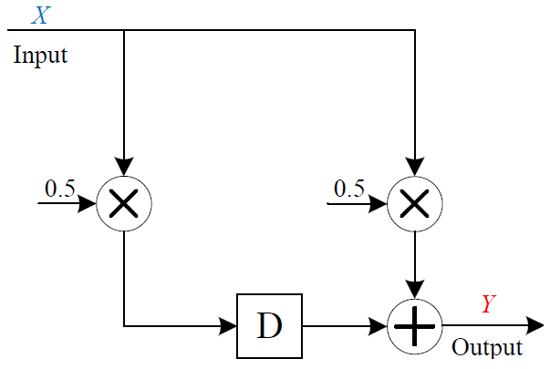
Digital Logic and Signal Processing Computations with Molecular Reactions
Hua Jiang
PhD Candidate, Electrical Engineering
University of Minnesota
Advisors
Professor Keshab Parhi and Professor Marc Riedel
Notes:
1

Slide 2
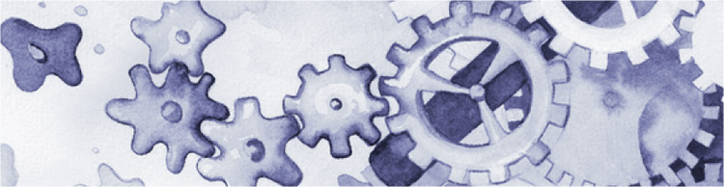
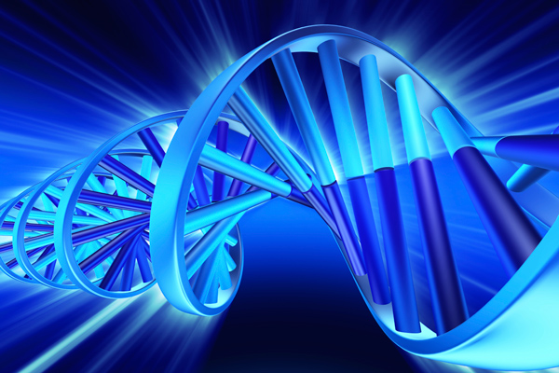
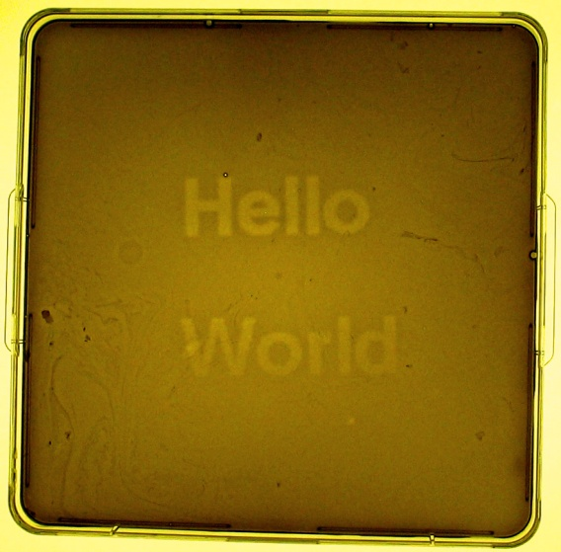
Synthetic Biology
“design and construction of new biological functions and systems not found in nature”

Slide 3
Sequential Computation
A sequential system takes an input sequence and produces an output sequence.
A digital signal is a sequence of numbers.
1010
0010
1100
0101
0110
0111
Electronics
Molecular
Reactions
input
Computation
output
10, 2, 12, 8, 4, 8, 10, 2, …
Chemically, molecular quantities, or concentrations, represent the digital signal.
Electronically, numbers are represented by binary strings (zeros and ones are voltages).
5, 6, 7, 10, 6, 6, 9, 6, …
Notes:
Emphasize on “Concentration”

Slide 4
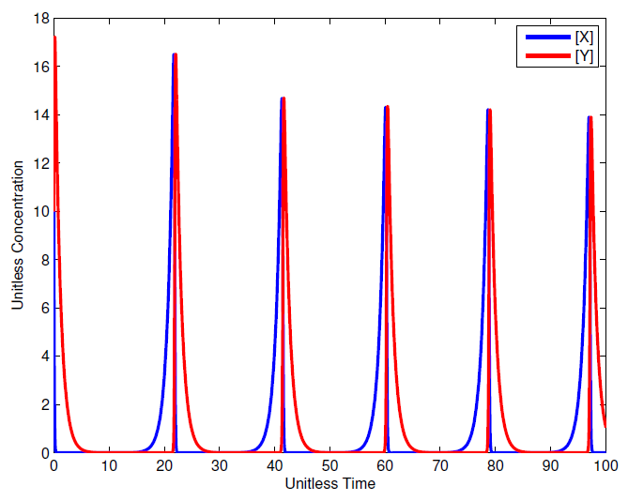
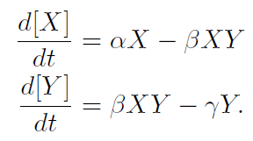
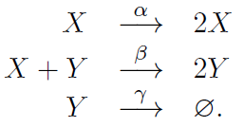
Analysis: From Chemical Reactions to Differential Equations
Notes:
Spend less time; get the LF slide

Slide 5
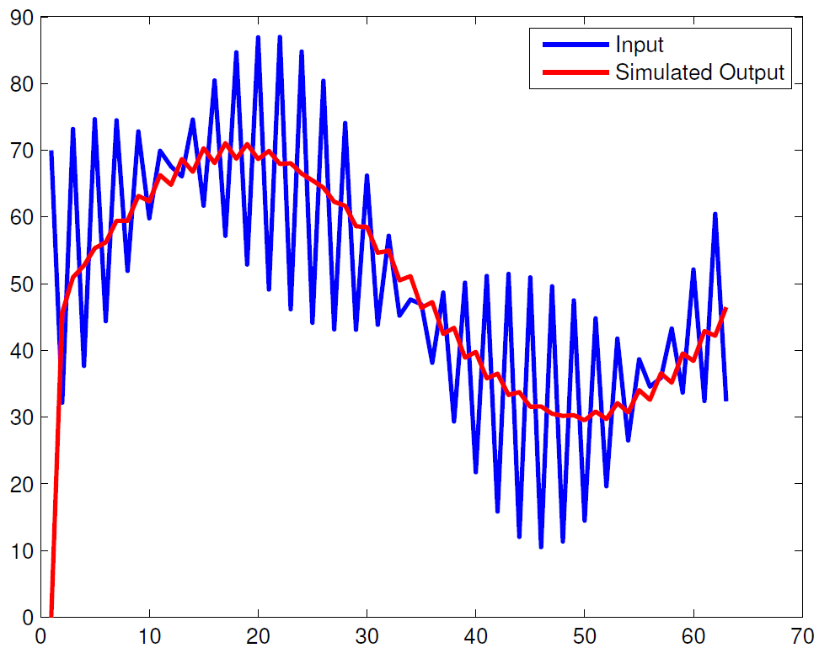
Synthesis: From Input/Output Specification to Chemical Reactions?
input
output
Chemical Reactions?
Rates?
Low Pass Filtering?
Notes:
Color-code this slide

Slide 6
Motivation
Performing sequential computations
  Digital signal processing
  Sequential digital logic
Robustness
  Rate-independent
Physically implementable
  DNA strand displacement

Slide 7
Overview
Self-timed implementation of digital signal processing systems
Synchronous implementation of digital signal processing systems
Implementing sequential digital logic based on a bi-stable bit representation
Discussion and future work

Slide 8
Overview
Self-timed implementation of digital signal processing systems
Synchronous implementation of digital signal processing systems
Implementing sequential digital logic based on a bi-stable bit representation
Discussion and future work

Slide 9
DSP with Reactions
Input
Output
10, 2, 12, 8, 4, 8, 10, 2, …
5, 6, 7, 10, 6, 6, 9, 6, …
Reactions
…
…
Time-varying changes in concentrations of an input molecular type.
Time-varying changes in concentrations of output molecular type.

Slide 10
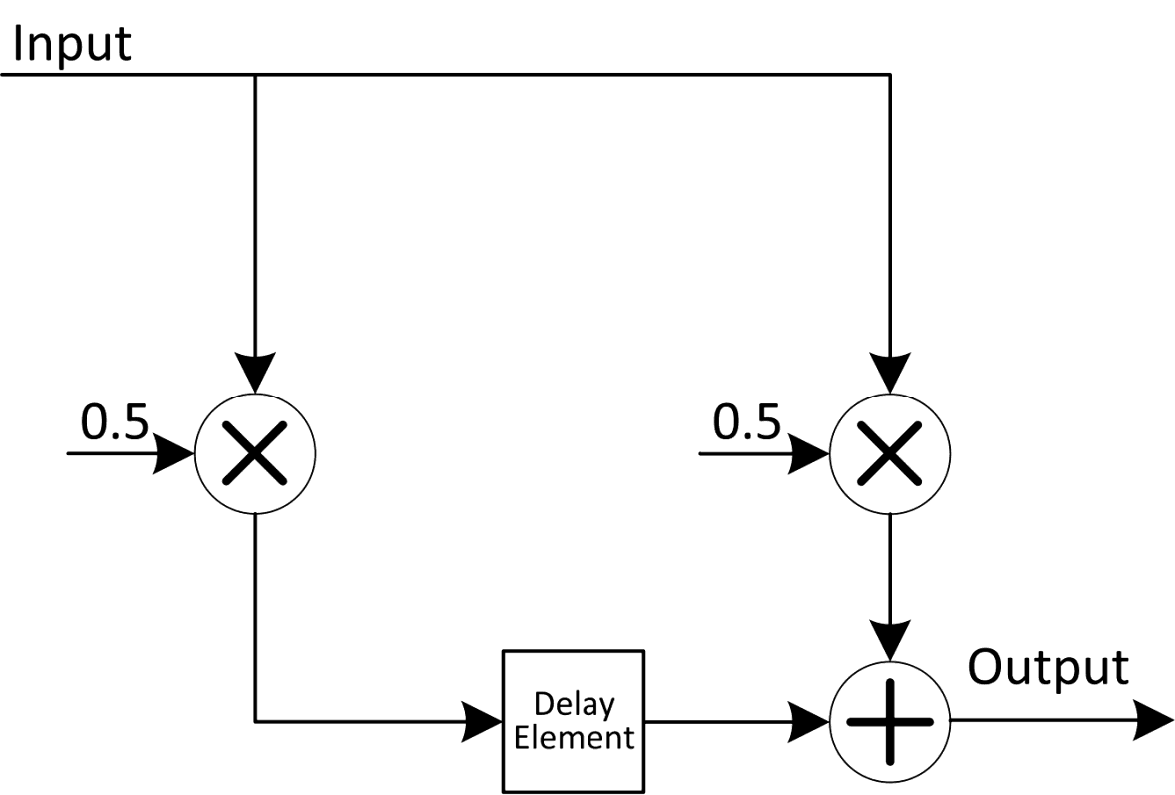

Moving Average Filter: Molecular
Molecular
Reactions
time
time
But how do we achieve the synchronization?
Notes:
Say synchronization. Put y[n]=.5x[n-1]+.5[n]

Slide 11
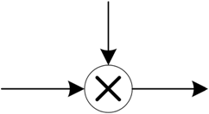
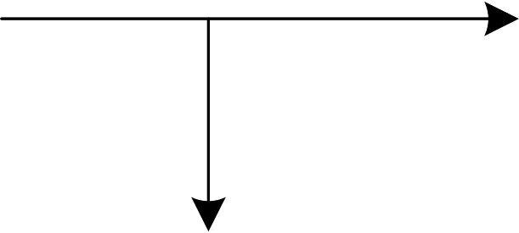
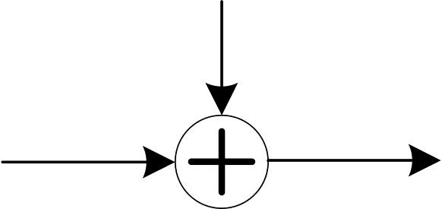
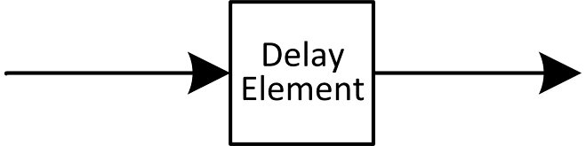
DSP Building Blocks
Most DSP systems can be specified in terms of 4 major components: constant multipliers, fanouts, adders and delay elements.
Constant Multiplier
Fanout
Adder
Delay Element

Slide 12


Computational Modules
Constant Multiplier
X
Y

Slide 13

Computational Modules
Adder
Notes:
No SPECIFIC ANYTHING

Slide 14


Computational Modules
X
Fanout
B
A

Slide 15

Delay Element
Molecular quantities are preserved over “computational cycles.” Contents of different delay elements are transferred synchronously.

Slide 16
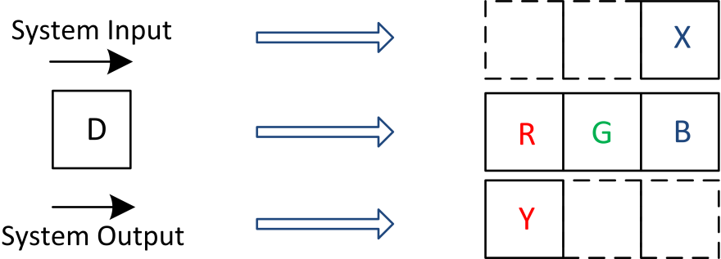

3-Phase Scheme
We use a three compartment configuration for delay elements: we categorize the types into three groups: red, green and blue.
Every delay element D_{i} is assigned R_{i}, G_{i}, and B_{i}
Notes:
Why fire to completion/subscripts

Slide 17
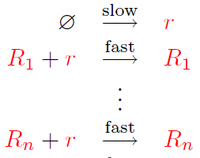

Absence Indicators
But how do we know that a
group of molecules is absent?
R
r
Notes:
Say sth about \phi / animation speed

Slide 18
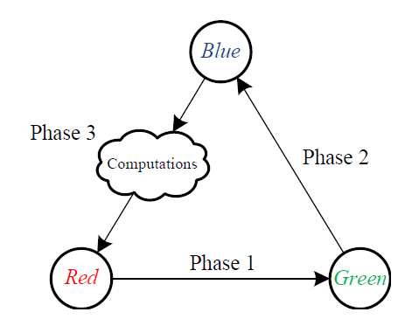
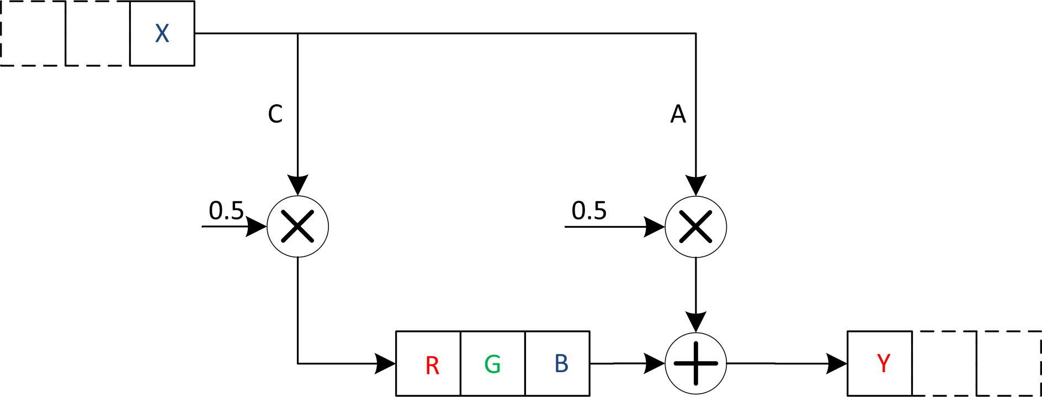
Moving Average Filter
absence
indicators

Slide 19
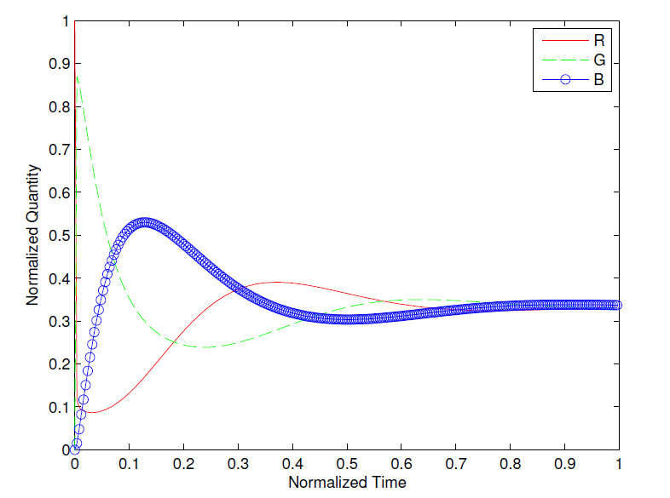
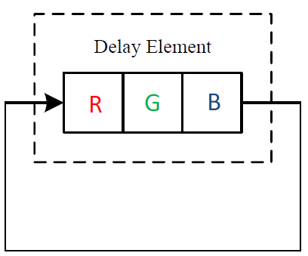
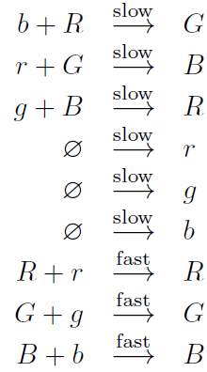
RGB Scheme
R, G, and B converge!

Slide 20
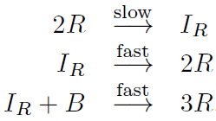
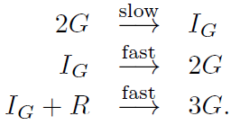
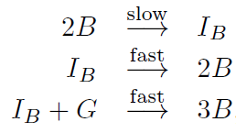
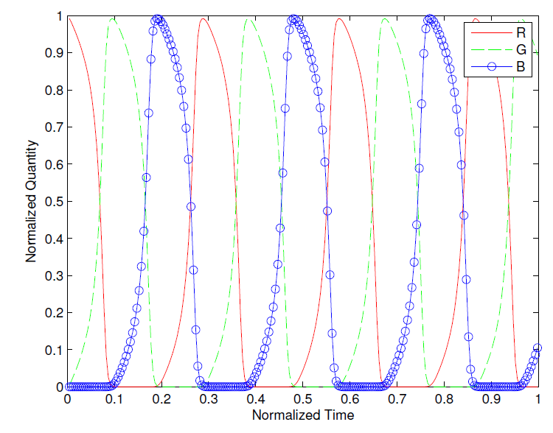
RGB Scheme
Oscillating!

Slide 21
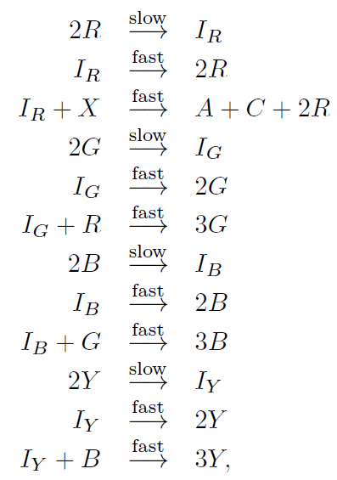
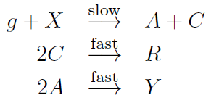
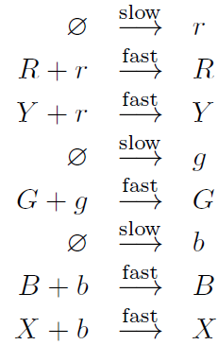
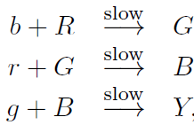
Moving Average Filter
Signal transfer
Computation
Absence indicator

Slide 22
Simulation
Molecular
Reactions
DSD
Reactions
DSD
Mapper
Transient
Response
System
ODE
ODE
Solver

Slide 23
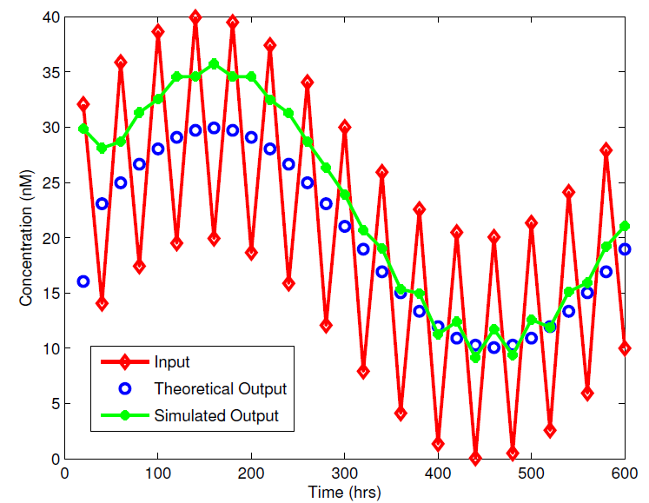
Simulation Results: Moving Average

Slide 24
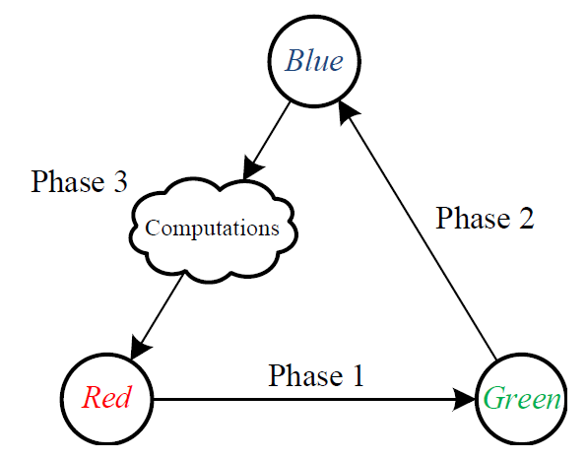
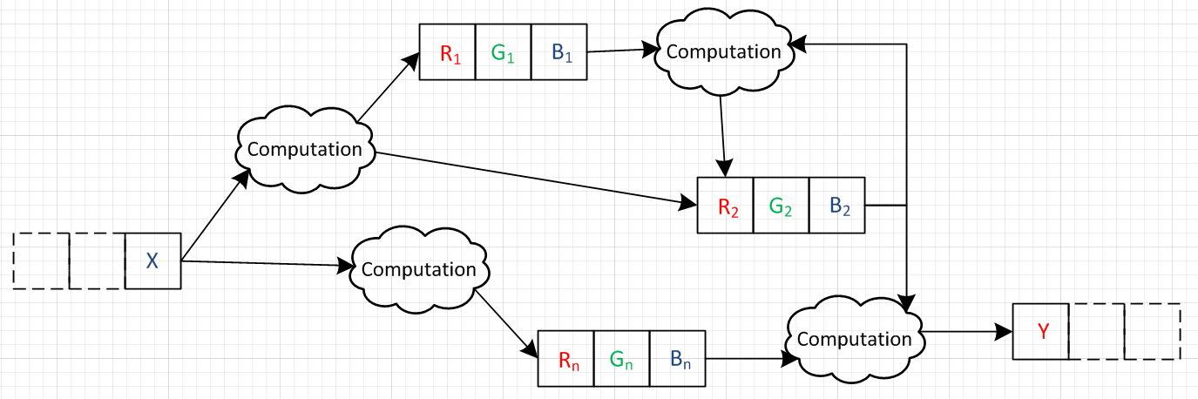
General DSP System

Slide 25
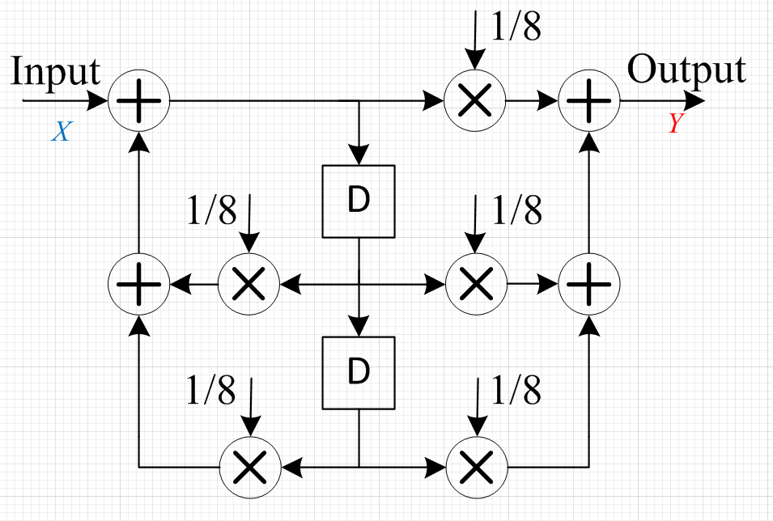
Biquad Filter

Slide 26
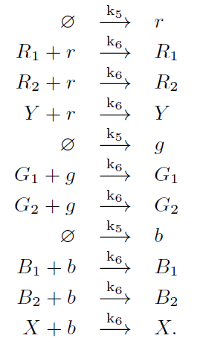
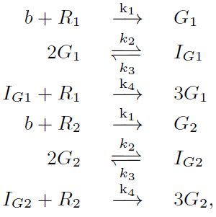
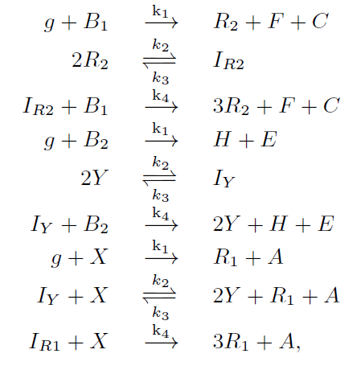
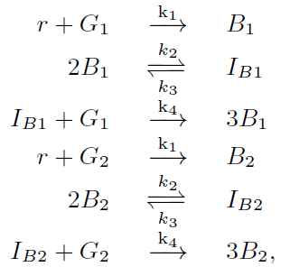
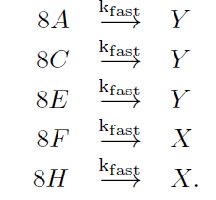
Biquad Filter
Absence indicator
Signal transfer
Computation

Slide 27
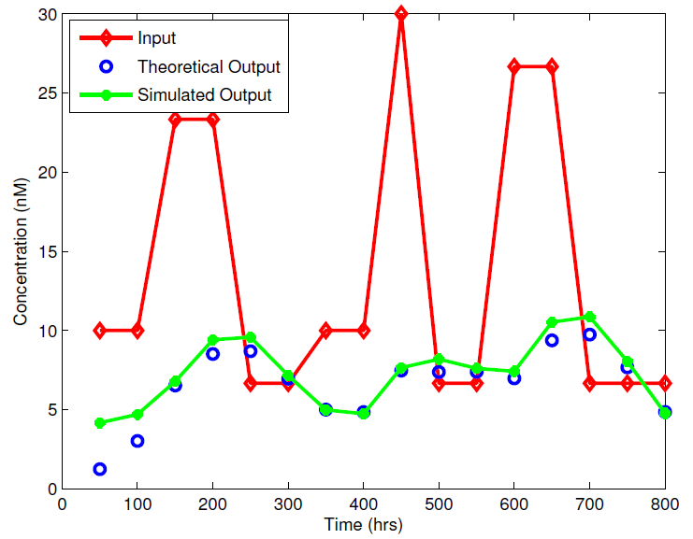
Simulation Results: Biquad

Slide 28
Overview
Self-timed implementation of digital signal processing systems
Synchronous implementation of digital signal processing systems
Implementing sequential digital logic based on a bi-stable bit representation
Discussion and future work

Slide 29
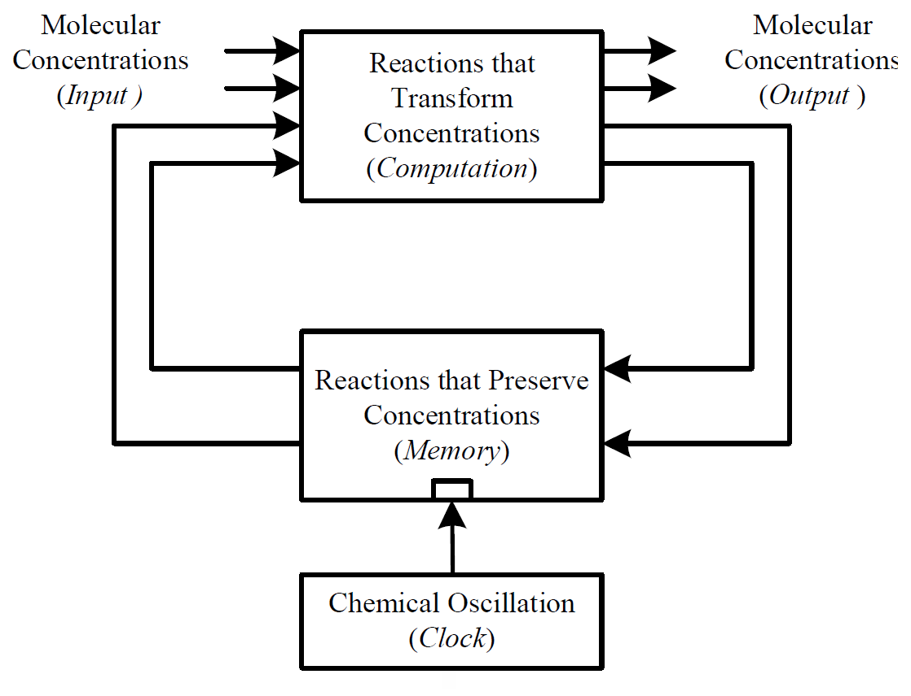
Synchronous Sequential Computation
Notes:
animation; references

Slide 30
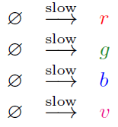
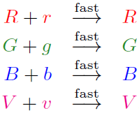
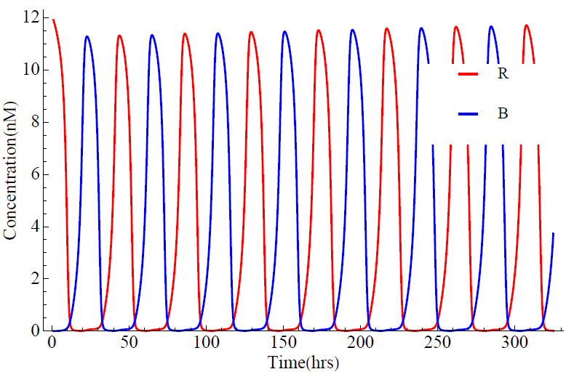
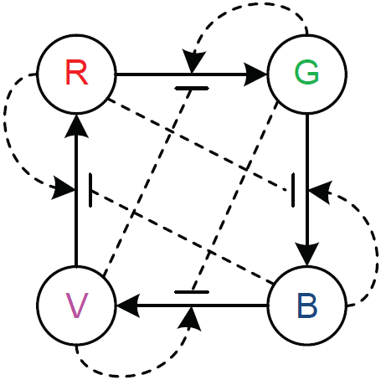
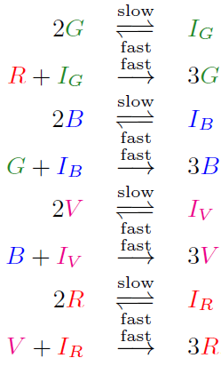
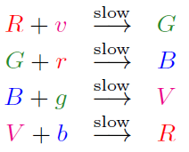
Implementing Clock

Slide 31
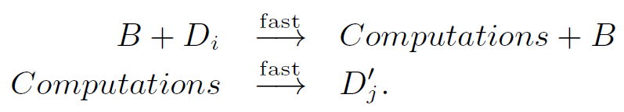

Implementing Memory
D₁’
D₁
D₂’
D₂
Blue phase:
Red phase:

Slide 32
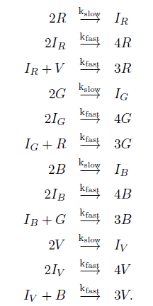
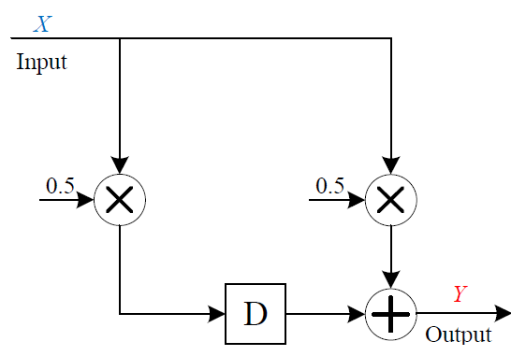
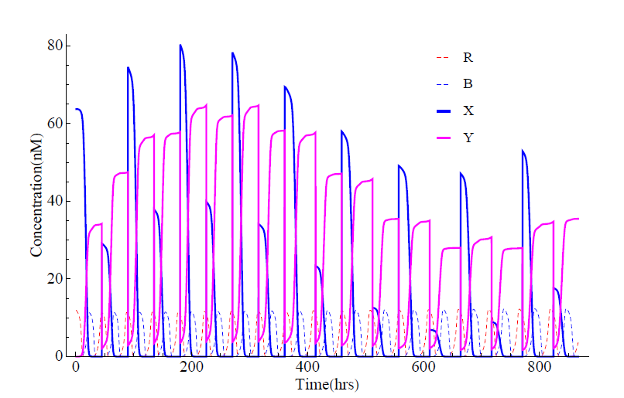

Examples
FIR filter

Slide 33


Examples
IIR filter

Slide 34


Examples
4-point FFT

Slide 35


Examples

Slide 36


Examples
4-point FFT

Slide 37
Overview
Self-timed implementation of digital signal processing systems
Synchronous implementation of digital signal processing systems
Implementing sequential digital logic based on a bi-stable bit representation
Discussion and future work

Slide 38


Bit Representation

Slide 39


AND Gate
Outputting 0
Outputting 1

Slide 40


OR Gate
Outputting1
Outputting 0

Slide 41


XOR Gate
Outputting 1
Outputting 0

Slide 42

Logic Gates

Slide 43


Implementing D Latch
Traditional method

Slide 44
Implementing D Latch
Recall the bit representation…
It’s a latch!

Slide 45



Implementing D Latch
Adding control reactions

Slide 46




Implementing D Flip Flop
Master-slave configuration

Slide 47


Example: 3-Bit Counter

Slide 48


Example: Linear Feedback Shift Register

Slide 49
Overview
Self-timed implementation of digital signal processing systems
Synchronous implementation of digital signal processing systems
Implementing sequential digital logic based on a bi-stable bit representation
Discussion and future work

Slide 50
Discussion
Computational Chemical Design
vis-a-vis
Technology-Independent Logic Synthesis
Synthesize a design for a precise, robust, programmable computation – with abstract types and reactions.
Experimental Design
vis-a-vis
Technology Mapping in Circuit Design
Implement design by selecting specific types and reactions – say from “toolkit”.

Slide 51

DNA Strand Displacement
X₁
X₂
+
X₃
D. Soloveichik et al: “DNA as a Universal Substrate for Chemical Kinetics.” PNAS, Mar 2010

Slide 52

DNA Strand Displacement
X₁
+
X₂
X₃
D. Soloveichik et al: “DNA as a Universal Substrate for Chemical Kinetics.” PNAS, Mar 2010

Slide 53





Moving Average Filter: DNA Level Reactions

Slide 54
Future Work
System optimization
  Impact of specific DSP constructs
  DSD level design
Computer-aided design
  Molecular level
  DSD level
System Implementation
  With DSD

Slide 55


Intel® 4004 Processor, 1971
2300 transistors
740 kHz
Intel® Xeon® Processor, 2010
1.9 billion transistors
3 GHz
DSP with chemical reactions, 2012
?

Slide 56
Thank you!
(Advisors, Committee, Fellow Students, Funders, Audience…)

