Slide 1
Polysynchronous Stochastic Circuits
M. Hassan Najafi, David J. Lilja, Marc Riedel, and Kia Bazargan
{najaf011, lilja, mriedel, kia}@umn.edu
ASP-DAC 2016

Slide 2
Overview
  Introduction
    Synchronous systems: CDNs a major design bottleneck
    Completely asynchronous, GALS
  Our proposed approach
    Polysynchronous stochastic
  Background
    Stochastic computation
  Basic Stochastic Operations with polysynchronous inputs
  Stochastic Circuits with Polysynchronous Inputs
  Experimental results
    High level simulation
    Circuit level simulation
  Conclusion

Slide 3
Introduction
  Electronic systems are inherently asynchronous
    They can be adapted to behave synchronously
Synchronism
  brings significant advantages:
    Simplifies the design effort, Performance guarantee
  But comes at a significant cost:
    Must create clock distribution network (CDN)
    A single clock signal arrival time (zero clock skew)
CDNs are becoming a major design bottleneck
  Accounts for significant area,
  consumes significant power,
  limits the circuit performance
Figure 1. A global CDN
Notes:
By carefully choreographing transitions with clock signals, asynchronous circuitry can be adapted to appear to behave synchronously.
CDN: supplies a common reference signal to all components. a single clock signal arrival time
With increasing variation in circuit parameters, designing CDNs with tolerable clock skew is becoming a major design bottleneck.

Slide 4
Introduction
  Completely asynchronous design methodologies
    Have been studied for decades
    have never gained widespread acceptance
  Globally asynchronous, but locally synchronous (GALS)
    Pros. reduces the cost of the distribution network
      By Splitting the domains
    Cons. complex circuitry for handshaking
      So splitting is only performed at a coarse level.
Notes:
Completely asynchronous: have been studied for decades. but these have never gained widespread acceptance (in spite of strong advocacy by proponents).
Circuits with multiple independent clock domains globally asynchronous, but locally synchronous (GALS)
Pros. Splitting the domains reduces the cost of the distribution network
so the splitting is only performed at a coarse level.

Slide 5
Our proposed approach
  We propose a radically new approach:
  Splitting clock domains at a very fine level
  Domains consisting of only a handful of gates each
  Each domain is synchronized by
    an inexpensive clock signal, generated locally
      A ring of inverters.
  This is feasible by adopting
    a stochastic representation for signal values.

Slide 6
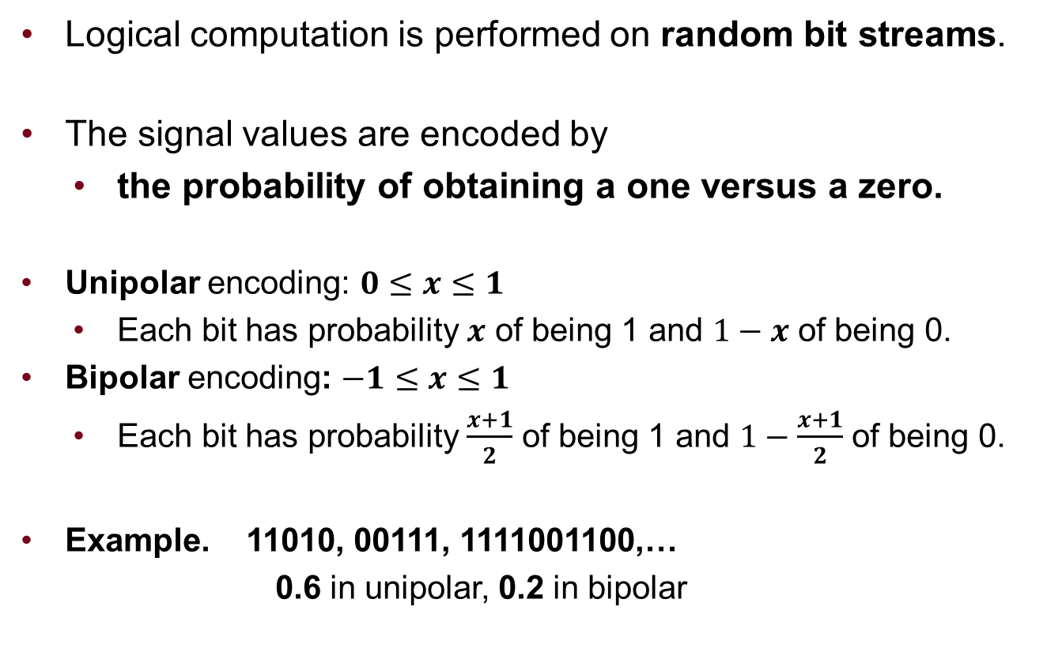
Background: Stochastic Computation
  Logical computation is performed on random bit streams.
  The signal values are encoded by
    the probability of obtaining a one versus a zero.
  Unipolar encoding: $0≤x≤1$
    Each bit has probability $x$ of being 1 and $1−x$ of being 0.
  Bipolar encoding: $−1≤x≤1$
    Each bit has probability $\frac{x+1}{2}$ of being 1 and $1−\frac{x+1}{2}$ of being 0.
  Example. 11010, 00111, 1111001100,…
  0.6 in unipolar, 0.2 in bipolar
Notes:
Inputs and outputs are between 0 and 1 (or -1 and 1)

Slide 7
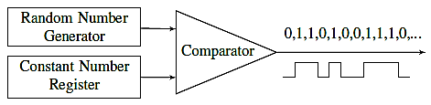
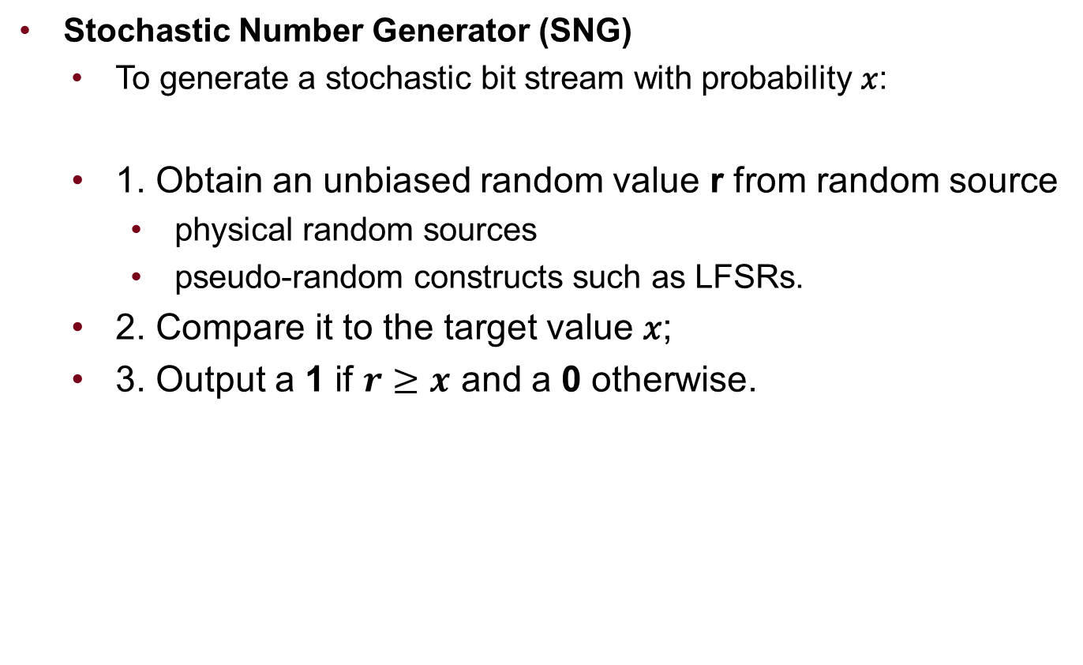
Background: Stochastic Number Generator
  Stochastic Number Generator (SNG)
    To generate a stochastic bit stream with probability 𝑥:
    1. Obtain an unbiased random value r from random source
      physical random sources
      pseudo-random constructs such as LFSRs.
    2. Compare it to the target value 𝑥;
    3. Output a 1 if $r≥x$ and a 0 otherwise.
Fig 6. Stochastic Number Generator

Slide 8
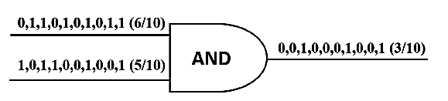
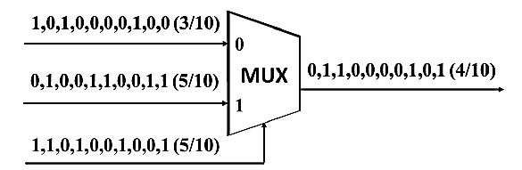
Background: Stochastic Computation
  Complex operations can be performed with very simple logic.
    Multiplication: AND gate Scaled addition: MUX
    A reduction in area of 50x or 100x compared to conventional implementations is common.
Figure 2. An example of multiplication
using an AND gate
Figure 3. An example of scaled addition
using a MUX unit
Notes:
In a binary radix representation $M$ bits can represent $2^{M}$ distinct numbers.
To represent real numbers with a resolution of $2^{−M}$ a stochastic representation requires a stream of $2^{M}$ bits.
Stochastic values are restricted to the interval [0, 1] one cannot perform addition or subtraction directly, since the result might lie outside these intervals. However, one can perform scaled addition and subtraction. Fig. 3 illustrates the operation 1/2A + 1/2B.

Slide 9
Background: Stochastic Computation
  Another advantage over binary radix: Error Tolerance
  In a noisy environment:
    With a binary representation in the worst case
      the most significant bit gets flipped => a large error.
    With a stochastic representation
      all the bits in the stream have equal weight.
      A single flip results in a small error.
    Stochastic representation is high error tolerant.
Notes:
bit flips occur and these afflict all the bits with equal probability.

Slide 10
Polysynchronous Stochastic
A more compelling advantage:
  with a stochastic representation,
    computational units can tolerate skew
      Obviates the need for a global clock signal
This stems from the fact: the stochastic representation is uniform
    All that matters:
      the fraction of time that the signal is high.
The correct value is computed even when the inputs are misaligned temporally.
    polysynchronous stochastic
Notes:
all that matters in terms of the value that is computed is
Accordingly, adopting the stochastic paradigm obviates the need for a global clock signal and the associated CDN.
We demonstrate that the correct value is computed even when the inputs are misaligned temporally.
Instead one can 1) simply use local clock signal generators throughout, 2) or relax the arrival time requirements of a global clock signal
The clock signals need not be of high quality a very cheap inverter ring will suffice.
to distinguish it from asynchronous and GALS methodologies.

Slide 11
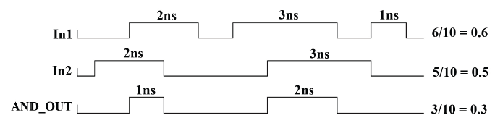
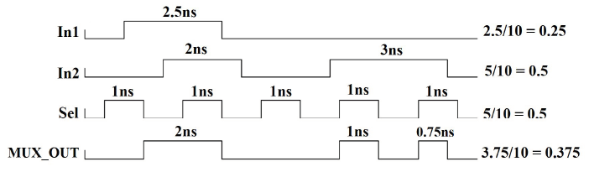
Polysynchronous Stochastic
Stochastic operations with polysynchronous inputs:
Multiplication
Scaled addition
Fig 4. Stochastic multiplication using an AND with unsynchronized bit streams.
Fig 5. Stochastic scaled addition using a MUX with unsynchronized bit streams.
Notes:
The value represented by a bit stream is the time that the signal is high divided by the total length of the stream.
Fig. 4 illustrates an example of multiplying two unsynchronized bit streams representing 0.6 and 0.5. As shown, the value represented by the bit stream at the output of the AND gate is 0.3, the value one expects when multiplying 0.6 by 0.5.
Fig. 5 illustrates an example of scaled addition this time on two unsynchronized bit streams representing 0.25 and 0.5. As expected, the output is a bit stream representing 0.375, the result of the scaled addition.

Slide 12
Basic Stochastic Operations with polysynchronous inputs
  Consider an AND gate, responsible for multiplying two input bit streams, P1 and P2
  P1 and P2 are generated by SNGs driven by two clocks with different periods, T1 and T2.
  Simple case.
    We connect two clocks with periods of T1 and T2 to the inputs
    The inputs are both P=0.5
    The expected output value is Y=0.25.
    We verify three different scenarios:
      1) T1=2ns, T2=3.5ns,
      2) T1=2ns, T2=3.2ns,
      3) T1=1.8ns, T2=3.2ns.
Notes:
To simplify the problem, we first show how an AND gate works when two unsynchronized clocks are connected directly to its inputs.
Then we discuss the behavior with arbitrary stochastic input streams.
We verify the functionality of performing multiplication using AND gate according to three different scenarios:

Slide 13
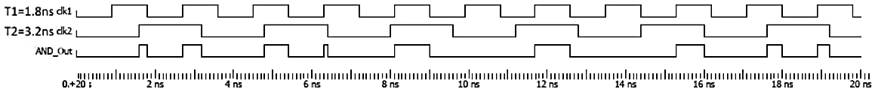
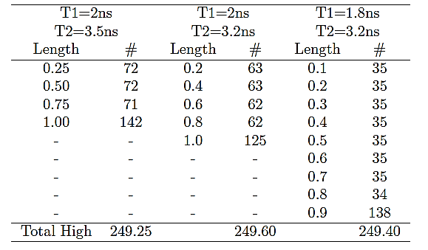
Basic Stochastic Operations with polysynchronous inputs
Temporal misalignment of input values does not affect the accuracy of the computation.
Fig 7. Input clock signals and the corresponding output from connecting polysynchronous inputs to an AND gate.
Table 1. Different observed lengths of high pulses at the output of the AND gate and the number of occurrences of each one for 1000ns.
Notes:
Fig. 7 illustrates the input signals as well as the output signal in the case where T1=1.8ns and T2=3.2ns for 20ns of operation.
Continuing the operation for about 1000ns will produce a good view of the different lengths of high pulses that are observed at the output of the AND gate.
Dividing the total fraction of the time that the output signal is high by the total time gives the result of the multiplication operation.
As can be seen in Table I, when we vary the periods of the two clock sources, the total time that the output is high does not change much. The length of the observed high pulses and the number of occurrences of each changes, but the total fraction of the time that the output is high is very close to 250ns. Dividing 250ns by 1000ns produces 0.25, the expected output of multiplying the two input streams.
This example, we hope, provides an intuitive explanation of why polysynchronous stochastic operations work: temporal misalignment of input values does not
affect the accuracy of the computation.

Slide 14
Basic Stochastic Operations with polysynchronous inputs
  Functionality of a MUX unit performing scaled addition with temporally misaligned inputs.
  The measured output values are essentially equal to the expected output value of 0.5
              (0.5 + 0.5)/2=0.5
Table 2. The measured output of the MUX when three polysynchronous clocks with distinct periods are connected to its inputs for 1000ns.
T1(ns) | T2(ns) | T3(ns) | Total High Time | Measured Output | Expected Output
2.00 | 1.80 | 3.75 | 499.43 | 0.499 | 0.500
1.90 | 2.63 | 2.12 | 500.21 | 0.500 | 0.500
3.20 | 1.60 | 2.00 | 498.80 | 0.499 | 0.500
2.87 | 2.43 | 2.10 | 499.23 | 0.499 | 0.500
Notes:
To study the functionality of the MUX unit, we connect three polysynchronous clocks with distinct periods, T1, T2, and T3, to the inputs. We compare the fraction of time that the output is high divided by the total time to the expected value, (1/2+1/2)/2. The results are shown in Table II.
The main difference between this unit and the AND gate
the MUX unit has an extra select stream performing the scaling.

Slide 15
Basic Stochastic Operations with polysynchronous inputs
  General case.
  Results are based on bit streams of length 1024, generated with 32-bit LFSRs.
  In spite of the polysynchronous clocking, the results are accurate to within the error bound expected for stochastic computation.
Table 3. Stochastic multiplication and scaled addition, using an AND gate and a MUX, with inputs generated by unsynchronized SNGs.
 |  |  |  |  | AND Output |  | MUX Output
In1 | T1(ns) | In2 | T2(ns) | T3(ns) | Meas. | Expec. | Meas. | Expec.
0.50 | 2.10 | 0.50 | 2.30 | 2.00 | 0.247 | 0.250 | 0.502 | 0.500
0.35 | 2.82 | 0.66 | 3.11 | 3.68 | 0.237 | 0.231 | 0.498 | 0.505
0.27 | 2.81 | 0.48 | 2.36 | 3.61 | 0.128 | 0.129 | 0.372 | 0.375
0.18 | 1.60 | 0.53 | 3.70 | 2.20 | 0.096 | 0.095 | 0.350 | 0.355
Notes:
Table 3 presents the results of trials for stochastic multiplication and scaled addition. In this table, T1 and T2 are the periods of the clocks of the SNGs responsible for generating the first and the second streams,. For the scaled addition operations, T3 is the period of the clock of the SNG responsible for generating the select stream, which is set to 0.5.
The results presented are based on bit streams of length 1024, generated with 32-bit LFSRs. This configuration produces a good Bernoulli distribution of probabilities for the individual bits in the stream.

Slide 16
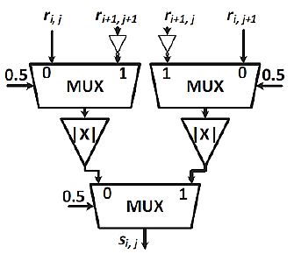
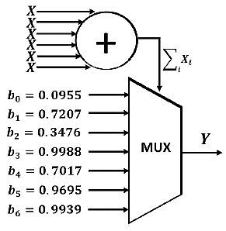
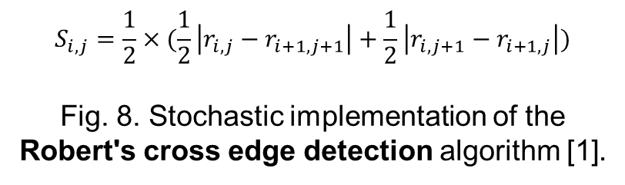
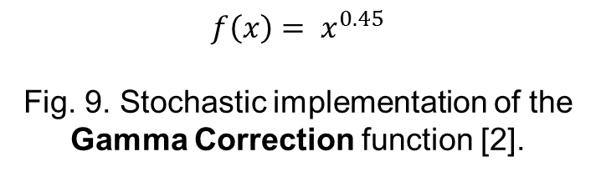
Stochastic Circuits with Polysynchronous Inputs
$$S_{i,j}=\frac{1}{2}×(\frac{1}{2}\left|r_{i,j}−r_{i+1,j+1}\right|+\frac{1}{2}\left|r_{i,j+1}−r_{i+1,j}\right|)$$
Fig. 8. Stochastic implementation of the Robert's cross edge detection algorithm [1].
$$f\left(x\right)= x^{0.45}$$
Fig. 9. Stochastic implementation of the Gamma Correction function [2].
[1] Peng Li, D.J. Lilja, Weikang Qian, K. Bazargan, and M.D. Riedel. Computation on stochastic bit streams digital image processing case studies. TVLSI 2014.
[2] Weikang Qian, Xin Li, M.D. Riedel, K. Bazargan, and D.J. Lilja. An architecture for fault-tolerant computation with stochastic logic. IEEE Transactions on Computers, 2011.
Notes:
Extending the analysis to more complex stochastic circuits
To evaluate polysynchronous stochastic paradigm. We use the stochastic implementations of three digital image processing algorithms as case studies
Each operator consists of a pair of 2 convolution kernels that process an image pixel based on its three neighbors as follows:
Gamma Correction
useful in image and video processing systems
The inputs to this system consist of six independent bit streams, each with probability corresponding to the value x of the input pixel, as well as seven random bit streams set to constant values, corresponding to the Bernstein coefficients,
For further details, readers are referred to

Slide 17

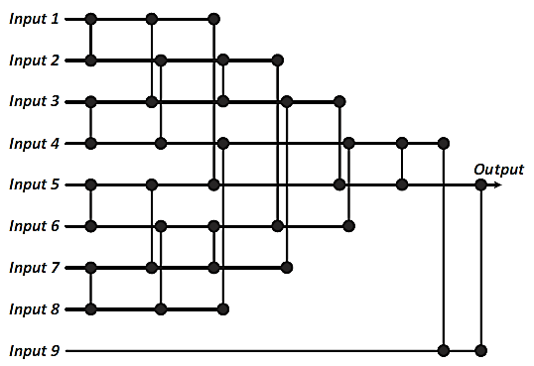
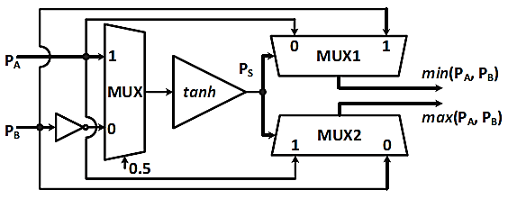
Stochastic Circuits with Polysynchronous Inputs
Fig. 10.a. Basic Sorting Unit [1]
Fig. 10.b. Stochastic implementation of the basic sorting unit [1].
Fig. 10.c. A stochastic implementation of a 3*3 Noise reduction median filter [1]
[1] Peng Li, D.J. Lilja, Weikang Qian, K. Bazargan, and M.D. Riedel. Computation on stochastic bit streams digital image processing case studies. TVLSI 2014.]
Notes:
An efficient technique for noise reduction in gray-scale images is to use a median filter. It replaces each pixel with the median value of its neighboring pixels.
So the operation considers a local window around each pixel, computes the median value of the pixels inside that window, and replaces the pixel with the computed value.

Slide 18
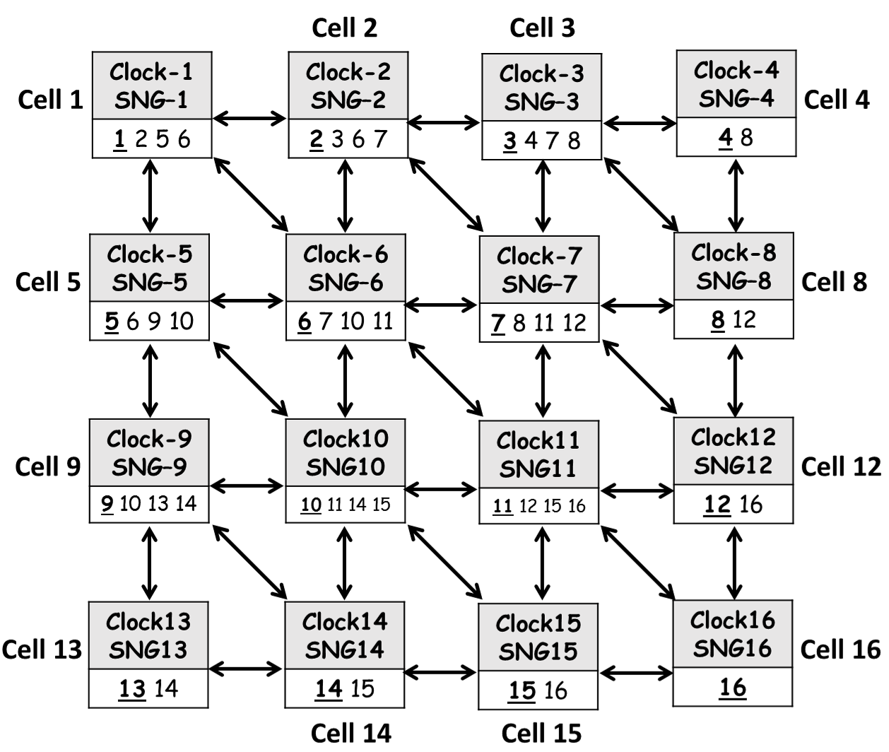
Stochastic Circuits with Polysynchronous Inputs
  Parallel processing of a 4x4 input image
The input bit streams arriving from neighboring are generated by SNGs driven by their local clocks and so are all potentially misaligned temporally.
Fig. 11. 16 Robert's Cross Cells processing a 4x4 input image concurrently.
Notes:
Supposed that we are given an input 4x4 gray-scale image to process by a stochastic Robert's cross edge detection circuit.
An efficient way of processing the image is to use 16 instances of the Robert's cross stochastic circuit to process each of the pixels concurrently.
Fig. 11 shows a diagram of such a parallel circuit. Call each instance a Robert's cross cell. Each cell has its own local clock; it converts its input pixel value, presented as a stochastic bit stream, into an output pixel value, presented as stochastic bit stream.
These bit streams are generated by a SNG driven by the cell's local clock. The cell communicates with its neighbor cells to receive their pixel values, presented as input bit streams. These bit streams arriving from neighboring are generated by SNGs driven by their local clocks; so the input bit streams will not all be synchronized. The clocks will potentially all have different frequencies and phases.
Consider the first cell in Fig. 7. This cell is responsible for processing the image pixel 1 to decide whether it is on an edge or not. This cell takes a pixel intensity value and converts it to a stochastic bit stream using an SNG driven by a local clock. It does so while receiving streams corresponding to the values of neighboring pixels 2, 5, and 6. The pulses that the first cell receives from cells 2, 5, and 6 are all generated by SNGs driven by local clocks. Accordingly, the input bit streams are all potentially misaligned temporally.

Slide 19
Experimental Results
  Circuits are implemented in Verilog,
  Simulation in Modelsim
  a 256*256 sample input image
For the Robert's cross circuit,
  3 out of 4 streams are received asynchronously
For the Median Filtering circuit,
  8 out of 9 streams are received asynchronously
For the Gamma correction circuit,
  Bernstein coefficients streams are generated with SNGs driven by local clocks.
For the SNGs: 32-bit maximal period LFSR, seeded with a random initial value for each trial, Bit streams of length 1024
Notes:
10 trials were performed to ensure statistically significant results.
To convert the output bit streams into deterministic real values, we measured the fraction of the time the output signal is high and divide by the total time of the output signal. For example, if the output signal was high 25% of the time, the output is evaluated as 0.25.

Slide 20
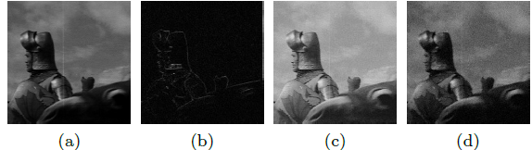
Experimental Results
  Generating a golden case
    All local clocks are synchronized (period of 2ns).
      Even with synchronized clocks there are some inaccuracy when comparing with the conventional binary outputs.
Original image
Robert’s cross
2.88%
Gamma
2.56%
Median Filter
3.15%
Fig. 12. The original sample image, and the outputs of processing the sample image using stochastic circuits working with synchronized local clocks.
Notes:
We processed the sample image using stochastic circuits with all local clocks synchronized.
To evaluate the correct functionality of our polysynchronous circuits,
Fig. 12 shows the sample image and the resulting output images. The synchronized clocks had a period 2ns.

Slide 21
Experimental Results
  We compare 6 different clocking schemes
Scheme 1. The period of the local clock in all processing cells
  Is fixed at 2ns (the golden case).
Scheme 2. The period of the local clock in each cell
  a random real value between 2-3 ns
  So 50% variation between the clock periods.
Scheme 3. The period of the local clock in each cell
  a random real value between 2-4ns
  so 100% variation.
Notes:
The motivation for schemes 2 and 3 is to study the impact of having more variation between the local clocks.

Slide 22
Experimental Results
  We compare 6 different clocking schemes
Scheme 4. The periods of the local clocks
  random values between 2-4ns,
  but high output pulses that are less than 10% of the 2ns clock period (0.2ns) are filtered out (i.e., they are set to 0).
Scheme 5. Same as Scheme 4, but we filter out high output pulses that are less than 15% of the 2ns clock period.
Scheme 6. Same as Scheme 4, but we filter out high output pulses that are less than 20% of the 2ns clock period
Notes:
The motivation of schemes 4, 5 and 6, is to approximate hardware conditions in which short pulses, call them -runt pulses-, do not reach a valid high or low level, and so cannot change the output states of the gates.

Slide 23
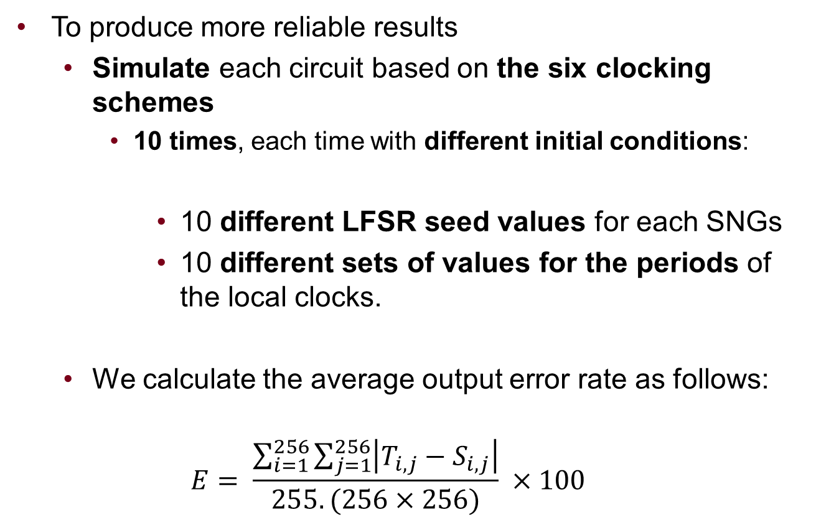
Experimental Results
To produce more reliable results
  Simulate each circuit based on the six clocking schemes
    10 times, each time with different initial conditions:
      10 different LFSR seed values for each SNGs
      10 different sets of values for the periods of the local clocks.
  We calculate the average output error rate as follows:
  $$E= \frac{\sum_{i=1}^{256}{\sum_{j=1}^{256}{\left|T_{i,j}−S_{i,j}\right|}}}{255.(256×256)} ×100$$
Notes:
The results are the average results of these trials.
where Si;j is the expected pixel value in the output image and Ti;j is the pixel value produced using the stochastic circuit.

Slide 24
Experimental Results
The accuracy of the computations is essentially independent of how synchronized the local clocks are.
Polysynchrony might actually help instead of hurting!
Table 4. The mean of the output error rates for the three implemented stochastic circuits, simulated in six different clocking schemes.
 | Clocking Schemes
 | S.1 | S.2 | S.3 | S.4 | S.5 | S.6
Robert | 2.88% | 2.89% | 2.94% | 2.89% | 2.92% | 2.88%
Gamma.. | 2.56% | 2.50% | 2.49% | 2.51% | 2.59% | 2.64%
Median. | 3.15% | 3.19% | 3.31% | 3.28% | 3.39% | 3.31%
Notes:
Comparing the results:
In fact, as this table shows, the clock periods can vary by up to 100% without affecting the accuracy of the results.
In some cases, the mean of the error in the polysynchronous circuits is actually slightly below that of the synchronous case.
because provide more random-looking input streams.
So polysynchrony might actually help instead of hurting!

Slide 25
Experimental Results
SPICE-Level Verification
SPICE netlist of the Robert's cross circuit
Simulation using 45-nm gate library in HSPICE
500 sets of random input values,
For the conventional synchronous: clock periods =>1ns.
For the polysynchronous: clock periods => random (1ns-2ns)
On 500 trials, the mean of the output error rates were
  4.91% for the synchronous approach.
  4.42% for the polysynchronous approach.
  Polysynchronous stochastic circuits are essentially as accurate as conventional synchronous circuits.
Notes:
For a circuit-level verification of these ideas
Simulations were carried out using a 45-nm gate library in HSPICE
Note that the period corresponds to a single bit in the random stream.
Random periods in the range from 1ns to 2ns (so 100% variation).
we can conclude that polysynchronous stochastic circuits are essentially as accurate as conventional synchronous circuits.

Slide 26
Conclusion
  We presented “Polysynchronous Stochastic Computation”
    As a proof of concept
  It is predicated on the paradigm of stochastic computing.
    Low cost, low power consumption, high resiliency
Another important benefit of the stochastic paradigm
  the flexibility it provides for the clocking mechanism.
  Computation is accurate irrespective of the temporal alignment of input values,
    So it can tolerate arbitrary amounts of clock skew.
    We can remove the CDN and instead use
      Locally inexpensive generated clocks
    Improving area, power, and design complexity
Notes:
low leakage power consumption, a concern to modern integrated circuit designers.
As a result, we can replace a global clock and its associate clock distribution network with locally generated clocks. These can be simple, fast inverter rings.
We did not perform a full implementation to quantify the savings obtained by eliminating the CDN in integrated circuits.
Obviously, the area, power and design complexity will all be impacted in positive sense if we can eliminate the CDN.
We conclude that the polysynchronous stochastic approach is a good fit for applications that
require only modest accuracy
but call for low cost, low power and high resiliency.
In future work,
we will make this case with a comparison of full integrated circuit designs, including clock mechanisms and I/O circuitry.

Slide 27
Thank you
  Questions?
  M. Hassan Najafi
  Najaf011@umn.edu

