Slide 1

Sayed Ahmad Salehi
Marc D. Riedel
Keshab K. Parhi
University of Minnesota, USA
Markov Chain Computations
using Molecular Reactions

Slide 2
Outline
Introduction
Modeling of Molecular Systems
  Mass-action Law
  Stochastic Kinetics
Markov Chain (Random Process)
  Gambler’s Ruin Problem
  Modeling by Molecular Reactions
Analysis
Simulation Results
Summary

Slide 3
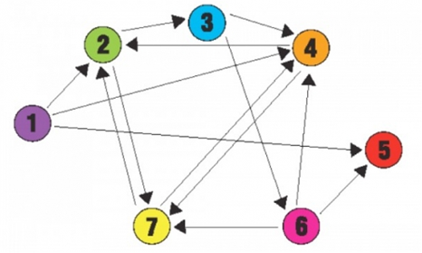
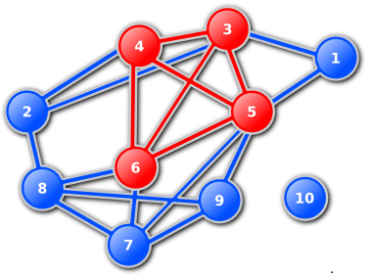
Introduction
DNA Computation
  Combinatorial Problems
    Hamiltonian(Adleman,94), Maximal Clique(Ouyang,97)
  Deterministic Functions
    Addition (Guarnieri,et al.,96), Semilinear Functions (Chen,et al.,2013)
  Logical Functions
    Seesaw Gates (Qian,et. al.,2011), …
  Signal Processing
    Discrete Time Signal Processing (Jiang, et. al.,2013)
  …

Slide 4
Computational Modules
Constant Multiplier

Slide 5
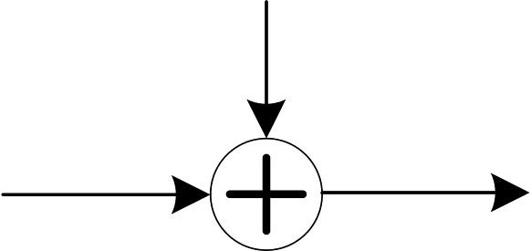
Computational Modules
Adder

Slide 6
DSP with Reactions
10, 2, 12, 8, 4, 8, 10, 2, …
5, 6, 7, 10, 6, 6, 9, 6, …
Reactions
…
…
Input molecular type
Output molecular type
How do we find such reactions?

Slide 7
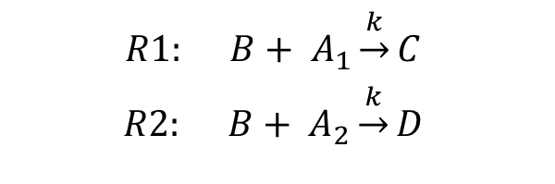

Molecular Modeling
$$R1: B+ A_{1}\underset{→}{k}C$$
$$R2: B+ A_{2}\underset{→}{k}D$$
Mass-action kinetics:
ODE representation:
$$\frac{d{[A}_{1}]}{dt}=−\frac{d\left[C\right]}{dt}=k.\left[A_{1}\right].[B]$$
$$\frac{d{[A}_{2}]}{dt}=−\frac{d[D]}{dt}=k.\left[A_{2}\right].[B]$$
Stochastic chemical kinetics:

Slide 8












Molecular Modeling
R1: $B+ A_{1}\underset{→}{k}C$
R2: $B+ A_{2}\underset{→}{k}D$
$$a_{1}={[A}_{1}]$$
$$a_{2}={[A}_{2}]$$
$$b=[B]$$
$$c=[C]$$
$$d=[D]$$
Stochastic chemical kinetics:
  Each reaction can be fired randomly
$$P\left(R1\right)$$
$$(a_{1}−1,a_{2},b−1,c+1,d)$$
$$P\left(R1\right)$$
$$P\left(R2\right)$$
$$(a_{1},a_{2},b,c,d)$$
$$P\left(R2\right)$$
$$(a_{1},a_{2}−1,b−1,c,d+1)$$
$$P\left(R1\right)$$
  $$P\left(R1\right)=\frac{k\left(\begin{matrix}b \\ 1\end{matrix}\right)\left(\begin{matrix}a_{1} \\ 1\end{matrix}\right)}{k\left(\begin{matrix}b \\ 1\end{matrix}\right)\left(\begin{matrix}a_{1} \\ 1\end{matrix}\right)+k\left(\begin{matrix}b \\ 1\end{matrix}\right)\left(\begin{matrix}a_{2} \\ 1\end{matrix}\right)}=\frac{a_{1}}{a_{1}+a_{2}}$$
  $$P\left(R2\right)=\frac{k\left(\begin{matrix}b \\ 1\end{matrix}\right)\left(\begin{matrix}a_{2} \\ 1\end{matrix}\right)}{k\left(\begin{matrix}b \\ 1\end{matrix}\right)\left(\begin{matrix}a_{1} \\ 1\end{matrix}\right)+k\left(\begin{matrix}b \\ 1\end{matrix}\right)\left(\begin{matrix}a_{2} \\ 1\end{matrix}\right)}=\frac{a_{2}}{a_{1}+a_{2}}$$
$$P\left(R2\right)$$
P(R1) and P(R2) change
after each event.

Slide 9
Markov Chain
(1st order) Markov Property: Past and future values of the process are conditionally independent given the present value.

Slide 10
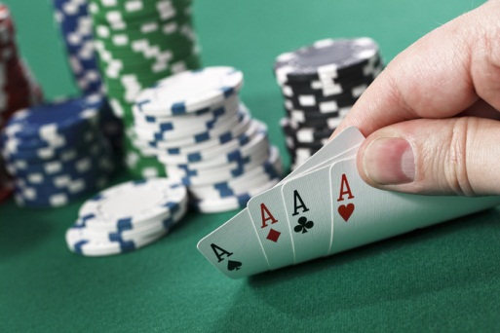
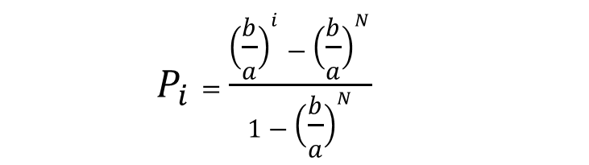
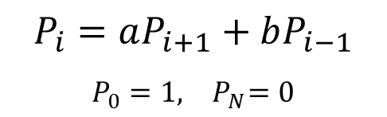
Gambler’s Ruin Problem
Gambler starts with i dollars and plays game of chance in each step, either increasing his money by $1 or decreasing by $1. He stops when money is gone or when he has N dollars. What’s the probability of “ruin”?
  $$P_{i}=\frac{{\left(\frac{b}{a}\right)}^{i}−{\left(\frac{b}{a}\right)}^{N}}{1−{\left(\frac{b}{a}\right)}^{N}}$$
$$P_{i}=aP_{i+1}+bP_{i−1}$$
$$P_{0}=1,{ P}_{N}=0$$

Slide 11



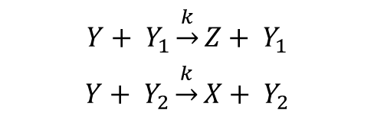



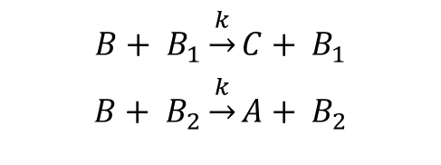
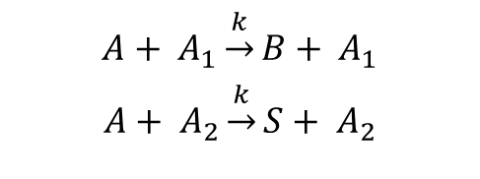




Modeling by Molecular Reactions
Initialization
a) $Probability control molecules:$
$$A_{1}=30$$
$$A_{2}=70$$
$$B_{1}=30$$
$$B_{2}=70$$
$$…$$
$$Y_{1}=30$$
$$Y_{2}=70$$
b) $Data molecules (based on the value of i):$
$$A=0$$
$$B=80$$
$$Y=0$$
State transfer reactions:
$$A+ A_{1}\underset{→}{k}B+ A_{1}$$
$$A+ A_{2}\underset{→}{k}S+ A_{2}$$
$$B+ B_{1}\underset{→}{k}C+ B_{1}$$
$$B+ B_{2}\underset{→}{k}A+ B_{2}$$
$$Y+ Y_{1}\underset{→}{k}Z+ Y_{1}$$
$$Y+ Y_{2}\underset{→}{k}X+ Y_{2}$$
$$…$$

Slide 12


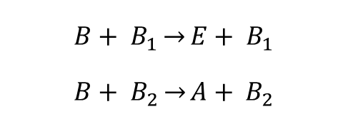
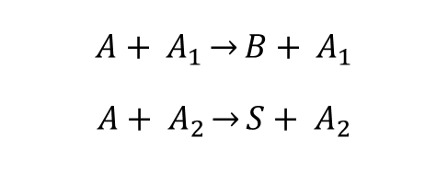
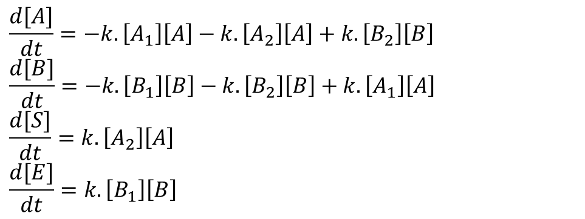
Analysis (Mass-action model)
$$A_{1}=30$$
$$A_{2}=70$$
$$B_{1}=30$$
$$B_{2}=70$$
$$A+ A_{1}\underset{→}{}B+ A_{1}$$
$$A+ A_{2}\underset{→}{}S+ A_{2}$$
$$B+ B_{1}\underset{→}{}E+ B_{1}$$
$$B+ B_{2}\underset{→}{}A+ B_{2}$$
Mass-action:
$$\frac{d[A]}{dt}=−k.\left[A_{1}\right]\left[A\right]−k.\left[A_{2}\right]\left[A\right]+k.\left[B_{2}\right]\left[B\right]$$
$$\frac{d[B]}{dt}=−k.\left[B_{1}\right]\left[B\right]−k.\left[B_{2}\right]\left[B\right]+k.\left[A_{1}\right]\left[A\right]$$
$$\frac{d[S]}{dt}=k.\left[A_{2}\right]\left[A\right]$$
$$\frac{d[E]}{dt}=k.\left[B_{1}\right]\left[B\right]$$

Slide 13
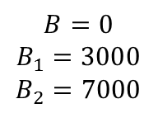



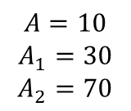




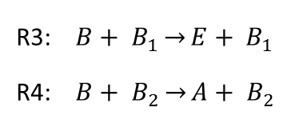


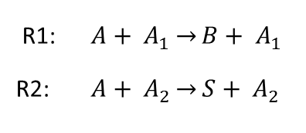




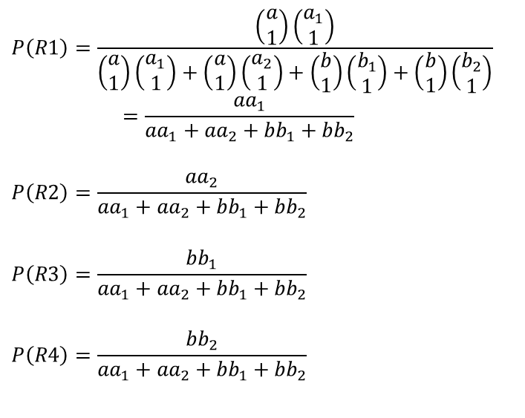


Analysis (Stochastic model)
$$A=10$$
$$A_{1}=30$$
$$A_{2}=70$$
$$B=0$$
$$B_{1}=3000$$
$$B_{2}=7000$$
R1: $A+ A_{1}\underset{→}{}B+ A_{1}$
R2: $A+ A_{2}\underset{→}{}S+ A_{2}$
R3: $B+ B_{1}\underset{→}{}E+ B_{1}$
R4: $B+ B_{2}\underset{→}{}A+ B_{2}$
$$P\left(R1\right)$$
  $$P\left(R1\right)=\frac{\left(\begin{matrix}a \\ 1\end{matrix}\right)\left(\begin{matrix}a_{1} \\ 1\end{matrix}\right)}{\left(\begin{matrix}a \\ 1\end{matrix}\right)\left(\begin{matrix}a_{1} \\ 1\end{matrix}\right)+\left(\begin{matrix}a \\ 1\end{matrix}\right)\left(\begin{matrix}a_{2} \\ 1\end{matrix}\right)+\left(\begin{matrix}b \\ 1\end{matrix}\right)\left(\begin{matrix}b_{1} \\ 1\end{matrix}\right)+\left(\begin{matrix}b \\ 1\end{matrix}\right)\left(\begin{matrix}b_{2} \\ 1\end{matrix}\right)}=\frac{{aa}_{1}}{{aa}_{1}+{aa}_{2}+{bb}_{1}+{bb}_{2}}$$
  $$P\left(R2\right)=\frac{{aa}_{2}}{{aa}_{1}+{aa}_{2}+{bb}_{1}+{bb}_{2}}$$
  $$P\left(R3\right)=\frac{{bb}_{1}}{{aa}_{1}+{aa}_{2}+{bb}_{1}+{bb}_{2}}$$
  $$P\left(R4\right)=\frac{{bb}_{2}}{{aa}_{1}+{aa}_{2}+{bb}_{1}+{bb}_{2}}$$
Stochastic Kinetic:
$$P\left(R2\right)$$
$$P\left(R1\right)$$
$$(0,9,1,0)$$
$$…$$
$$P\left(R3\right)$$
$$\left(s,a,b,e\right)=(0,10,0,0)$$
$$P\left(R4\right)$$
$$P\left(R1\right)$$
$$P\left(R2\right)$$
$$(1,9,0,0)$$
$$P\left(R2\right)$$
$$…$$
$$P\left(R3\right)$$
$$P\left(R4\right)$$

Slide 14
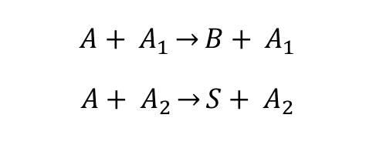
Analysis
Another interpretation:
Each molecule is an instant of the Gambler problem.
$$A+ A_{1}\underset{→}{}B+ A_{1}$$
$$A+ A_{2}\underset{→}{}S+ A_{2}$$

Slide 15
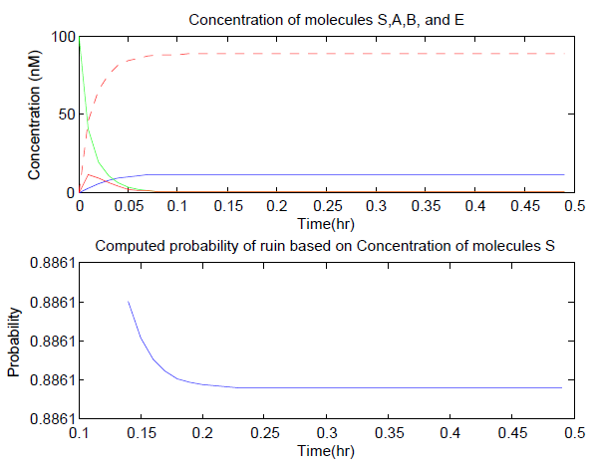
Simulation Results (Mass-action model)
ODE simulation
S ---
A
B
E
Theory: ruin probability= 0.8861 , win probability= 0.1139

Slide 16
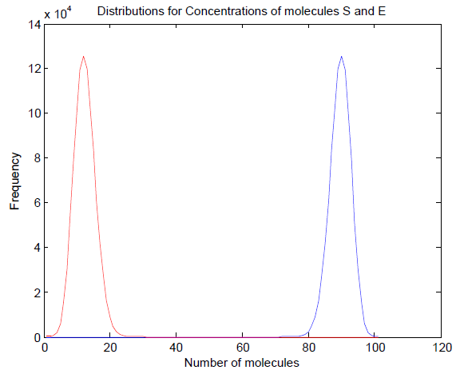
Simulation Results (Stochastic model)
Monte Carlo simulation
iteration=10⁶
Simulation: Ruin probability= 0.8861, Win probability= 0.1139
E
S
Theoretical and simulation results in both mass-action and stochastic models match well.

Slide 17
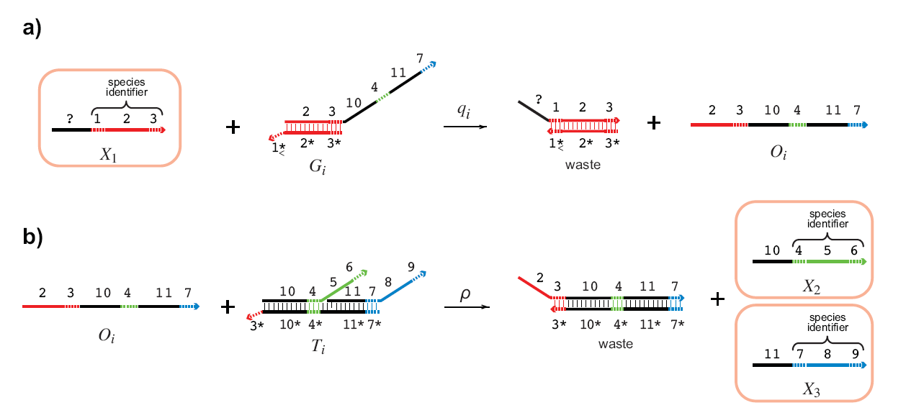
DNA Strand Displacement
X₁
X₂
+
X₃
D. Soloveichik et al: “DNA as a Universal Substrate for Chemical Kinetics.” PNAS, Mar 2010

Slide 18
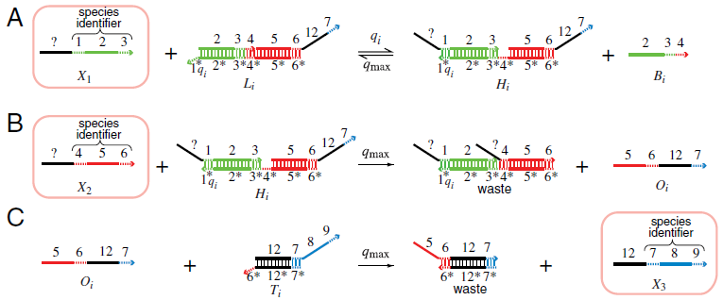
DNA Strand Displacement
X₁
+
X₂
X₃
D. Soloveichik et al: “DNA as a Universal Substrate for Chemical Kinetics.” PNAS, Mar 2010

Slide 19
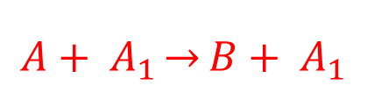
Modeling by DNA strands
Template for each reaction
$$A+ A_{1}\underset{→}{}B+ A_{1}$$

Slide 20
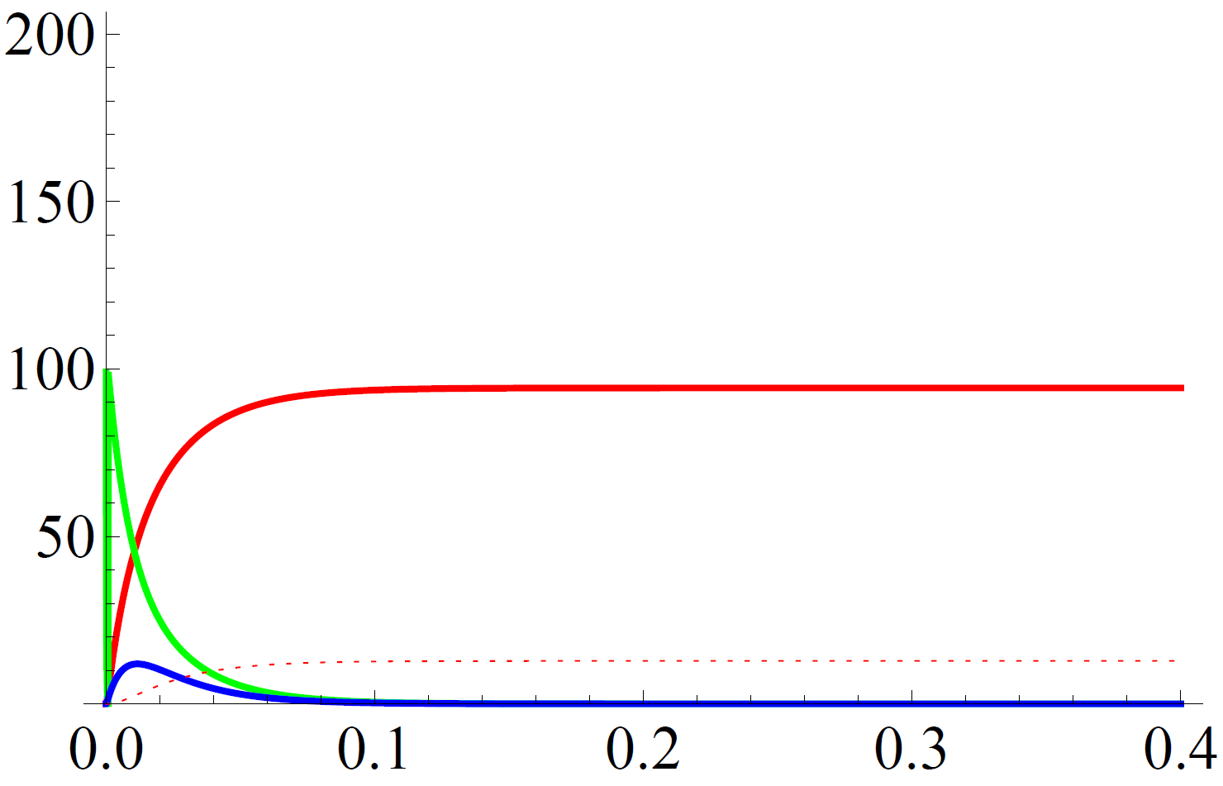

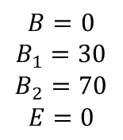
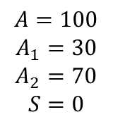

DNA Simulation Results
$$A=100$$
$$A_{1}=30$$
$$A_{2}=70$$
$$S=0$$
$$B=0$$
$$B_{1}=30$$
$$B_{2}=70$$
$$E=0$$
S
A
B
E
$$Concentration (nM)$$
$$Time(hr)$$

Slide 21
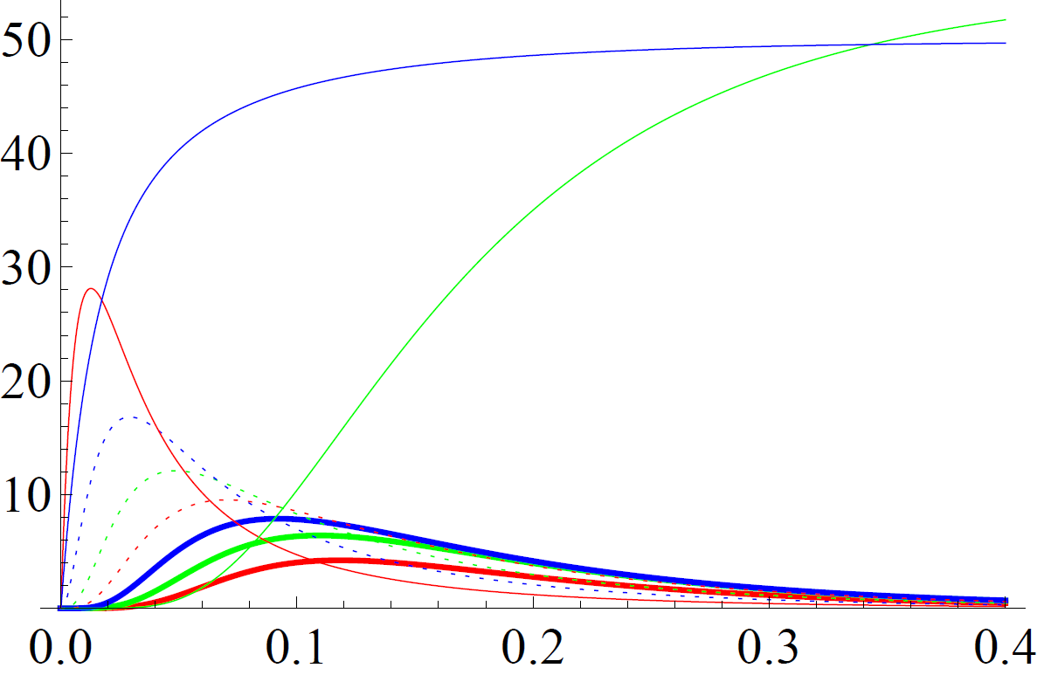


DNA Simulation Results
For N=9, concentration for state H=100
A
B
C
D
F
G
H
Ruin
Win
$$Concentration (nM)$$
$$Time(hr)$$

Slide 22
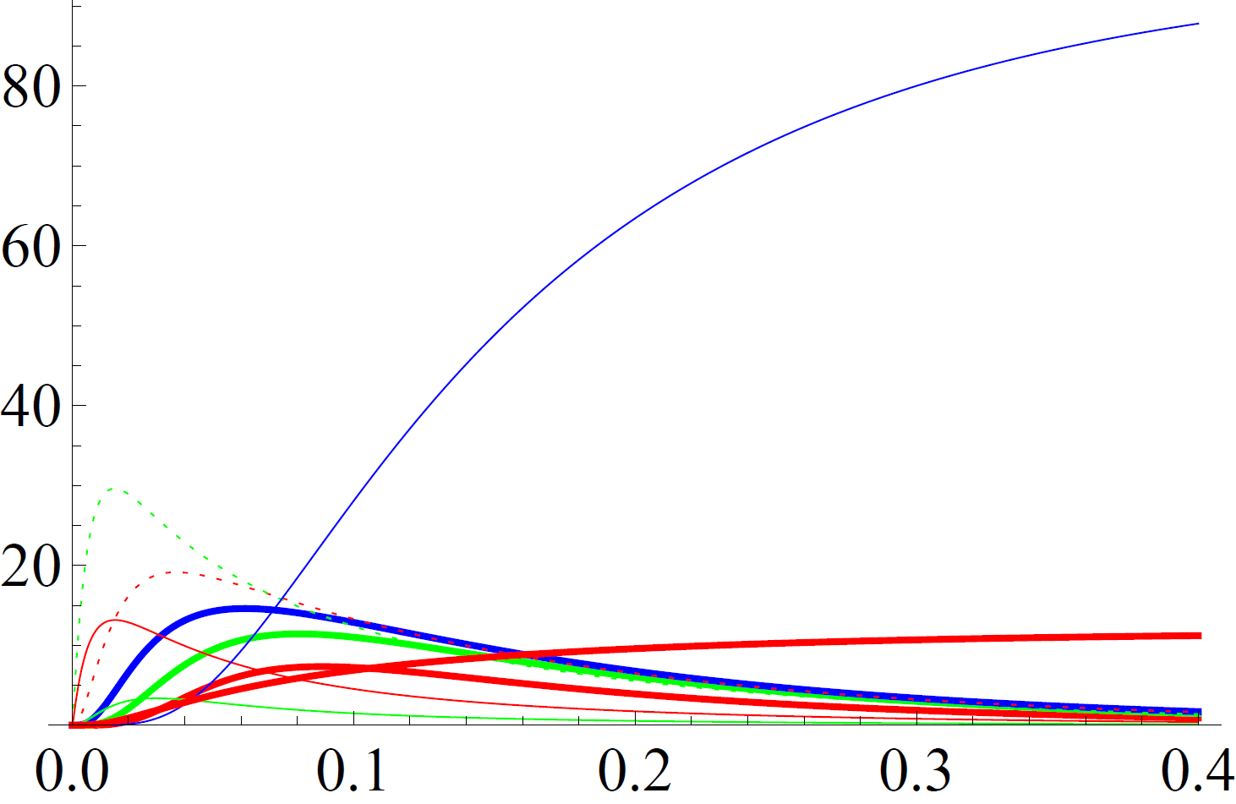
DNA Simulation Results
For N=9, concentration for state C=100
RUIN
A
B
C
D
F
G
H
WIN
$$Concentration (nM)$$
$$Time(hr)$$

Slide 23
Summary
Implementing Markov chain with molecular reactions
Applicable for analyzing and synthesizing artificial models to emulate stochastic behavior of natural biological systems

Slide 24
Future Work
Implementation of more complex natural biochemical systems using their Markove chain model.

