Slide 1
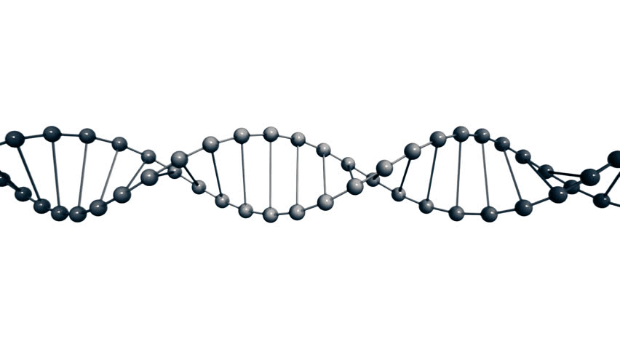
Simulating Chemical Reaction Networks for Computation with Naturally-Occurring DNA
Owen Hoffend
EE4982V – Senior Honors Thesis Final Report
May 1, 2020
Project Advisor: Marc Riedel

Slide 2
Presentation Overview
Background: Molecular Computation with Nicked DNA
Project Motivation: Why compute with DNA?
Simulator Design
Monte-Carlo DNA Simulation Algorithm Design
Results
Project Overview
Summary and Conclusion
Simulation Results
Prior Work
Simulator Software Overview

Slide 3
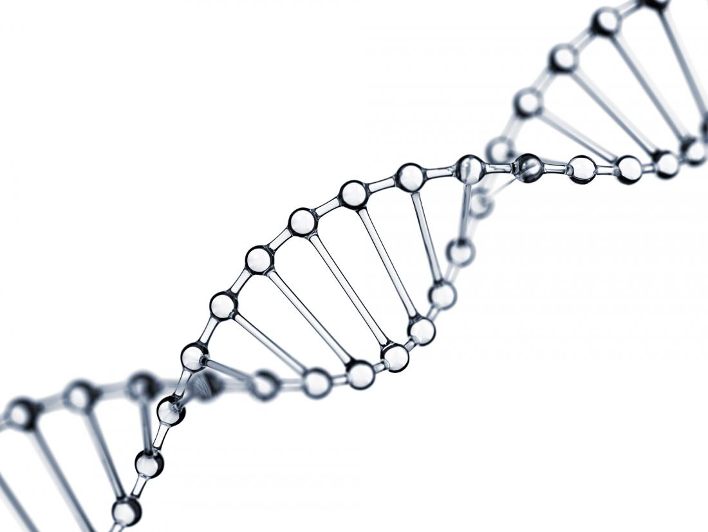
Background

Slide 4
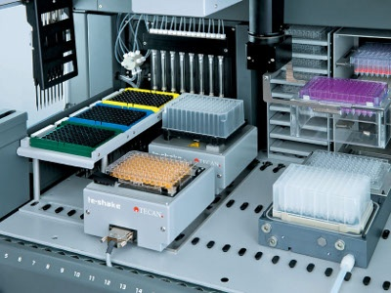
Project Motivation
Why are we interested in molecular computation?
Potential to unlock highly parallel computation.
  Billions of chemical reactions can occur simultaneously.
Extremely high data density:
  DNA is (theoretically) ~4 Exabytes/gram [9].
May unlock significant high-performance computing.
  Parallel matrix multiply [6].
  Parallel arbitrary polynomial functions [7].
Microplates containing many small test tubes for carrying out CRNs [10].
[6] Soloveichik, David, Andy Ellington, Marc Riedel, A. Hernandez, O. Milenkovic, C. Schroeder, and H Zhao. DARPA Review Meeting, Aug. 27, 2019, Follow-up. Presentation. Unpublished.
[9] Tabatabaei, S Kasra, Boya Wang, Nagendra Bala Murali Athreya, Behnam Enghiad, Alvaro Gonzalo Hernandez, Jean-Pierre Leburton, David Soloveichik, Huimin Zhao, and Olgica Milenkovic. “DNA Punch Cards: Encoding Data on Native DNA Sequences via Nicking.” BioRxiv, 2019.
[7] Salehi, Sayed Ahmad, Xingyi Liu, Marc D. Riedel, and Keshab K. Parhi. “Computing Mathematical Functions Using DNA via Fractional Coding.” Scientiﬁc Reports 8, no. 1 (2018).

Slide 5

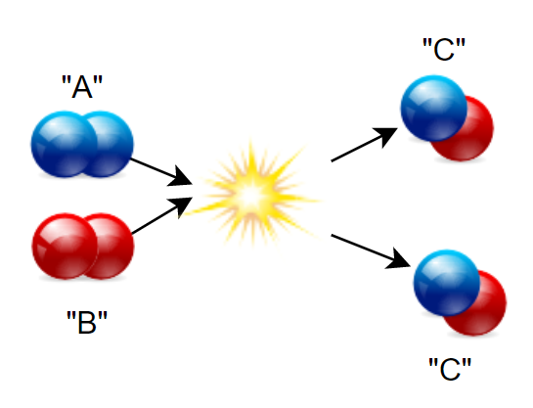

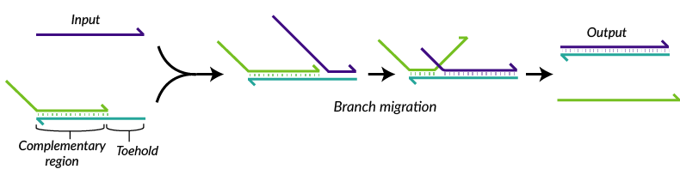
Prior Work – What’s been done already?
Basic chemical reaction networks (CRNs) [1]:
  Reactions operating on the concentration of molecules in a solution.
  Inputs: Concentration of molecules A and B.
  Output: Concentration of molecule C.
Implement CRNs with DNA molecules [8]:
  Specify [A, T, C, G] pairings to design I/O and reaction behavior.
  Cascades of “strand displacement” reactions.
  PROBLEM: Requires costly DNA Synthesis
    About $0.12 / eq. binary bit.
DNA displacement reaction: [11].
[1] Brijder, Robert. “Computing with Chemical Reaction Networks: a Tutorial.” Natural Computing 18, no. 1 (2019): 119–37.
[8] Soloveichik, D., G. Seelig, and E. Winfree. “DNA as a Universal Substrate for Chemical Kinetics.” Proceedings of the National Academy of Sciences 107, no. 12 (April 2010): 5393–98.

Slide 6
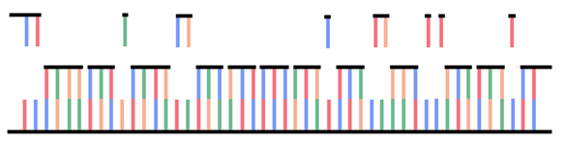
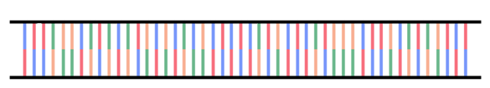
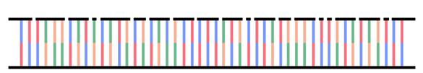
Representing Data with DNA
Low cost solution: Modify existing DNA!
“Hydroxyl Radical” reaction to randomly “nick” the DNA molecule with probability:
Heating causes small sequences of length <k to “denature” (detach). k=2 in this case.
Strand now has exposed bases with probability:

Slide 7

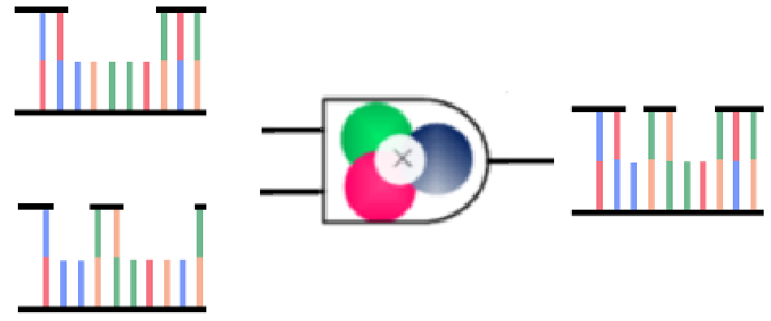




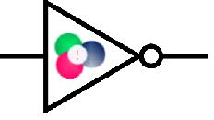
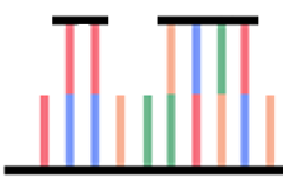

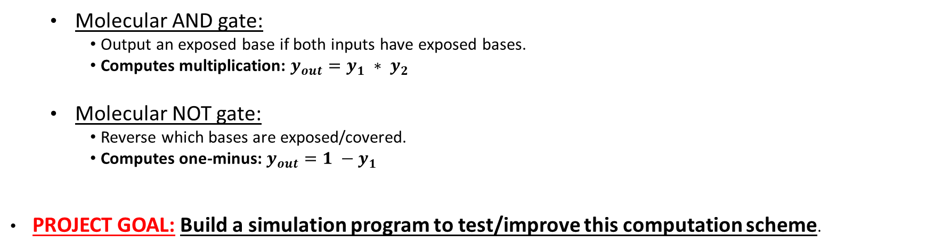
Operating on Data
Can operate on the probability
  Operation: Heating/Cooling the solution to control binding/denaturation.
  Operation: Mixing different solutions together.
  All operations are SIMD – Can affect many molecules in parallel.
  Molecular AND gate:
    Output an exposed base if both inputs have exposed bases.
    Computes multiplication: $y_{out}=y_{1} ∗ y_{2}$
  Molecular NOT gate:
    Reverse which bases are exposed/covered.
    Computes one-minus: $y_{out}=1 −y_{1}$
PROJECT GOAL: Build a simulation program to test/improve this computation scheme.

Slide 8
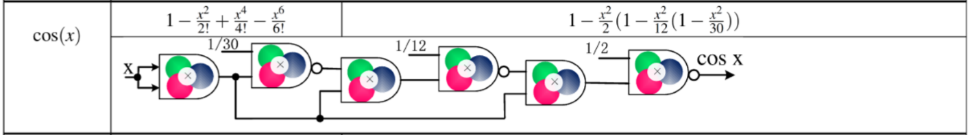
Implementing Arbitrary Functions
Input Function F(x)
Taylor Expansion into Polynomial P(x)
Rewrite P(x) in terms of “multiply” and “one-minus” operations (known as Horner’s Rule)
Implement with molecular gates
See ref. [7]
[7] Salehi, Sayed Ahmad, Xingyi Liu, Marc D. Riedel, and Keshab K. Parhi. “Computing Mathematical Functions Using DNA via Fractional Coding.” Scientiﬁc Reports 8, no. 1 (2018).

Slide 9
Simulation Algorithm Design

Slide 10
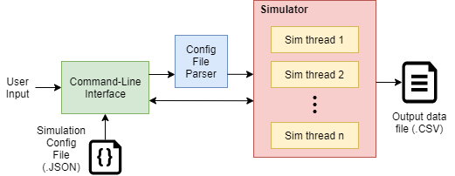
Simulator Software Overview
Python-based simulator software with built-in command line interface.
  Emphasize ease-of-use to aide research.
Input: A file with simple text-based function definitions for the simulator.
  Example:
"funcs":{
"cos" : "(1-x^2/2(1-x^2/12(1-x^2/30)))”,
…
}
Output: A file containing a table of the simulation results.
Optimization: Use of multithreading to improve simulation performance.

Slide 11

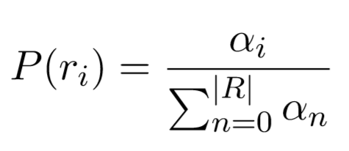
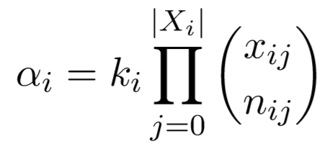
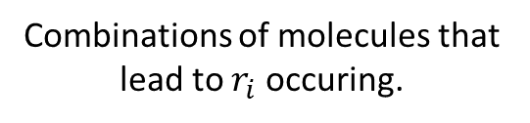

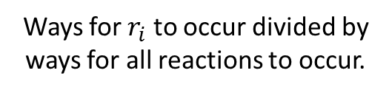
Monte-Carlo Simulation Algorithm
Traditional simulators for chemical dynamics use a “Monte Carlo” approach [4]:
Start by computing a set of $R$ potential reactions.
Compute the probability of each $r_{i}∈R$ occurring in the next timestep.
Randomly sample a reaction $r_{i}∈R$ to “fire” accordingly.
Ways for $r_{i}$ to occur divided by ways for all reactions to occur.
Combinations of molecules that lead to $r_{i}$ occuring.
[4] Gillespie, Daniel T. “Stochastic Simulation of Chemical Kinetics.” Annual Review of Physical Chemistry 58, no. 1 (2007): 35–55.

Slide 12
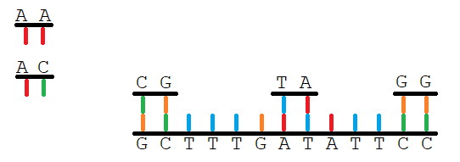
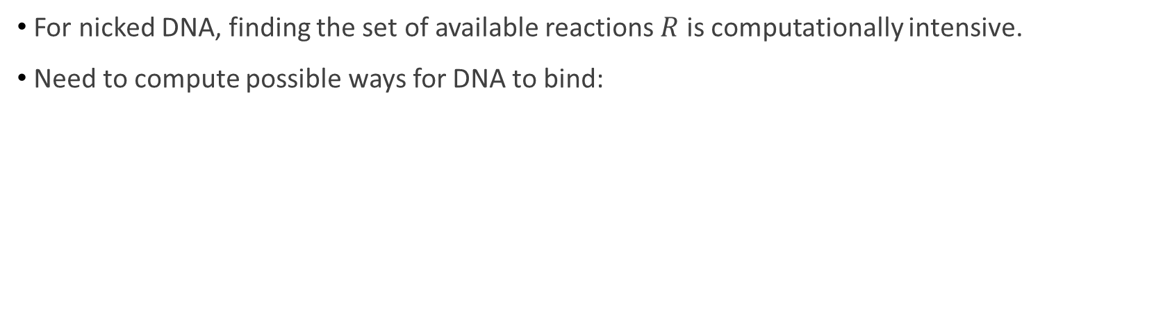
Problem with Usual Approach
For nicked DNA, finding the set of available reactions $R$ is computationally intensive.
Need to compute possible ways for DNA to bind:
4 Ways to match the sequences in this case.
These sequence matching algorithms were prototyped:
  Brute Force
  Radix Tree Search
  Hash Table

Slide 13
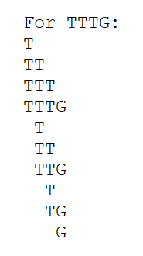
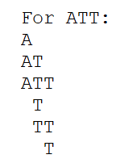
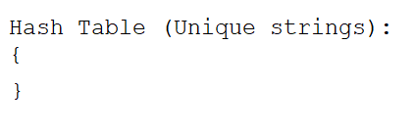
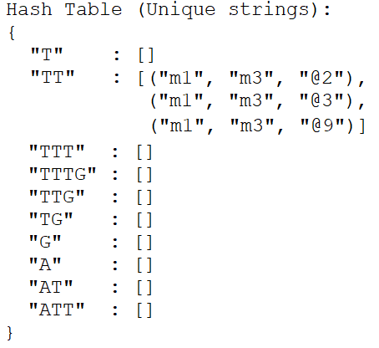
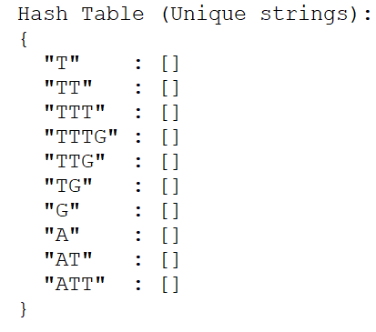
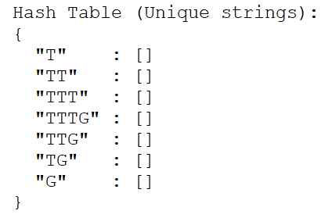
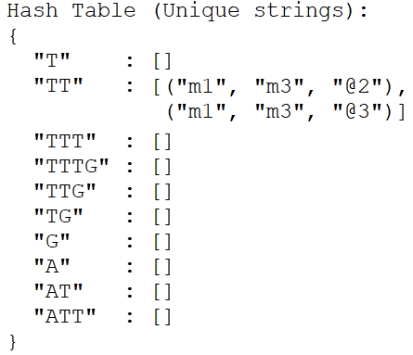
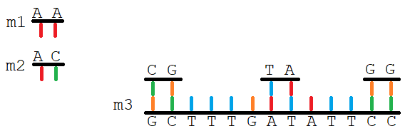


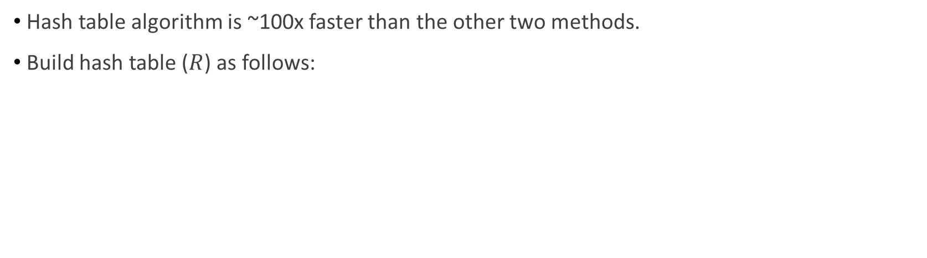
Improved Simulation Algorithm
Hash table algorithm is ~100x faster than the other two methods.
Build hash table ($R$) as follows:
Also includes functions required for molecular gates:
  Performing random nicking
  Denaturing
  Mixing solutions of DNA together

Slide 14
Results

Slide 15
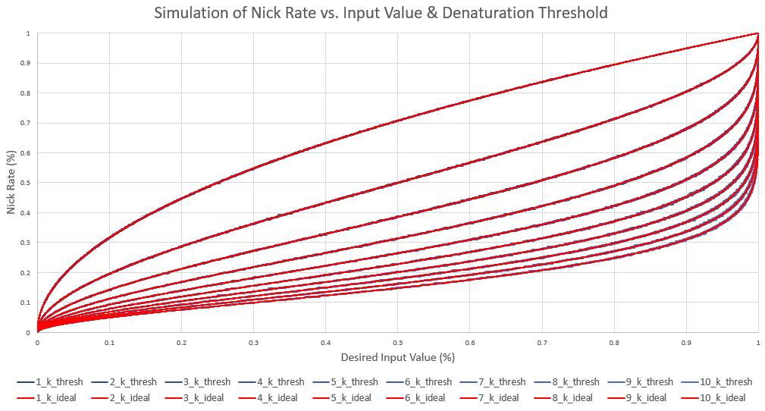
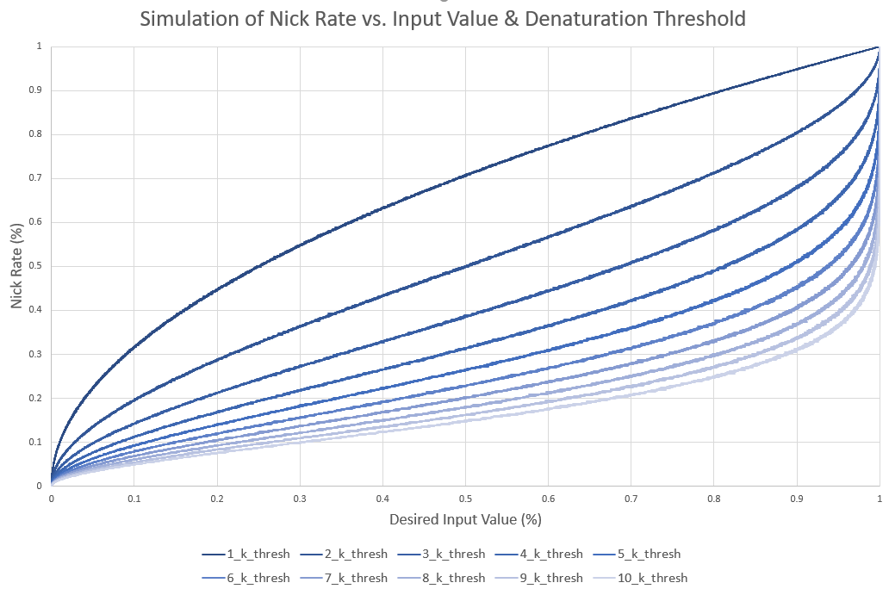

Nick Rate vs. Input Value Relationship
  Nick rate (x): Rate at which nicks are etched into the molecule.
  Threshold (k): Represents the heat level applied to the molecule.
  Input value (y): Ratio of exposed bases to covered bases after heating.
Function fit with equation:
$$y=1−(1+kx){(1−x)}^{k}$$
Developed a simple proof of this relationship.

Slide 16


Nick Rate vs. Input Value Relationship
Proof based on the probability of base remains covered:
. . .
. . .
Remains covered if:
  No nick in the prior k bases:
  OR: At least one nick in the prior k bases, but no nick in the following k bases:

Slide 17
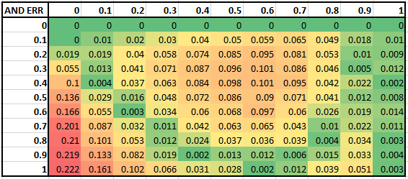
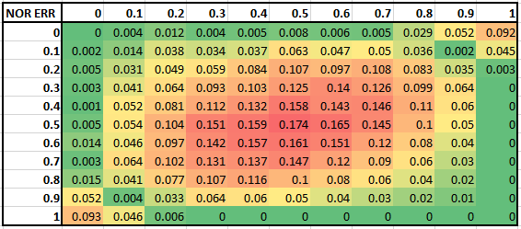
Accuracy of Fundamental Gates
Plots of absolute-value error of fundamental gate w/ respect to input value.
  Average over 25 samples, with DNA length of 10,000
NOT Gate - Max Error: 0.087
AND Gate – Max Error: 0.222
NOR Gate – Max Error: 0.174

Slide 18
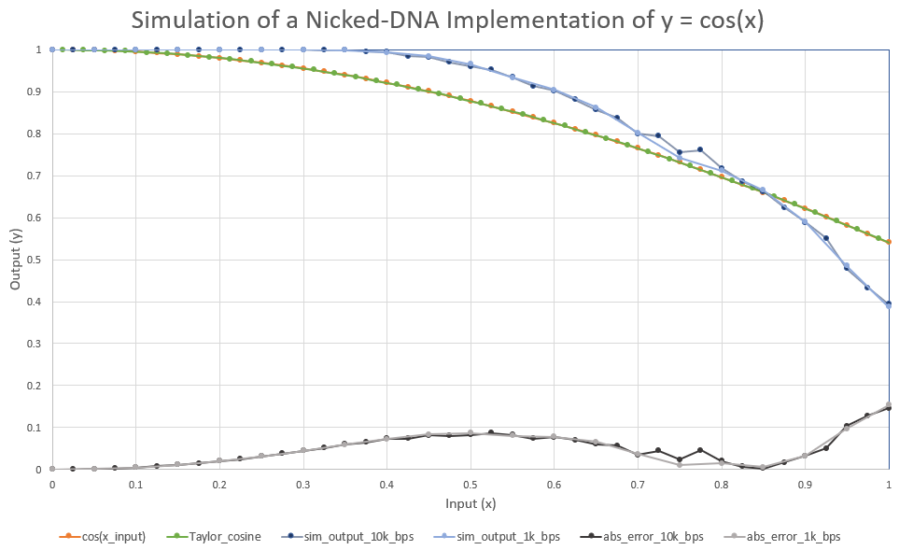

Slide 19
Results Summary & Conclusion
Project Motivation
DNA-based computation shows promise as a novel method for high-performance parallel computing.
Project
Goals
Results
Future Work
Design improved molecular gates to reduce error.
A custom Monte-Carlo style simulator for modeling DNA computation was built.
Project Goal: Simulate the operation of proposed native DNA computation schemes.
Simulator provided insight into the mathematics and accuracy of DNA-based computation.
Conduct physical DNA experiments - Couldn’t happen for this project due to COVID.
A secondary goal was to build a “compiler” - Command-line interface achieves this partially.
Current research is being done on computing on native DNA.

Slide 20
References
[1] Brijder, Robert. “Computing with Chemical Reaction Networks: a Tutorial.” Natural Computing 18, no. 1 (2019): 119–37. https://doi.org/10.1007/s11047-018-9723-9.
[2] Brown, B.d., and H.c. Card. “Stochastic Neural Computation. I. Computational Elements.” IEEE Transactions on Computers 50, no. 9 (2001): 891–905. https://doi.org/10.1109/12.954505.
[3] Chen, Tonglin, and Marc Riedel. “Parallel Binary Sorting and Shifting with DNA.” International Workshop on Bio-Design Automation, July 2019.
[4] Gillespie, Daniel T. “Stochastic Simulation of Chemical Kinetics.” Annual Review of Physical Chemistry 58, no. 1 (2007): 35–55. https://doi.org/10.1146/annurev.physchem.58.032806.104637.
[5] Jiang, Hua, Sayed Ahmad Salehi, Marc D. Riedel, and Keshab K. Parhi. “DiscreteTime Signal Processing with DNA.” ACS Synthetic Biology 2, no. 5 (February 2013): 245–54. https://doi.org/10.1021/sb300087n.
[6] Soloveichik, David, Andy Ellington, Marc Riedel, A. Hernandez, O. Milenkovic, C. Schroeder, and H Zhao. DARPA Review Meeting, Aug. 27, 2019, Follow-up. Presentation. Unpublished
[7] Salehi, Sayed Ahmad, Xingyi Liu, Marc D. Riedel, and Keshab K. Parhi. “Computing Mathematical Functions Using DNA via Fractional Coding.” Scientiﬁc Reports 8, no. 1 (2018). https://doi.org/10.1038/s41598-018-26709-6.
[8] Soloveichik, D., G. Seelig, and E. Winfree. “DNA as a Universal Substrate for Chemical Kinetics.” Proceedings of the National Academy of Sciences 107, no. 12 (April 2010): 5393–98. https://doi.org/10.1073/pnas.0909380107.
[9] Tabatabaei, S Kasra, Boya Wang, Nagendra Bala Murali Athreya, Behnam Enghiad, Alvaro Gonzalo Hernandez, Jean-Pierre Leburton, David Soloveichik, Huimin Zhao, and Olgica Milenkovic. “DNA Punch Cards: Encoding Data on Native DNA Sequences via Nicking.” BioRxiv, 2019. https://doi.org/10.1101/672394.
[10] Image source: https://www.biocompare.com/Lab-Automation-High - Throughput/20123-Microplate-Handling-High-Throughput-Automation/
[11] Image source: http://parts.igem.org/Part:BBa_K1761002:Experience

Slide 21



Collaborators
This project is being performed in support of a DARPA-funded collaboration between:
  University of Minnesota
    Marc Riedel – Circuits and Biology Group
  University of Illinois, Urbana-Champaign (UIUC)
    Alvaro Hernandez, Olgica Milenkovic, Charles Schroeder and Huimin Zhao
    Jean-Pierre Leburton lab, UIUC
  University of Texas, Austin
    Andy Ellington and David Soloveichik

Slide 22
Questions?
Notes:
Slide is done.

