Slide 1

Probability as a State Variable
for Nanoscale Computation
Marc Riedel
Associate Professor, Electrical and Computer Engineering
University of Minnesota
a = 6/8
c = 3/8
1,1,0,1,0,1,1,1
1,1,0,0,0,0,1,0
1,1,0,0,1,0,1,0
b = 4/8
ITA – Feb. 14, 2014 (“Singles’ Awareness Day”)

Slide 2

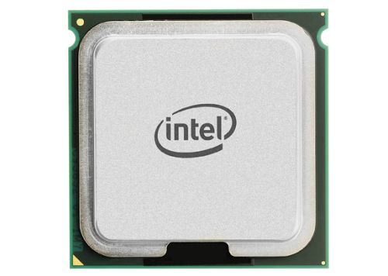
Positional Encodings
Human
757₁₀ = 7·10² + 5·10¹ + 7·10⁰
Computer
1010111₂ = 2⁶ + 2⁴ + 2² + 2¹ + 2⁰
A positional representation scheme is compact:
2^{n} distinct numbers can be represented with n bits.
Operating on this representation is complex.

Slide 3
Multiplication
a x b = c
HA: Half adder, 2 basic gates (AND and XOR)
FA: Full adder, 5 basic gates (AND, OR, and XOR)
In total 30 gates!
Notes:
Conventional multiplier works on binary radix encoded number. As any student in introductory course, it is complicated.

Slide 4

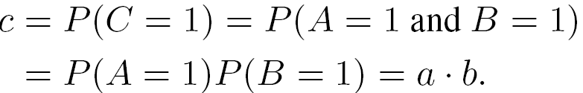
Multiplication
a x b = c
a = 6/8
c = 3/8
1,1,0,1,0,1,1,1
1,1,0,0,0,0,1,0
1,1,0,0,1,0,1,0
6/8 · 4/8 = 3/8
b = 4/8
Assume two input bit streams are independent
Notes:
Indeed, it is no a coincidence. Lower case letters represent probabilities…

Slide 5
Representing a Value by a Sequence of Random Bits
A real value x in [0, 1] is represented by a sequence of random bits, each of which has probability x of being one and probability of 1 − x of being zero.
x = 3/7
0,1,0,1,1,0,0

Slide 6


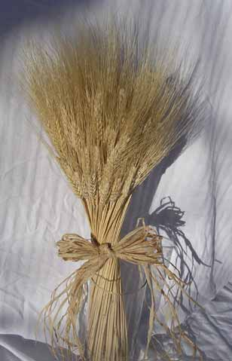
Serial versus Parallel
Stochastic Bit Streams
x = 3/7
0,1,0,1,1,0, 0
Probabilistic Bundles
0
1
0
1
x = 3/7
1
0
0
Notes:
Probabilistic bundle is applicable to nanowire crossbar arrays.

Slide 7




Physical Level
Nanowire Crossbar (Idealized)
A₁
A collection of inverters with shuffled outputs!
A₂
A₃
A₄
Notes:
However, they are random.
In an ideal situation, each horizontal nanowire intersects with the doped region of exactly one of the vertical nanowires.

Slide 8


Nanowire Crossbar Array
A₁
Shuffled AND
A₂
A₃
A₄
B₁
B₂
B₃
B₄
A₄B₃
A₁B₂
A₂B₄
A₃B₁
Notes:
In my preliminary work, I have explored the ways in which the randomness due to self assembly can be used.

Slide 9
Stochastic Logic
Probability values are the input and output signals.
4/8
3/8
combinational
circuit
5/8
4/8
3/8
8/8

Slide 10
Stochastic Logic
Probability values are the input and output signals.
0,1,1,0,1,0,1,0,…
0,1,1,0,1,0,0,0,…
combinational
circuit
1,1,0,1,0,1,1,0…
1,0,1,0,1,0,1,0,…
1,0,0,0,1,1,0,0,…
1,1,1,1,1,1,1,1,…
serial bit streams

Slide 11
Stochastic Logic
Probability values are the input and output signals.
4/8
5/8
3/8
combinational
circuit
4/8
3/8
8/8
parallel bit streams

Slide 12
Randomness
Analog/digital interface with fractional weighting of 1’s.
A/D
D/A
A/D
combinational
circuit
A/D
D/A
A/D
parallel bit streams

Slide 13
Arithmetic Operations
Multiplication
(Scaled) Addition
1
0
=
c
=
P
(
c
P
(
C
)
C
)
=
=
P
+
−
(
S
)
P
(
A
)
[
1
P
(
S
)]
P
(
B
P
(
A
)
P
(
B
)
)
=
=
s
a
+
−
(
1
s
a
b
)
b

Slide 14



Synthesizing Logic that Computes on Stochastic Bit Streams
0,1,1,0,1,0,1,0,…
0,1,1,0,1,0,0,0,…
combinational
logic
1,1,0,1,0,1,1,0,…
1,0,0,0,0,0,1,0,…
1,0,0,0,1,1,0,0,…
1,0,1,1,0,1,1,1,…
Applicable to arbitrary arithmetic functions
Gamma Correction
Function
Notes:
In today’s talk, I will cover two topics. The first topic is …
I proposed a general method to synthesize arbitrary arithmetic functions with this paradigm
An example I used in the talk is the gamma correction function and I’ll return to this example in the talk.

Slide 15
Stochastic Logic
Probability values are the input and output signals.
combinational
circuit
0.7
0.616

Slide 16
Stochastic Logic
Probability values are the input and output signals.
combinational
circuit
t
0
.
8
t
−
0
.
8
t
2
+
0
.
3
Functions of a probability value t.

Slide 17




Mathematical Model
X₁
Independent
Random
Boolean
Variables
combinational
logic
X₂
Random
Boolean
Variable
Y
X_{n}
?
Notes:
Mathematically, I’m considering combinational logic, built with AND, OR, assume that they are prefect, no defect in them.

Slide 18
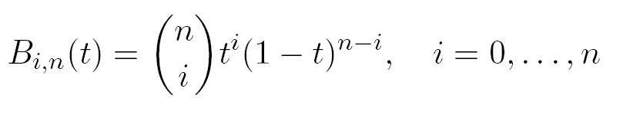
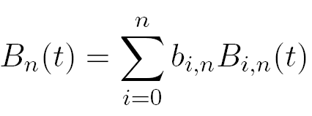

Bernstein Polynomial
Bernstein basis polynomial of degree n
Bernstein polynomial of degree n
is a Bernstein coefficient

Slide 19
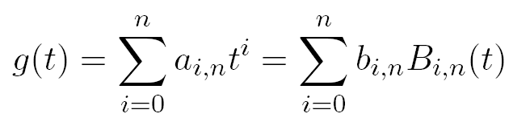
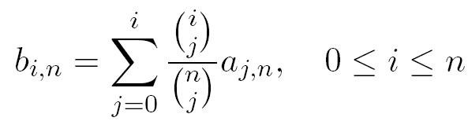
Bernstein Polynomial
Obtain Bernstein coefficients from power-form coefficients:
Given
, we have

Slide 20
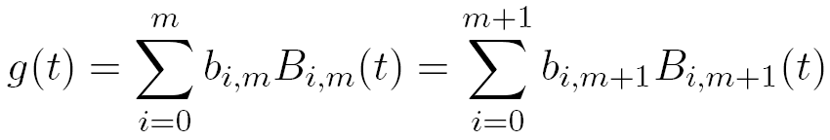
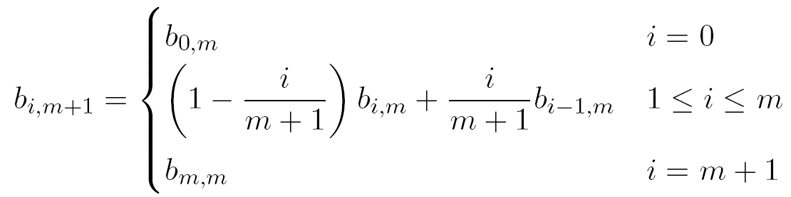
Bernstein Polynomial
Elevate the degree of the Bernstein polynomial:
Given
, we have

Slide 21
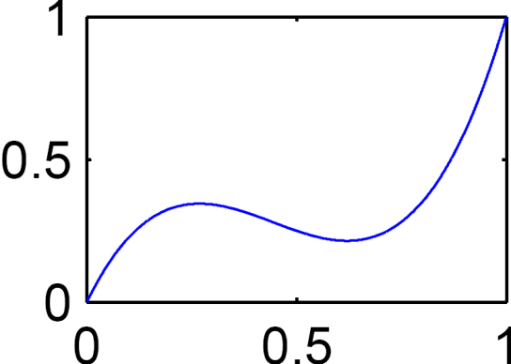

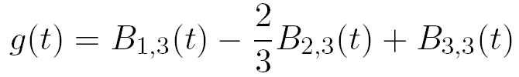
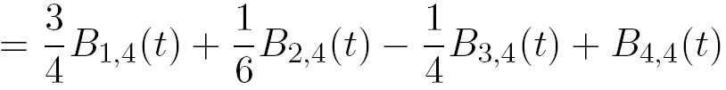
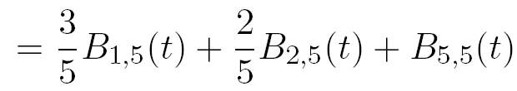
Example: Converting a Polynomial
Power-Form Polynomial
Bernstein Polynomial
coefficients in unit interval

Slide 22



Synthesizing Circuit to Implement Polynomial
Power-Form Polynomial
Bernstein coefficient
Bernstein polynomial of degree 2
Bernstein basis polynomial
Step 1: Convert the polynomial into a Bernstein form.

Slide 23

Synthesizing Circuit to Implement Polynomial
Power-Form Polynomial
coefficients all in unit interval
less than 0
Step 1: Convert the polynomial into a Bernstein form.
Step 2: Elevate the Bernstein polynomial until
all coefficients are in the unit interval.
Step 3: Implement this with “generalized multiplexing.”

Slide 24

Synthesizing Circuit to Implement Polynomial
Power-Form Polynomial
(Evaluate on t = 1/2)
g(1/2) = 1/4
P(X_{i}=1) = t
(= 1/2)
P(Z_{i}=1) = b_{i,3}
(Bernstein
Coefficient)

Slide 25

Generalized Multiplexing
P(X_{i}=1) = t
Independent
P(Z_{i}=1) = b_{i,n}
(0 ≤ b_{i,n} ≤ 1)
Notes:
The logic is traditional combinational logic

Slide 26

Mathematical Contributions
U is the set of polynomials that can be implemented by logical computation on stochastic bit streams.
V is the set of polynomials that can be represented as Bernstein polynomial with coefficients in the unit interval.
W is the set of polynomials g(t) such that
  Either g(t) ≡ 0 or ≡ 1
  Or 0 < g(t) < 1, for all 0 < t < 1, and 0 ≤ g(0), g(1) ≤ 1
Theorem:
“Uniform Approximation and Bernstein Polynomials
with Coefficients in the Unit Interval”
W. Qian, M. Riedel, and I. Rosenberg
European Journal of Combinatorics, 2011
Practical Implication:
A necessary and sufficient condition on whether polynomials can be
implemented by logical computation on stochastic bit streams.
A guarantee that degree elevation will produce Bernstein
polynomials with coefficients in the unit interval.
Notes:
Challenge part is U = W, using a combination of combinatorics, real analysis, polynomial theory to prove. A contribution in polynomial theory.

Slide 27


Non-Polynomial Functions
Find a Bernstein polynomial with coefficients in the unit interval that approximates the non-polynomial g(t).
Find real values to minimize
subject to
Solved by quadratic programming

Slide 28
Example: Gamma Correction Function
Coefficients of Degree-6 Bernstein polynomial approximation:
b_{0,6} = 0.0955, b_{1,6} = 0.7207, b_{2,6} = 0.3476, b_{3,6} = 0.9988,
b_{4,6} = 0.7017, b_{5,6} = 0.9695, b_{6,6} = 0.9939

Slide 29
Fault Tolerance
Stochastic Encoding
  A bit flip does not substantially change the probability:
  1010111001 → 1010011001
Binary Radix Encoding
  A bit flip in the most significant bit causes a huge change in the value:
  (1010)₂ → (0010)₂
0.6
0.5
10
2

Slide 30
Fault Tolerance
Implementing arithmetic function y=x₁x₂s+x₃(1−s) for x₁=4/8, x₂=6/8, x₃=7/8 and s=2/8. 10% noise injection.
Stochastic
Implementation
Small error!
Deterministic
Implementation
Large error!
Notes:
The deterministic design consists of adder and multiplier and the number is represented in binary radix encoding
The reason that the stochastic logic can tolerate fault better than deterministic design is that:
In the stochastic encoding, each bit is of the same significance and a bit flip only cause a small change on the number
For the deterministic design, the number is represented as the binary radix encoding, if the most significant bit gets flipped, a large error occurs.

Slide 31
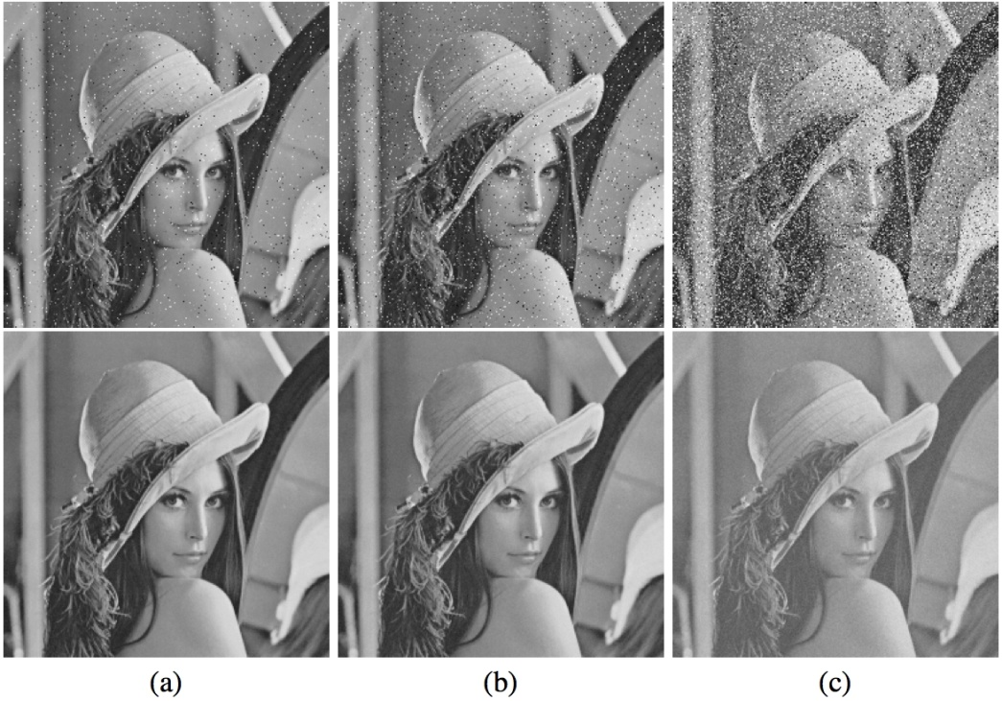
Deterministic v.s. Stochastic Implementation of Gamma correction function with 10% noise injection.
1%
2%
10%
Deterministic implementation:
37% pixels with errors > 25%
Conventional Implementation
Stochastic Implementation: no pixels with errors > 25%!
Stochastic Implementation

Slide 32
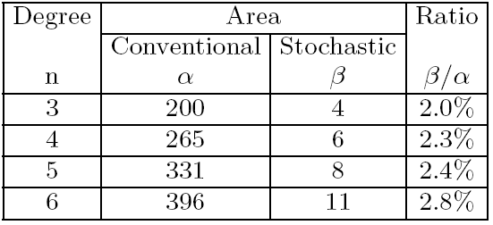
Hardware Cost Comparison
Compare conventional implementation to stochastic implementation of polynomial functions.
Mapped onto FPGA (counting the number of LUTs)
Conventional implementation: 10-bit binary radix
Stochastic implementation: bit stream of length 2¹⁰

Slide 33
Comparison of Fault Tolerance for Mathematical Functions
Sixth-order Maclaurin polynomial approx., 10 bits:
sin(x), cos(x), tan(x), arcsin(x), arctan(x), sinh(x),
cosh(x), tanh(x), arcsinh(x), exp(x), ln(x+1)

Slide 34
Sequential Constructs
What about complex functions such as tanh, exp, and abs?

Slide 35
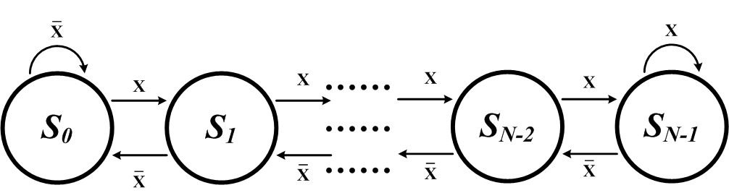
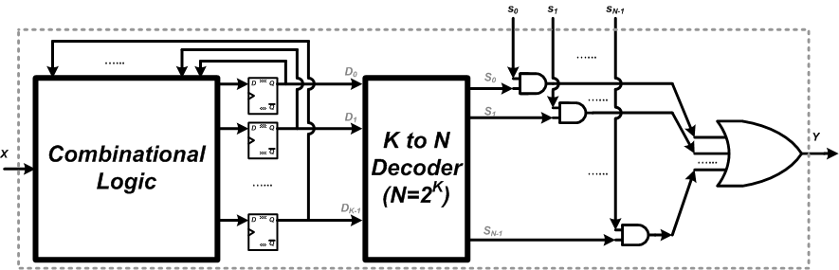
Sequential Constructs

Slide 36
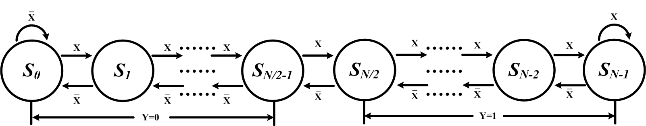
Sequential Constructs

Slide 37
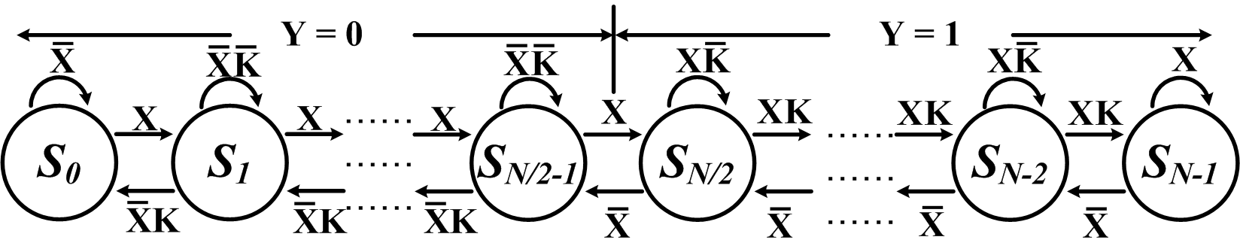
Sequential Constructs

Slide 38
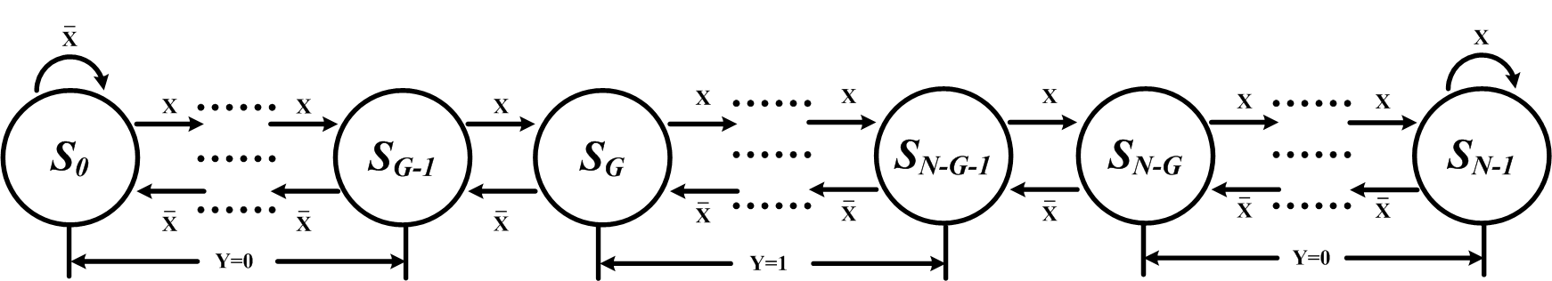
Sequential Constructs

Slide 39
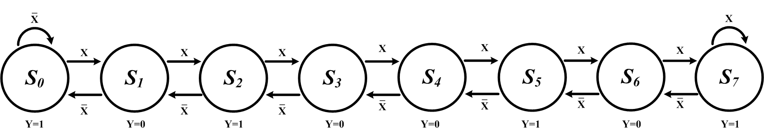
Sequential Constructs

Slide 40
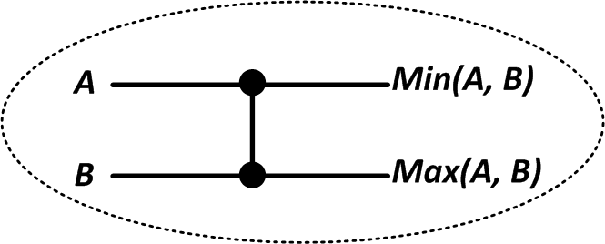
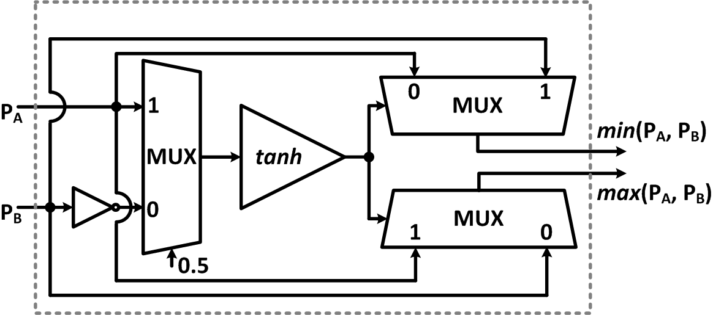
Sensing Applications
Median Filter-Based Image Noise Reduction

Slide 41
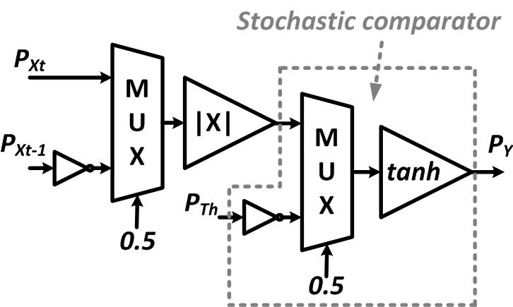
Sensing Applications
Frame Difference-Based Image Segmentation

Slide 42
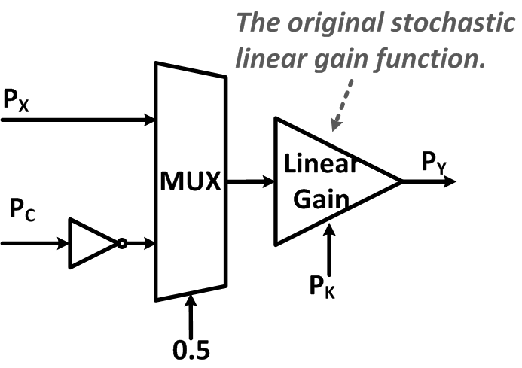
Sensing Applications
Image Contrast Enhancing

Slide 43
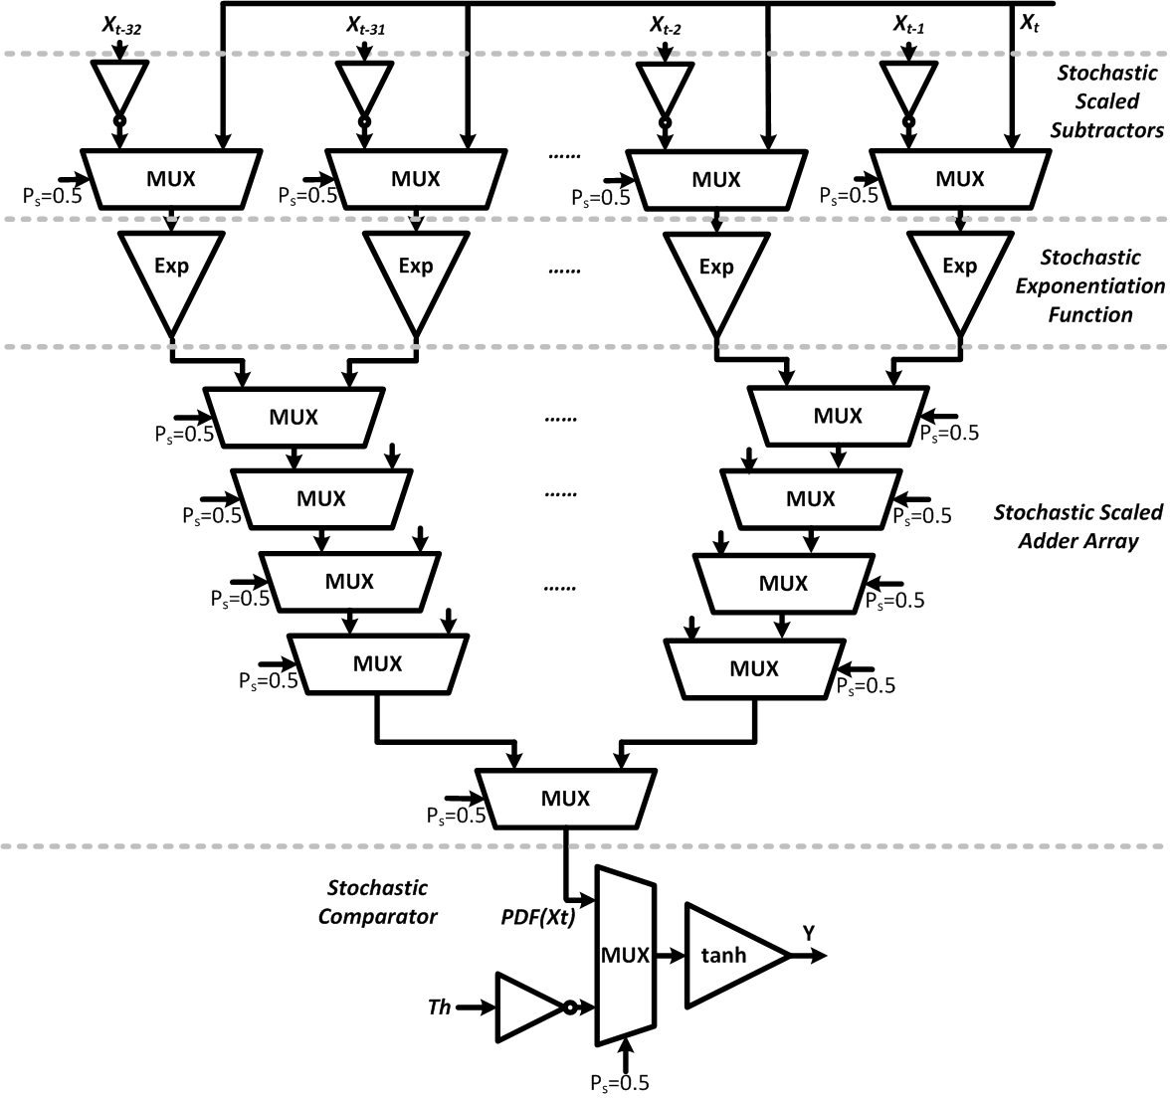
Sensing Applications
Kernel Density Estimation-Based Image Segmentation

Slide 44
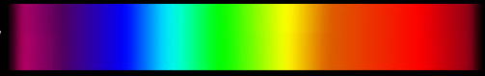
Comparison of Encoding
 | Binary Radix Encoding | Stochastic Encoding
Circuit Area | Large | Small
Error Tolerance | Bad | Good
Delay | Short | Long
(Positional,
Weighted)
(Uniform)
(Positional)
(Uniform,
Long Stream)
(Compact,
Efficient)
(Not compact,
Long Stream)
Binary Radix Encoding
Stochastic Encoding
Spectrum of Encoding

Slide 45
Future Directions
Spectrum of Encoding
Binary Radix Encoding
(Compact, Positional)
?
Stochastic Encoding
(Not compact, Uniform)
Possible encodings in the middle with the
advantages of both?
Notes:
A mixture of encoding.

Slide 46







Acknowledgements
Peng Li
Weikang Qian
David Lillja
Kia Bazargan
Ramesh Harjani

Slide 47
Switch-based Boolean computation
Shannon’s work: A Symbolic Analysis of Relay and Switching Circuits(1938)

Slide 48
1D and 2D switches

Slide 49
A lattice of 2D switches
3 × 3 2D switching network and its lattice form

Slide 50
Boolean functionality and paths
Switches are controlled by Boolean literals.
f_{L} evaluates to 1 iff there exists a top-to-bottom path.
g_{L} evaluates to 1 iff there exists a left-to-right path.

Slide 51
Logic synthesis problem
How can we implement a given target Boolean function f_{T} with a lattice of 2D switches?
Example: f_{T} = x₁x₂x₃+x₁x₄

Slide 52
Logic synthesis problem
Example: f_{T} = x₁x₂x₃+x₁x₄+x₁x₅
9 TOP-TO-BOTTOM PATHS!

Slide 53
Boolean Function Duality
Given:
Obtain:

Slide 54
Our synthesis method
Example: f_{T} = x₁x₂x₃+x₁x₄+x₁x₅
f_{T}^{D} = (x₁+x₂+x₃)(x₁+x₄)(x₁+x₅)
f_{T}^{D} = x₁ + x₂x₄x₅ + x₃x₄x₅
Obtain the dual of f_{T}.
Assign each product of f_{T} to a column.
Assign each product of f_{T} ^{D} to a row.
Compute an intersection set for each site.
Arbitrarily select a literal from an intersection set and assign it to the corresponding site.

Slide 55
Our synthesis method

Slide 56
Our method’s performance
The time complexity:
O(m²n²)
Area of the lattice: m×n
n and m are the number of products of the target function f_{T} and its dual f_{T}^{D}, respectively.

Slide 57
Computing with Defects
Ideally, if the applied voltage is 0, then all the crosspoints are OFF and so there is no connection between any of the plates.
Ideally, If the applied voltage is V_{DD}, then all the crosspoints are ON and so the plates are connected.
With defect in nanowires, not all crosspoints will respond this way.
57

Slide 58
Implementing Boolean functions
signals in: X_{ij}’s
signals out: connectivity top-to-bottom / left-to-right.
58

Slide 59
An example with 16 Boolean inputs
A path exists between top and bottom, f = 1
59

Slide 60
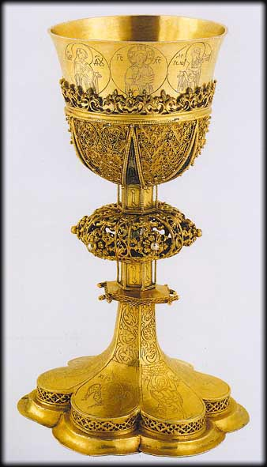
Non-Linearities
From vacuum tubes, to transistors, to carbon nanotubes, the basis of digital computation is a robust non-linearity.
signal out
Holy Grail
signal in

Slide 61
Percolation Theory
Rich mathematical topic that forms the basis of explanations of physical phenomena such as diffusion and phase changes in materials.
Sharp non-linearity in global connectivity as a function of random local connectivity.
Random
Graphs
61
Broadbent & Hammersley (1957); Kesten (1982); and Grimmett (1999).

Slide 62
Percolation Theory
Poisson distribution of points with density λ
Points are connected if their distance is less than 2r
D
Study probability
of connected components
S

Slide 63
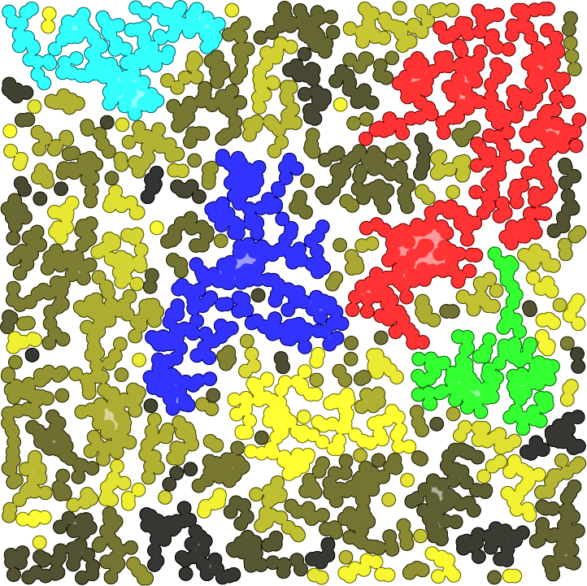
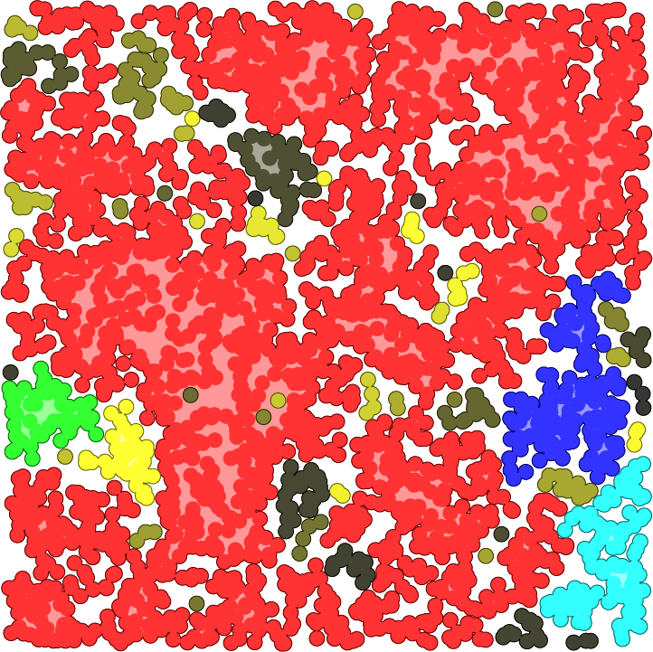


Percolation Theory
There is a phase transition at a critical node density value.
63

Slide 64
Non-Linearity Through Percolation
p₂
p₁
p₂ versus p₁ for 1×1, 2×2, 6×6, 24×24, 120×120, and infinite size lattices.
Each square in the lattice is colored black with independent probability p₁.
p₂ is the probability that a connected path exists between the top and bottom plates.
64

Slide 65
Margins
One-margin: Tolerable p₁ ranges for which we interpret p₂ as logical one.
Zero-margin: Tolerable p₁ ranges for which we interpret p₂ as logical zero.
Margins correlate with the degree of defect tolerance.
65

Slide 66
Margin performance with a 2×2 lattice
X₁₁ | X₂₁ | X₁₂ | X₂₂ | f | Margin | g | Margin
0 | 0 | 0 | 0 | 0 | 40% | 0 | 40%
0 | 0 | 0 | 1 | 0 | 25% | 0 | 25%
0 | 0 | 1 | 1 | 1 | 14% | 0 | 23%
0 | 1 | 0 | 1 | 0 | 23% | 1 | 14%
0 | 1 | 1 | 0 | 0 | 0% | 0 | 0%
0 | 1 | 1 | 1 | 1 | 14% | 1 | 14%
1 | 1 | 1 | 1 | 1 | 25% | 1 | 25%
f =X₁₁X₂₁+X₁₂X₂₂
g =X₁₁X₁₂+X₂₁X₂₂
Different assignments of input variables to the regions of the network affect the margins.
66

Slide 67
One-margins (always good)
ONE-MARGIN
f =1
f =0
Defect probabilities exceeding the one-margin would likely cause an (1→0) error.
67

Slide 68
Good zero-margins
ZERO-MARGIN
f =1
f =0
Defect probabilities exceeding zero-margin would likely cause an (0→1) error.
68

Slide 69
Poor zero-margins
POOR
ZERO-MARGIN
f =1
f =0
Assignments that evaluate to 0 but have diagonally adjacent assignments of blocks of 1's result in poor zero-margins
69

Slide 70
Lattice duality
Note that each side-to-side connected path corresponds to the AND of the inputs; the paths taken together correspond to the OR of these AND terms, so implement a sum-of-products expression.
A necessary and sufficient condition for good error margins is that the Boolean functions corresponding to the top-to-bottom and left-to-right plate connectivities f and g are dual functions.

Slide 71
Lattice duality

Slide 72
Future work
We are investigating our method’s applicability to different technologies.
We are studying the applicability of the math to the problem of testing whether two given monotone Boolean functions are mutually dual.

Slide 73
Thank You!

