Slide 1
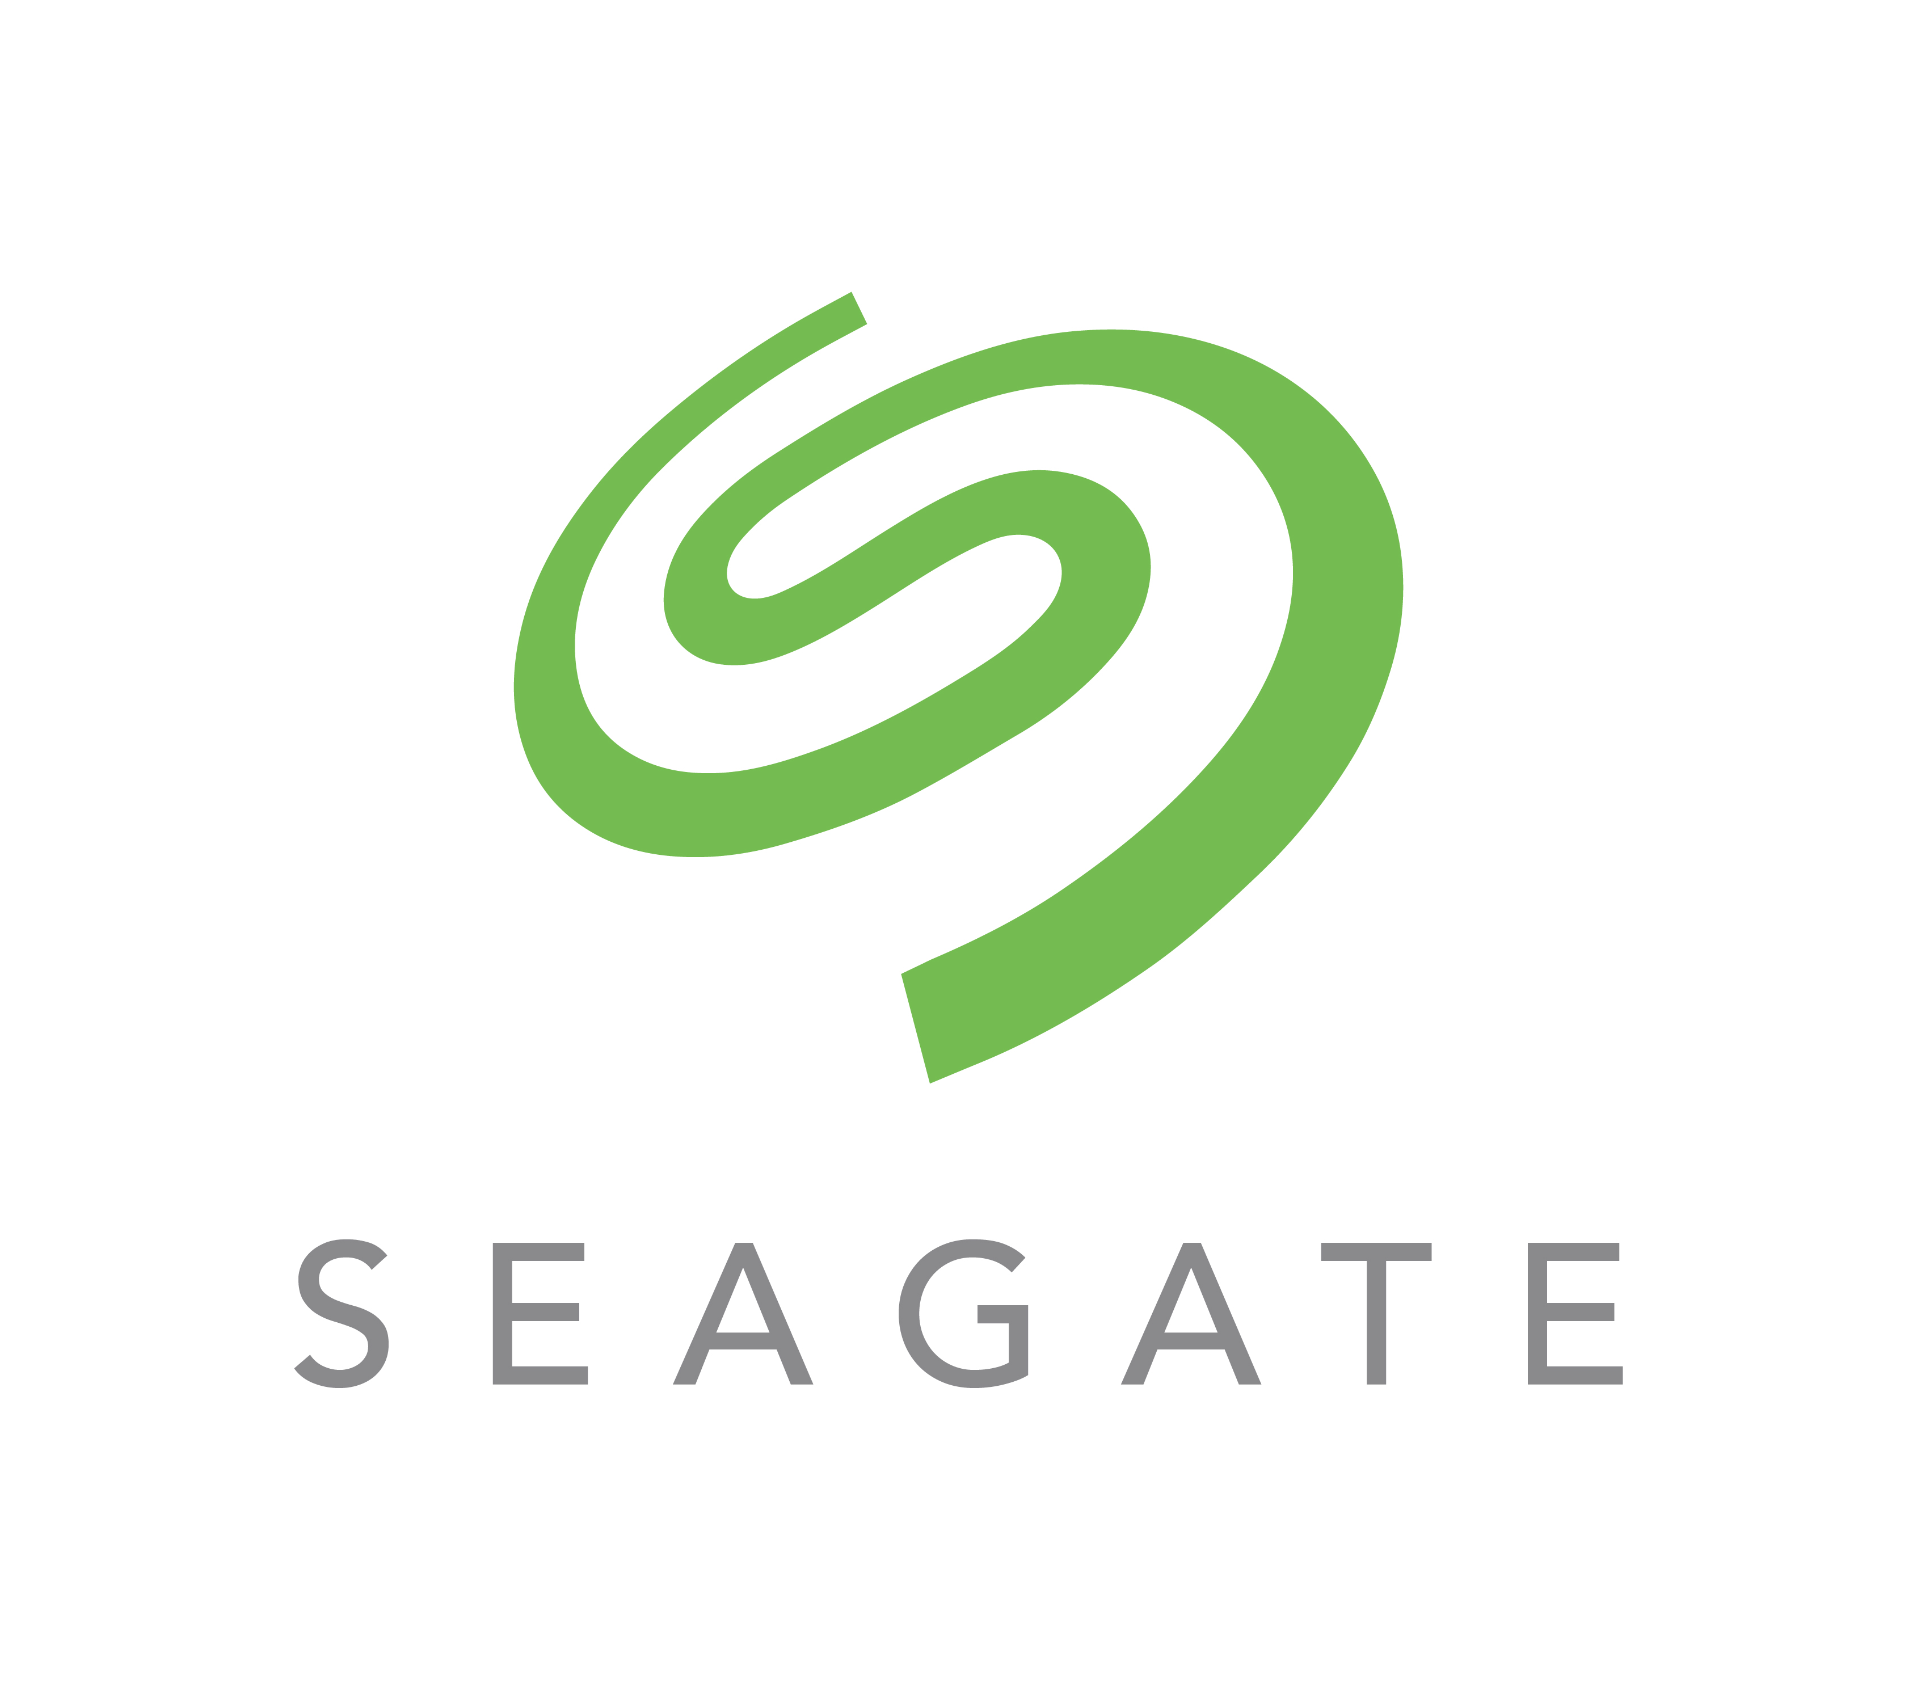
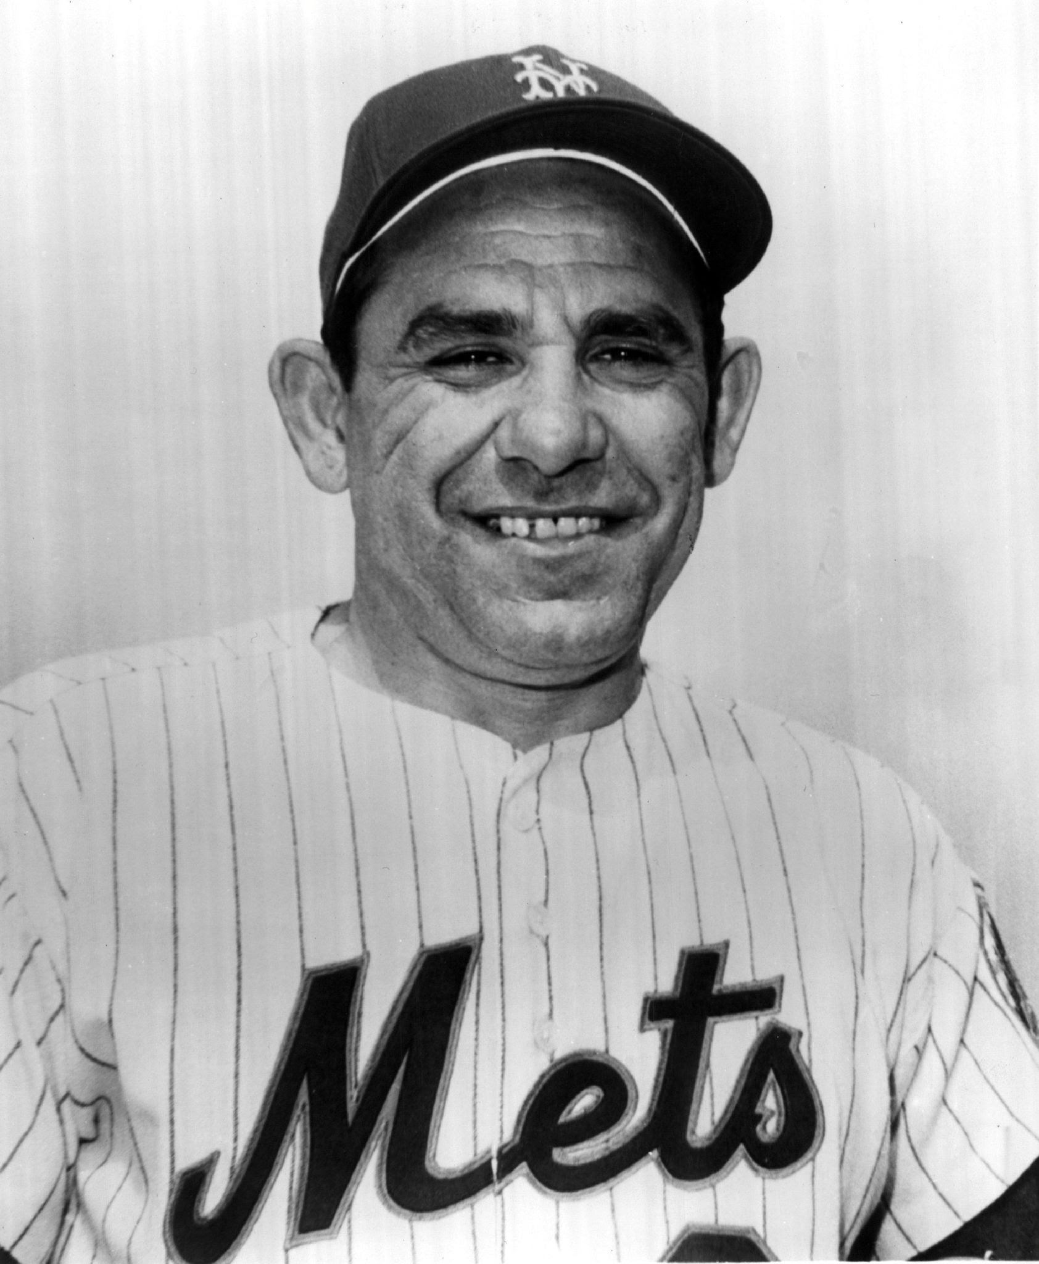
DNA Storage and Computing
Marc Riedel
Associate Professor
Electrical and Computer Engineering
University of Minnesota
In theory there’s no difference between theory and practice…
But in practice there is!
Lawrence Peter "Yogi" Berra
(May 12, 1925 – September 22, 2015)

Slide 2
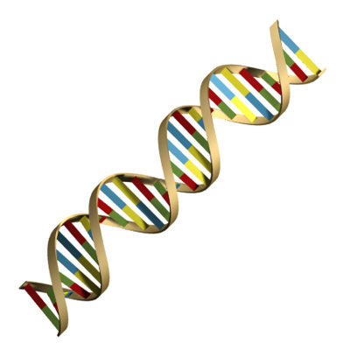
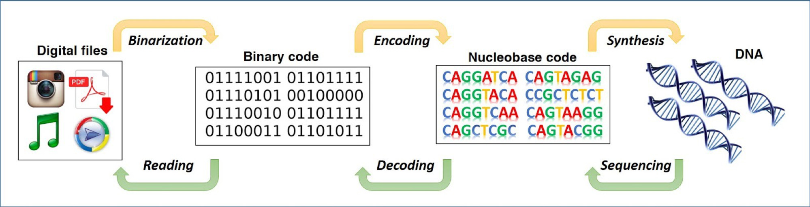
DNA Storage
Store data in 4-valued code of DNA {A: 00, C: 01, T:10, G:11}

Slide 3
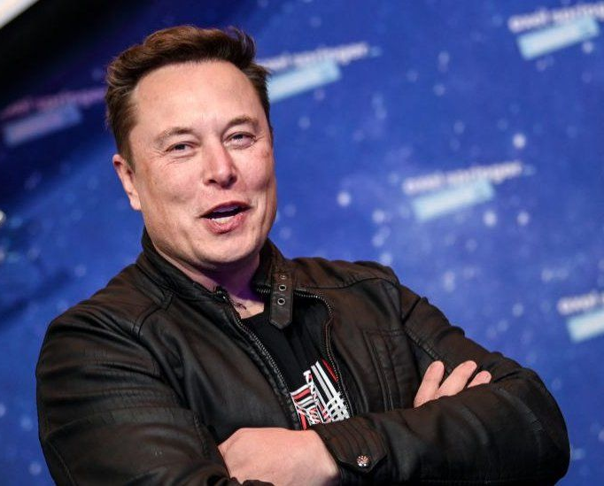
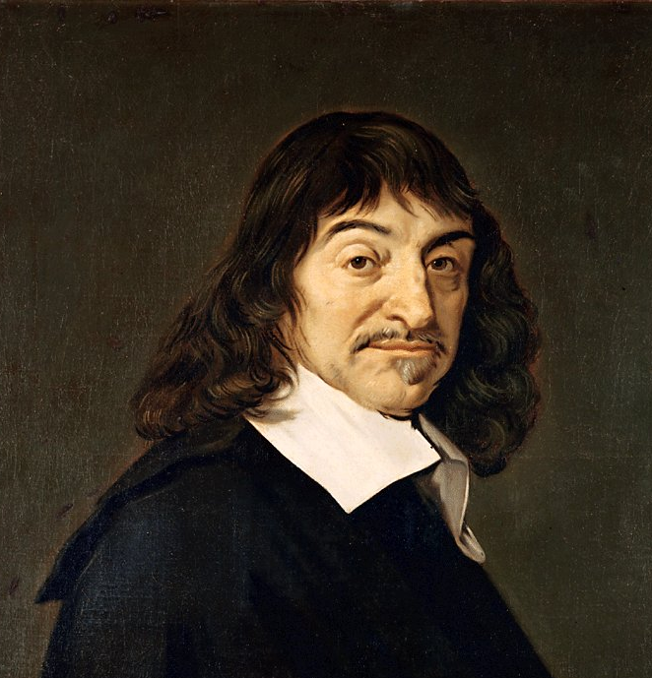
DNA Storage: First-Principles Thinking
“We get through life copying what other people do with slight variations. But when you want to do something new, you have to apply the [first principles] approach.”
Breathless claims:
Storage capacity of 200 petabytes/gram
(200 x 10¹⁵ bytes/gram)
“all the world’s data in a teaspoon”
Energy requirement is on the order of 10⁻¹⁹ joules/bit!
Durability of centuries to millennia!
Elon Musk (1971 – present)
Philosophy of “Cartesian Doubt”:
“Cast aside all [engineering] assumptions until all that you are left with are purely indubitable truths.”
René Descartes (1596 –1650)

Slide 4
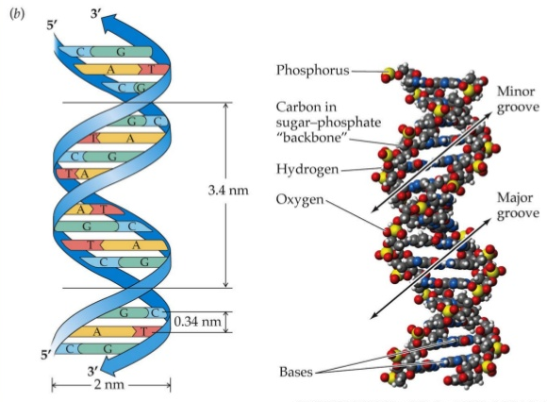
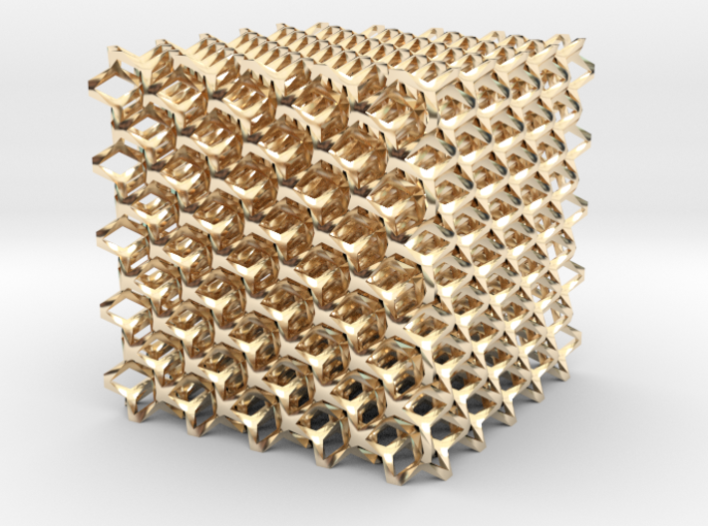
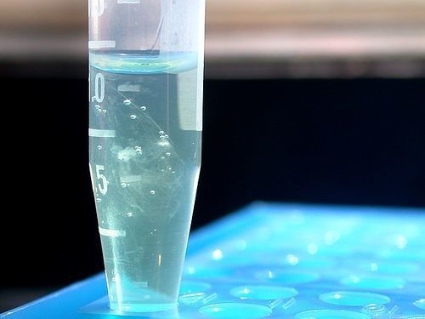
DNA Storage: First-Principles Thinking
X
Assumption: In solutions, multiple copies
Physical Dimensions of DNA
Packed like a lattice?
Single copy?

Slide 5
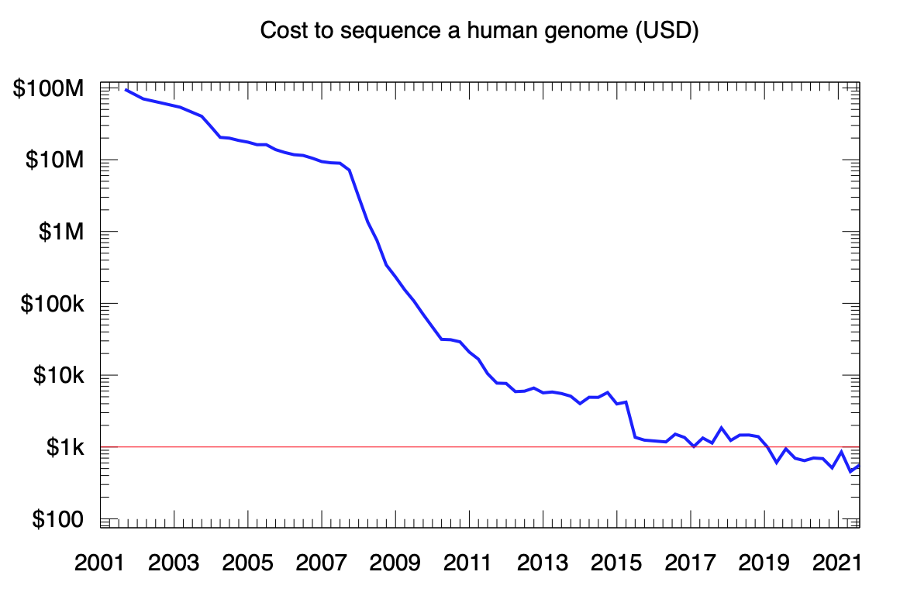
DNA Sequencing (Reading)
DNA technology is not so exotic: huge investment in sequencing techniques.

Slide 6
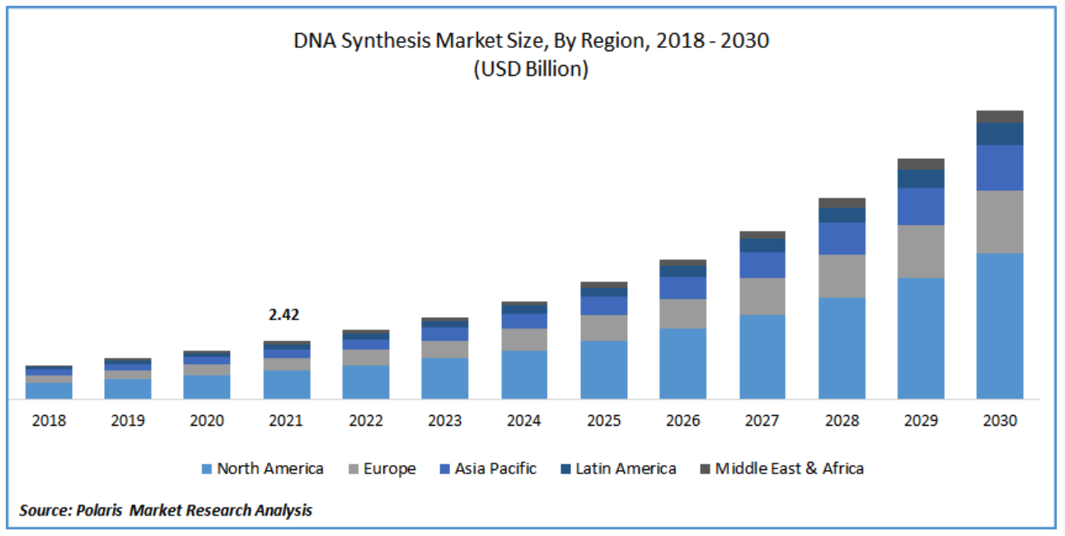
DNA Synthesis (Writing)

Slide 7
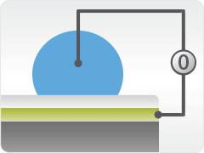
Technology for DNA Storage
Synthesize DNA for storage with Digital Microfluidics
We’re building electronics that manipulates droplets via electric charge.
It operates on many (thousands) of droplets.
It operates on small (nanoliter) droplets.
It moves them fast (milliseconds).

Slide 8
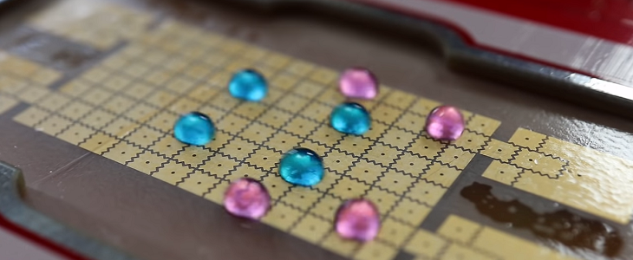
Technology for DNA Storage
Synthesize DNA for storage with Digital Microfluidics
Scale of Digital Microfluidics:
1000 x 1000 = 1 million
grid points.
nanoliter droplet size.
optimized for DNA synthesis (1 Terabyte/hour!)

Slide 9
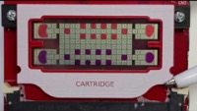
Technology for DNA Storage

Slide 10
Technology for DNA Storage
Operations are relatively slow, but system benefits from massive parallelism
Start with “symbols” each 16 bits long:
Attach “linkers”:
Hybridize strands together. Linkers ensure correct ordering:

Slide 11
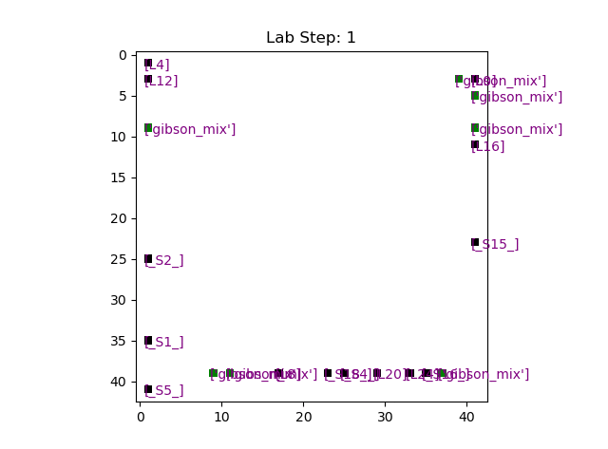
Algorithms for Routing
Analyze and optimize the choice of chemical protocols, the parameters, the layout, and the routing of droplets.
Goal: produce a parametrized design that maximizes throughput, minimizes the complexity, and minimizes the cost.

Slide 12
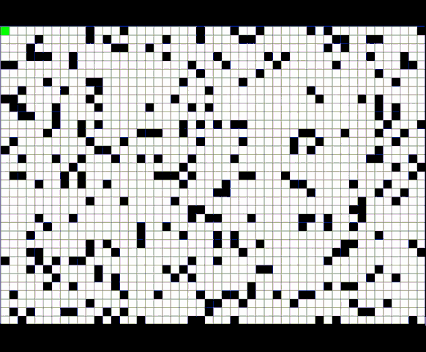
Algorithms for Routing
Seagate is funding UMN to design the droplet routing algorithm.
Goal: software that computes the optimal routing of droplets, parametrized according to the variables, including the chemical protocols.
Progress: Algorithm development complete.
“A Star” Routing Example

Slide 13
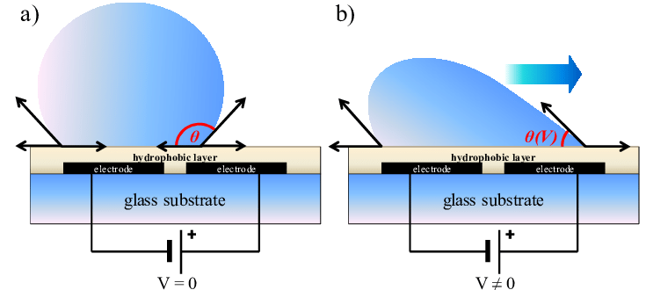
Modeling Hydrodynamics

Slide 14
Modeling Hydrodynamics
Occluded spaces
Droplet
Occupied Gridpoints
Active Gridpoint
Droplets are circles, not points with no real volume.
Droplets grow as they merge.
Droplets occupy multiple spaces.
Any space touched by the droplet’s outer edge can draw the droplet toward itself.
DNA Storage: incredibly fertile topic for research!

Slide 15
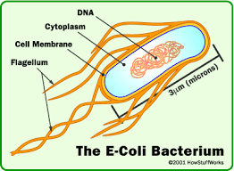
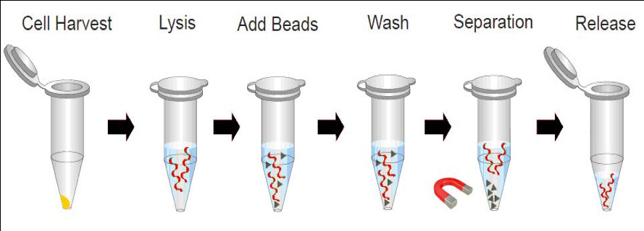
Another Approach: Use Existing DNA
The storage medium: E. coli K-12
Fixed sequence of A, C, T, G’s – so nothing is stored!
Synthesis rate: Mega/Gigabytes per second?
Synthesis cost: $0.01 per megabyte (or less).
15

Slide 16
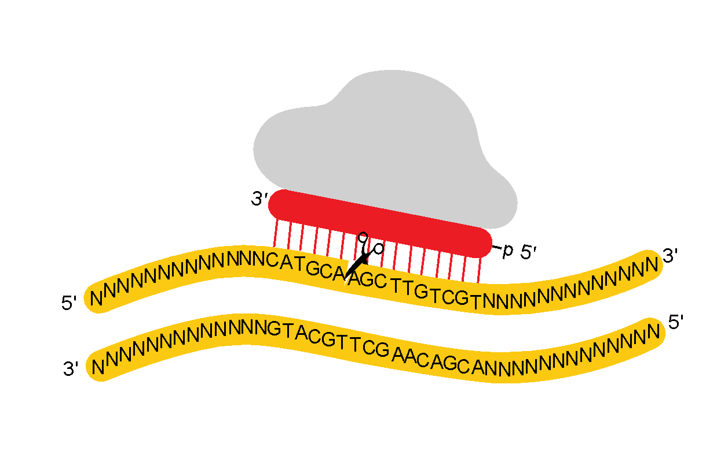
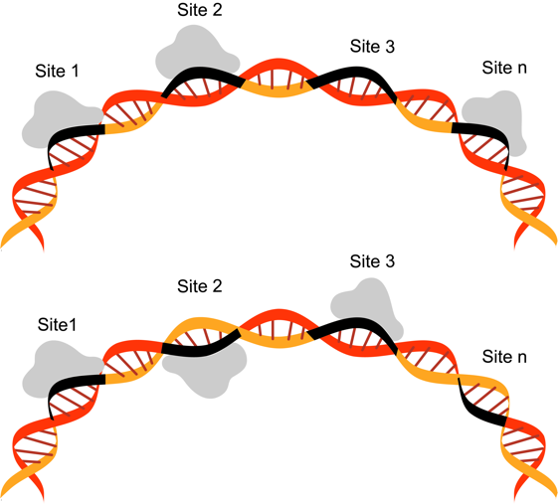
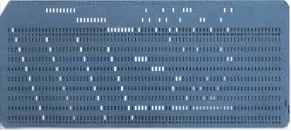
Another Approach: Use Existing DNA
Gene editing with CRISPR/Cas9 or PfAgo
PfAgo
Simplest form: a cut represents a 1; absence of a cut a 0.

Slide 17
Another Approach: Use Existing DNA
Gene editing with CRISPR/Cas9 or PfAgo
PfAgo
Encode data by a pattern of cuts, followed by heating.
1
2
3
4
5
Heat Up
1
2
3
4
5

Slide 18
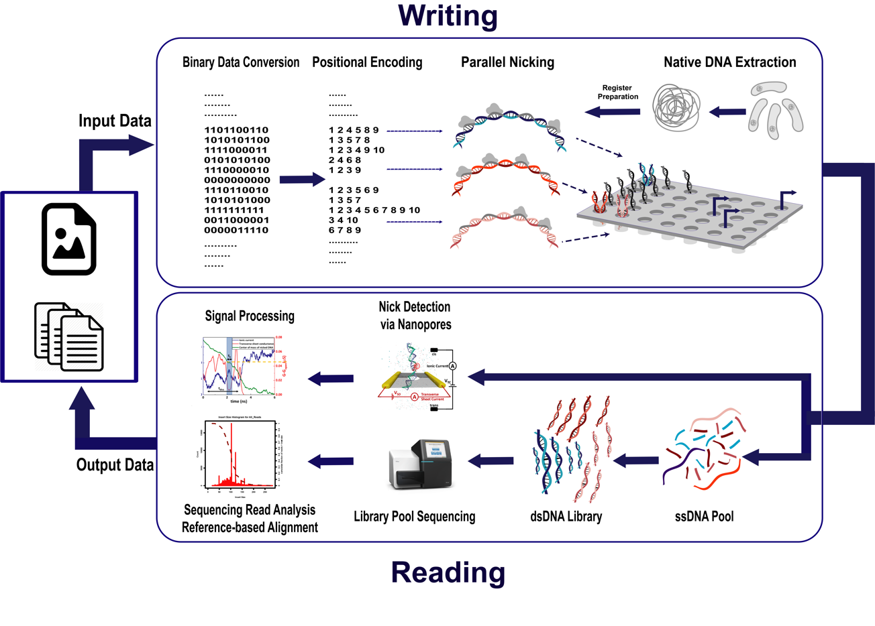

Slide 19
DNA Based In-Memory Computing
Objectives:
Perform “computation in memory” to reduce I/O operations.
Integrate storage with data-intensive algorithms, such as machine learning.
Query: Does Pattern Exist?
200 Petabytes from Physics Experiment
In-Memory Computation: Matrix Multiplies, Sorting, Thresholding
Motivation:
Techniques such as data aggregation and could reduce the I/O requirements.
Effective for applications that generate large volumes of static data.
Perform database-like queries on large volumes of data.
Answer: Yes or No

Slide 20
In-Memory Computing: Operations
Operations: Sorting and Searching
Querying and Reorganizing Data Stored in DNA.
Re-writable Meta-Data
Encode re-writable data via one-sided “gaps” in DNA. Use this mechanism to encoded meta-data, e.g., access counts, watermarks, or error checking.
Re-writing Stored Data
Using restriction enzymes, cut DNA at linker strands, in a targeted way; reorder and reassemble symbols, e.g., after sorting them.

Slide 21
Slides: Credit Georg Seelig

Slide 22
Slides: Credit Georg Seelig

Slide 23
Slides: Credit Georg Seelig

Slide 24
Slides: Credit Georg Seelig

Slide 25
Slides: Credit Georg Seelig

Slide 26
Slides: Credit Georg Seelig

Slide 27
Slides: Credit Georg Seelig

Slide 28
Slides: Credit Georg Seelig

Slide 29
Prerequisite for Computation: Gaps
linker strands
symbol (data) strands
TAAATCGATTCCGGCCATTAAACGTATTCCGGCCGTTAAACGAAATCCGGCC
ATTTAGCTAAGGCCGGTAATTTGCATAAGGCCGGCAATTTGCTTTAGGCC
Existing Scheme
use linker strands with gaps
TAAATCGATTCCGGCCA TTAAACGTATTCCGGCCG TTAAACGAAATCCGGCC
ATTTAGCTAAGGCCGGTACTAATTTGCATAAGGCCGGCACTAATTTGCTTTAGGCC
Proposed Scheme

Slide 30
Query Search using Strand Displacement
Objective: Search for a subsequence data stored in DNA.
Create complementary query strand.
It binds to toeholds.
If it matches, it will displace par of top strand.
Detect top strand fragments (via fluorenscence).
If strands are found, answer is “yes” to query.

Slide 31
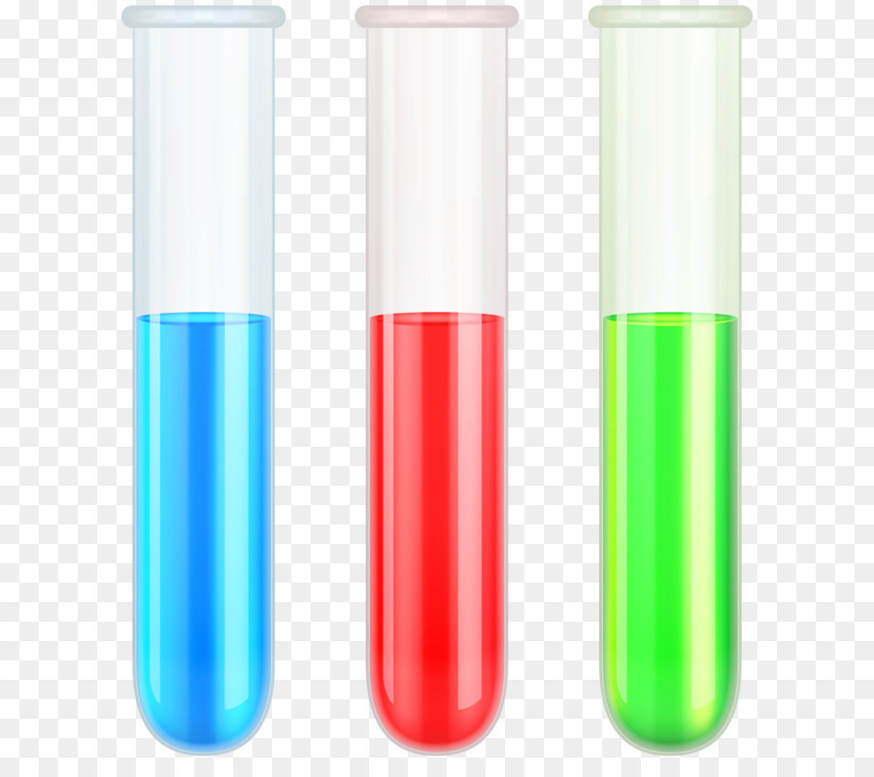
Parallelism with Nick-Based Displacement
Two levels of parallelism:
Bit-level Parallelism: instructions applied to all bits in array at once.
Data-level Parallelism: same instructions can be applied to different data in different arrays at once.
0
1
1
1
1
1
0
1
0
1
1
1
0
0
1
1
0
1
1
1
0
1
0
0
0
1
0
1
0
0
0
0
0
0
0
1
1
0
0
0
0
1
0
0
1
0
0
1

Slide 32
Parallelism with Nick-Based Displacement
Two levels of parallelism:
Bit-level Parallelism: instructions applied to all bits in array at once.
Data-level Parallelism: same instructions can be applied to different data in different arrays at once.
0
0
0
0
0
0
0
0
0
0
0
1
0
0
1
1
0
1
0
0
1
1
0
0
1
1
0
1
0
0
0
1
0
0
1
1
1
0
1
1
0
1
1
1
1
1
1
1

Slide 33
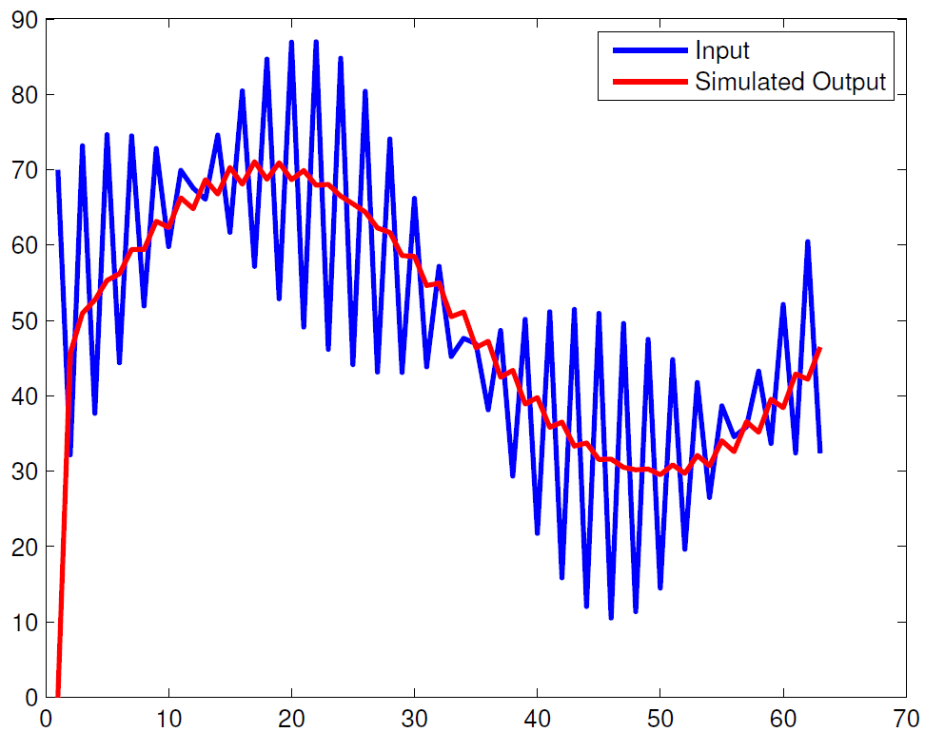
Example: Moving Average Filter
input: X
output: Y
Concentration (nM)
Time (Hours)

Slide 34
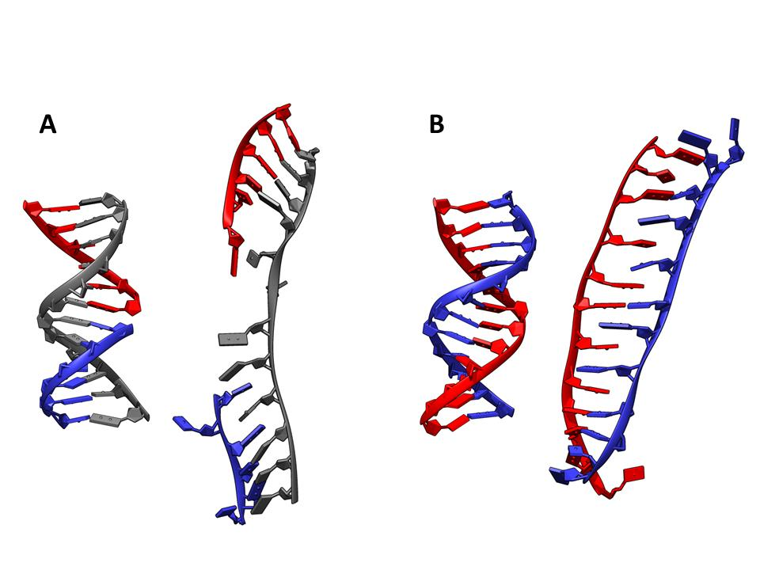
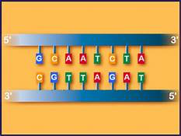
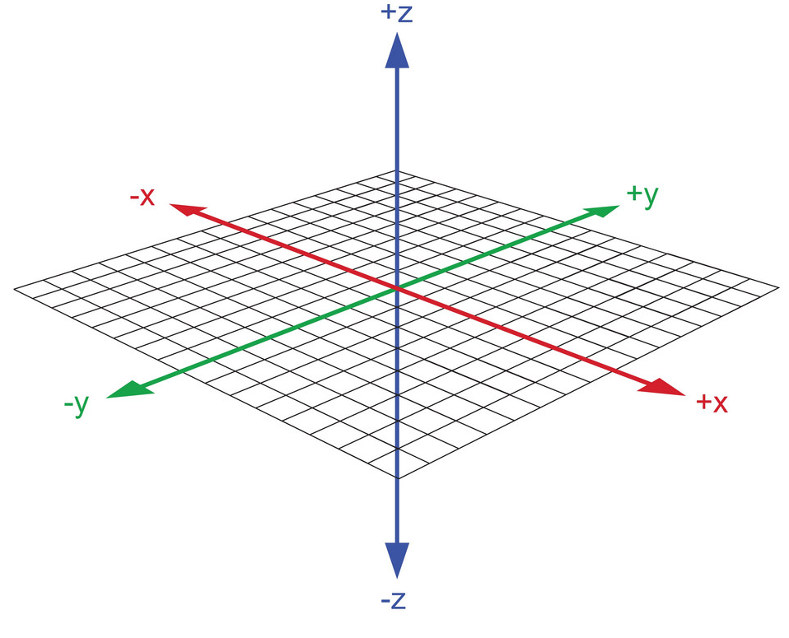
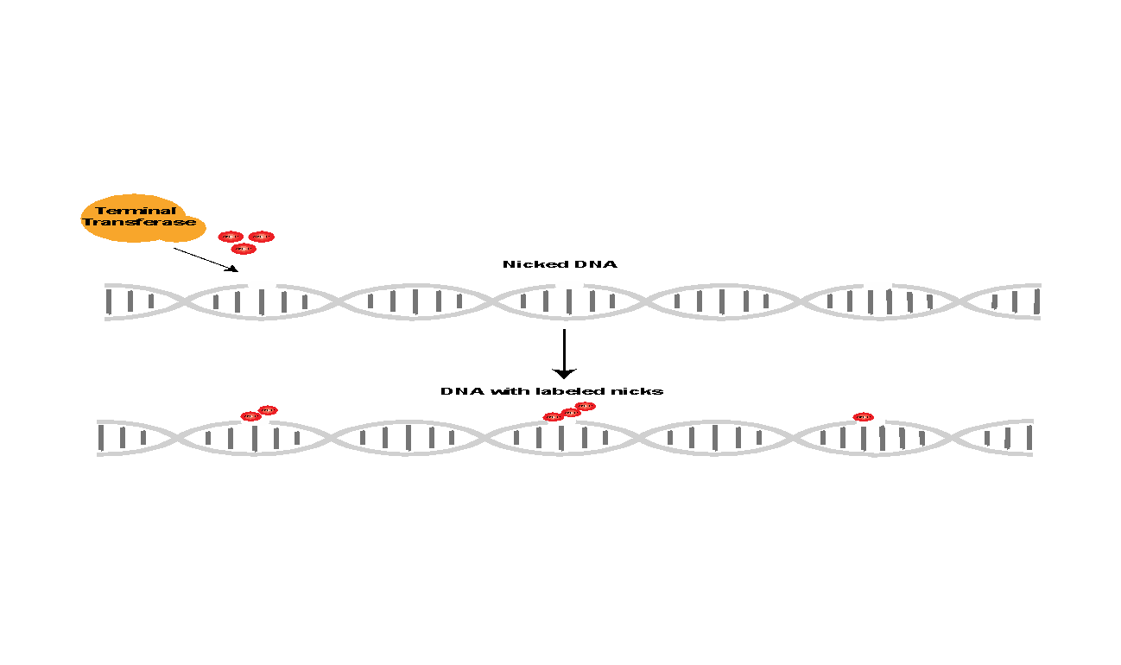
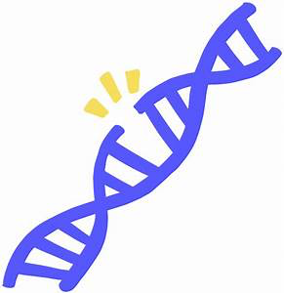
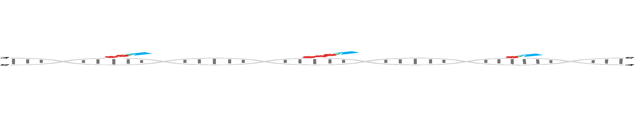
Multidimensional Data Storage with DNA
Sequence dimension
“Random dimension”
Topological dimension
Concentration dimension
34

Slide 35
“Predictions are Hard…
Especially about the Future!”
Lawrence Peter "Yogi" Berra
(May 12, 1925 – September 22, 2015)

Slide 36
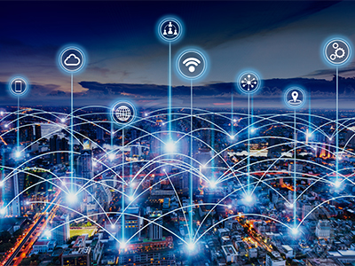
(2012) “Soon IoT Will be Everywhere!”

Slide 37
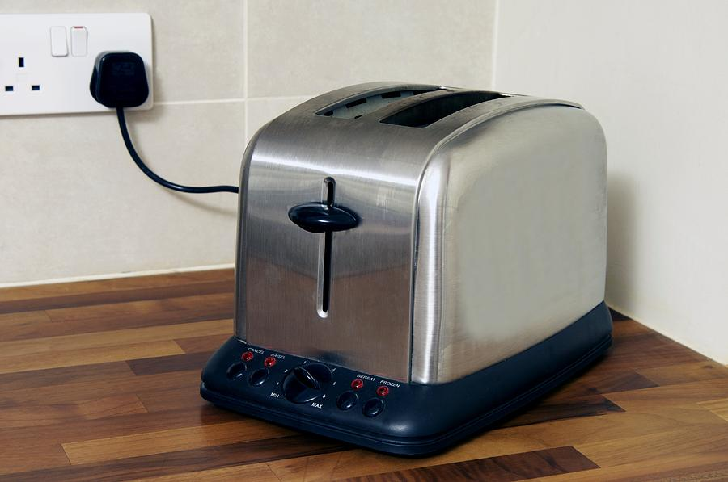
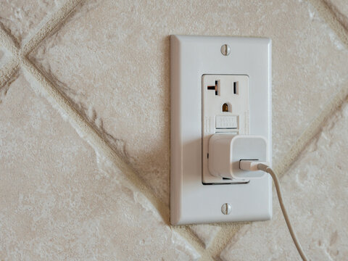
(2023) “Where is IoT?”
Near AC power.
In electric appliances.

Slide 38
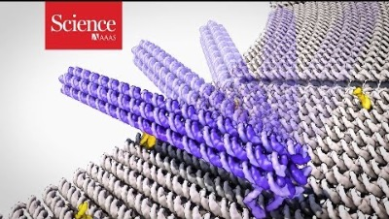
(2032) “IoT in more places?”

